Slide 1
CENG 2400, Embedded system design
Chapter 1: Introduction
KH Wong

Slide 2
Course Details
Lecturer: Kin Hong Wong (khwong@cse)
Website: http://www.cse.cuhk.edu.hk/~khwong
Useful links
http://www.arm.com/support/resources/arm-books/
Thanks to Drs Philip Leong, Y.S. Moon, O. Mencer, N. Dulay, P. Cheung for some of the slides used in this course

Slide 3
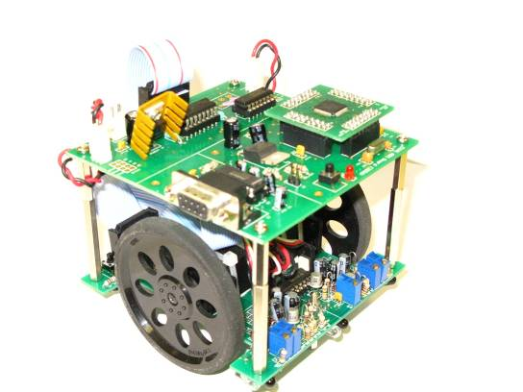
What to learn?
Build microcontroller/embedded systems
Program it using assembly / C languages
Techniques to interface sensors and control devices

Slide 4
References
References:
Furber, “ARM System-on-Chip Architecture”, 2000
(refer to course website for online references)
Honesty in Academic work
English Video : http://www.cuhk.edu.hk/clear/tnl/Plagiarism_English.html
Cantonese Video : http://www.cuhk.edu.hk/clear/tnl/Plagiarism_Cantonese.html
Staff Student expectations

Slide 5
CPUs and microcontrollers
A Central Processing Unit CPU is the soul of a computer; it is the element in a computer for calculation and program execution. However, it does not function independently, it also needs memory and input/output modules to make up the computer.
A microcontroller is a name given to a self-contained computer system that can operate on its own. It has a CPU inside as well memory and input/output modules which are packed inside a chip. So it is also named as a single-chip-computer. It is used for dedicated systems such as washing machines, mobile phones or mobile pads.

Slide 6
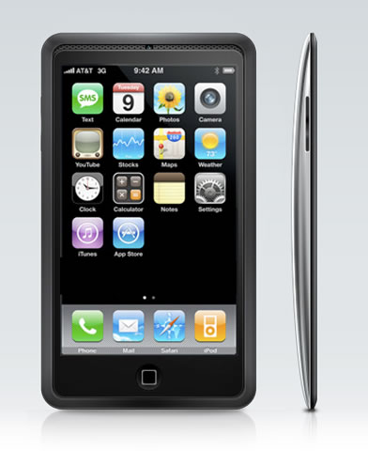
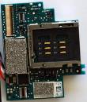
Examples of microcontrollers
It is a computer on a chip.
Examples:
Intel 8031, PIC (8-bit)
Arm (32-bit, 64-bit assembly or C)
“ARM-based CPU market share in 2010: over 95% in smartphone market; 10% in mobile computers; 35% in digital TVs and set-top boxes” ; from http://en.wikipedia.org/wiki/ARM_Holdings
Arm in the I-phone
http://content.zdnet.com/2346-9595_22-93276-27.html
http://www.mobilebond.com/wp-content/uploads/2010/12/11119422-apple-iphone-4.jpg

Slide 7
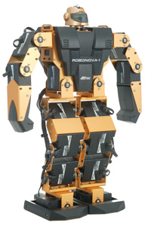
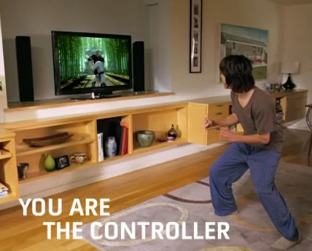
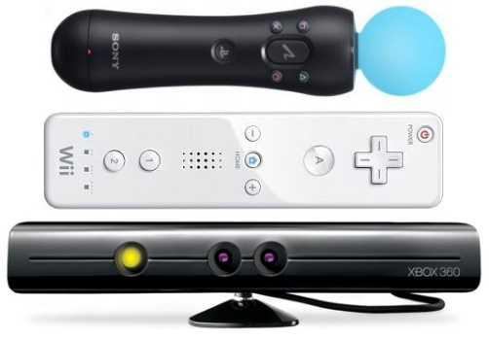
What are they used for?
Offices (Word processing, data bases)
Engineering (robot)
Game consoles (Kinect, PSP)
http://www.trossenrobotics.com/
http://www.draftexcellence.com/wp-content/uploads/2010/11/xbox-360-kinect-games.jpg
http://cdn.gamerant.com/wp-content/uploads/kinect-move-interest-low.jpg

Slide 8
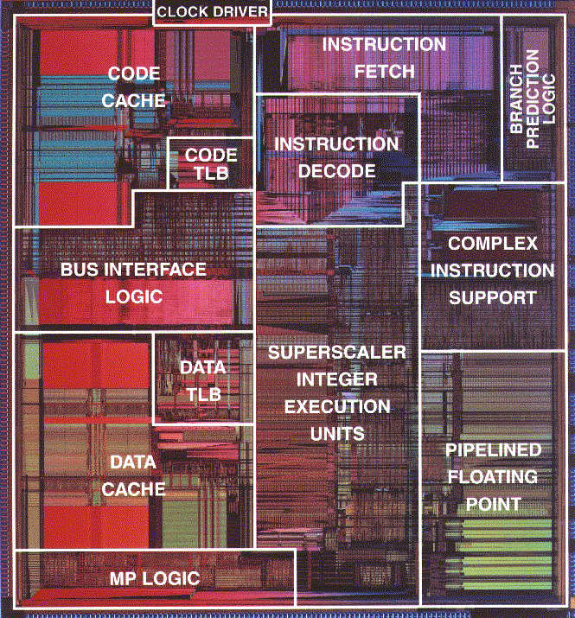
CPU on a Chip -> Microprocessor
Microcontroller (MCU) is a computer on a chip

Slide 9
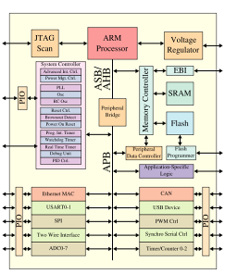
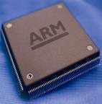
System on a chip (SoC) &
A new trend
http://en.wikipedia.org/wiki/System-on-a-chip . E.g. mobile phone SoC chip (ARM + wireless modules)
If the system is too large for an SoC chip, use system in package (SiP):multi- chip system .
+ wireless
module
http://www.mobilecomputermag.co.uk/images/stories/news/2008/01/arm-processor.jpg
+

Slide 10
Other CPUs
Intel Pentium
Motorola/IBM PowerPC
AMD K7
ARM StrongArm
Compaq (DIGITAL) Alpha
Zilog Z80
Motorola 68000
6502
MIPS
Interesting history about microprocessors: http://www.cpushack.com/
It seems only the Intel Pentium and ARM families are still actively being used nowadays.

Slide 11
ARM microprocessor cores
Main article: List of ARM microprocessor cores
A summary of the numerous vendors who implement ARM cores
Architecture | Family
ARMv1 | ARM1
ARMv2 | ARM2, ARM3
ARMv3 | ARM6, ARM7
ARMv4 | StrongARM, ARM7TDMI, ARM9TDMI
ARMv5 | ARM7EJ, ARM9E, ARM10E, XScale
ARMv6 | ARM11, ARM Cortex-M
ARMv7 | ARM Cortex-A, ARM Cortex-M, ARM Cortex-R :
 | ARM Cortex-A53 , 64-bit
Our CENG2400
Course
For Samsung galaxy 7
http://en.wikipedia.org/wiki/ARM_architecture

Slide 12

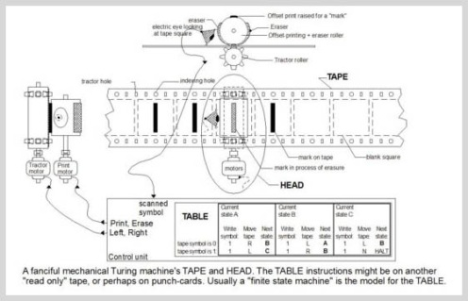
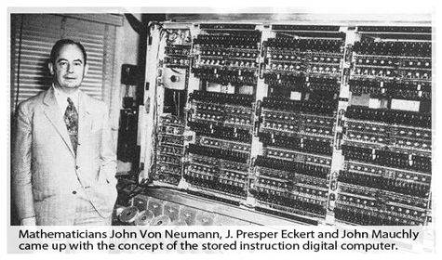
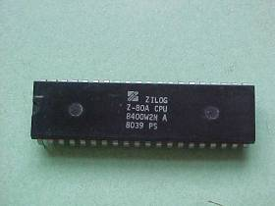
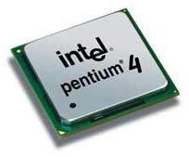
History
Turing and Turing
machine
http://www.bletchleypark.org.uk/edu/lectures/turing.rhtm
http://www.krcadinac.com/pictures/600px-Turing_machine_1.JPG
8-bit
64-bit
32-bit

Slide 13
computer hardware history
Turing developed the first digital computer around 1942.
Von Neumann architecture, 1946
Intel 8088 microprocessor (8/16-bit) , 1979
Motorola 68000 (16-bit) 1979.
Pentium 4 (32-bit), 2000
Pentium Dual core 2009
ARM 64/32 bit, 2011

Slide 14



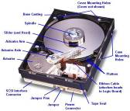

Hardware
http://images.google.com/images?gbv=2&hl=en&q=memory+ram&btnG=Search+Images
http://keppanet.netfirms.com/keppanet/harddisk/hdinside/hddfull2.jpg
http://www.nintendowiiremotes.com/img/Wii_Remote_Funtions_2x2.jpg
http://www.hardwarelogic.com/articles/reviews/misc/LogitechWave/KeyboardMouse.jpg
Hardware
Processor
Architecture
Memory
Hierarchy
User
Interfaces
-

Slide 15
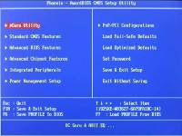
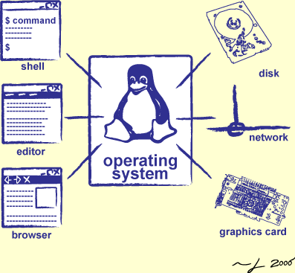


Software
http://www.swc.scipy.org/lec/img/shell01/operating_system.png
http://www.easeus.com/resource/images/bios.jpg
http://www.hardware-one.com/reviews/i845/Iwill_P4S/BIOS.jpg
http://img218.imageshack.us/img218/3165/foldergc5.gif
Software
Firmware
Operating
System/ Device driver
Software
Development
- Bios setup
- Assembly lang.
- Task scheduling
Device drivers
- Prog. languages

Slide 16
Software hierarchy
Different layers
we will be learning the software that can boot up the system and the making of the device drivers for controlling hardware devices.
Bios
Basic Input/output system:
Bootup
Operating system
(Vista, Linux)
Device driver:
Mouse, printer etc

Slide 17


To be covered
Lectures
Basic Knowledge
Machine Instructions & Assembly Language
ARM7 instruction set
Input/Output (I/O)
Memory
Tutorials/Lab
Assembly language and C programming
Microprocessor interfacing: build robot
Use Philips LPC2000 family (ARM7)
http://en.wikipedia.org/wiki/NXP_LPC

Slide 18
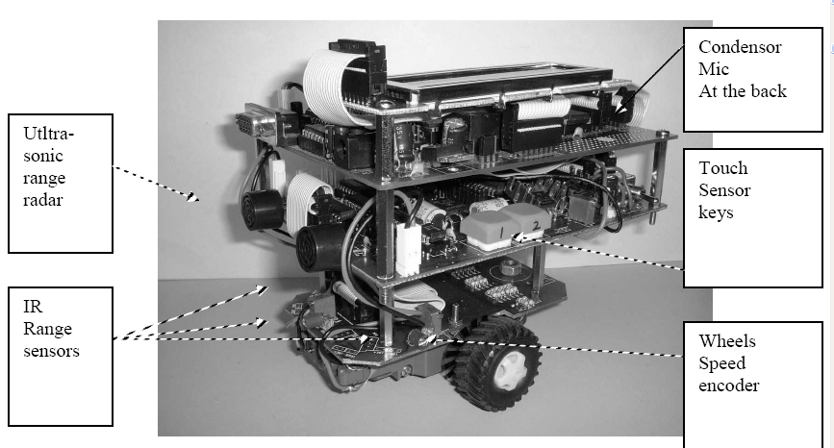
Lab: build a robot with sensors

Slide 19
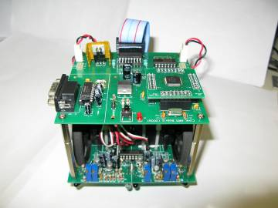
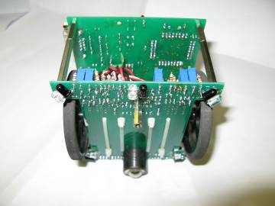
Our CE2400 ARM robot

Slide 20
Some demos
Self balancing robot
https://www.youtube.com/watch?v=D5UCJojCPdo
https://www.youtube.com/watch?v=f9WsAZbPKkc&feature=youtu.be
Flute robot
https://www.youtube.com/watch?v=NJ7wv2z8Wgk
Human following robot
https://www.youtube.com/watch?gl=HK&hl=zh-HK&v=75tkIz90oK4
Quad-rotor
https://www.youtube.com/watch?v=OGYUKVg35MM&feature=youtu.be
Speed encoder
https://www.youtube.com/watch?v=7qf_ypIGn_0&feature=youtu.be
Star Wars' BB-8 Droid
https://www.youtube.com/watch?v=A_K10fX9DSY

Slide 21
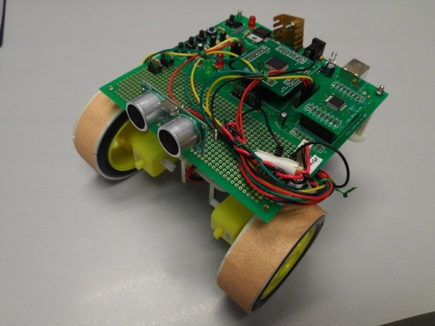
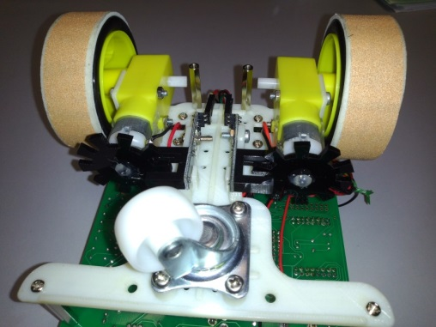
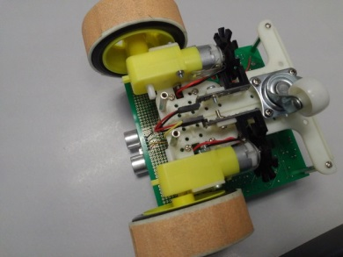
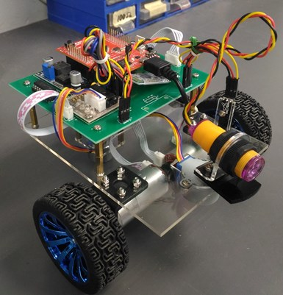
Our robots
Ultra-sound-radar
Electronic compass
2016 version
2017 version
Speed encoder
Previous CENG2400 robot video demo

Slide 22
Student D:_______________, Name: __________________, Date:____________________ Ex1.1: Hexadecimal numbers
Decimal | Hexadecimal | Binary
0 | 0 | 0000
1 | 1 | 0001
2 | 2 | 0010
3 | 3
4 | 4
5 | 5
6 | 6
7 | 7
8 | 8
9 | 9
10 | A
11 | B
12 | C
13 | D
14 | E
15 | F | 1111
A hexadecimal digital number has a value from 0 to F
In binary representation it has 4 binary bits
Different ways to write hexadecimal numbers:
E.g. many different forms, all have the same meaning
0x7=7h=7H=7hex
0xa=0xA=Ah=a(hex)=10(decimal) etc.
.
Fill in the
blanks

Slide 23
Exercise 1.2 Memory structure
Example
Memory is like a tall building.
In this example, memory size is 2¹⁶=64K locations (floors).
A 16-bit number can be represented by 4 hexadecimal numbers
Each location (a floor) has an address. E.g. address 0000H, address 0ACDH etc.
In each address location (a floor) has a data (the content) 8-bit (2 hexadecimal numbers)
16-bit Address (64K locations) (H=Hex) | 8-bit content (data)
FFFF H | 35H
FFFE H | 23H
… | …
0ACD H | 24H
… | …
0001 H | 32H
0000 H | 2BH
For a given memory device, can you change (i) the address, (ii) the data?
If the address is 8-bit, how many address locations are there in the memory?
If the address is 32-bit, how many address locations are there in the memory?

Slide 24
Overview of an embedded system
Internal
Input/output
Interface
Internal
ram

Slide 25
How does a system start? An example
Power up
Get content (2BH) of starting address (0000H), this is the machine code, e.g. 2BH here
Run the machine code 2BH
E.g. machine 2BH asks the machine to jump to location 0ACDH and run the code there
What happens after power up?
16-bit Address (64K locations) (H=Hex) | 8-bit content (data)
FFFF H | 35H
FFFE H | 23H
… | …
0ACD H | 24H
… | …
0001 H | 32H
0000 H | 2BH

Slide 26
Exercises 1.3 on Memory structure. Fill in the blanks
24-bit Address (H=Hex). Based on the descriptions on the left, fill in banks | 8-bit content (data)
Loc5:?______H | 35H
Loc4:?______H | 23H
… | …
Loc3:?______H | 24H
… | …
Loc2:?______H | 32H
Loc1:?______H | 2BH
In this example, memory size is 2²⁴=__?K locations (floors).
A 24-bit number can be represented by ___? hexadecimal numbers
Loc1 is the base address
Loc2 is the address location just above the base address
Loc3 is 100H above the base address
Loc4 is the address just below the top address
Loc5 is the top address
For a given memory device, can you change the size of the (i) address, (ii) data?
If the address is 20-bit, how many address locations are there in the memory?
If the address is 64-bit, how many address locations are there in the memory?

Slide 27
Exercise 1.4
Exercise : This to make sure you know how to convert hexadecimal to binary code or vice versa:
(a) Write 7FFEH in binary and
(b) Write 35H in binary
(b) Write 01111010B in hex

Slide 28
Review questions (Exercise 1.5)
List and discuss the Hardware and Software modules in a computer system.
How memory is used in a computer system?

Slide 29
Review questions (Exercise 1.6)
List and discuss different types of memory in a computer system. And how do they used for?
List the differences between address and data.
List the boot-up procedures of a computer?

Slide 30
Exercise 1.8 Self-study exercises for number systems
Convert binary 10110111 into decimal and hex-decimal number
Convert decimal 138 into hexadecimal number
Convert 89ABH into binary number
How many address locations are available if the address is 64-bit?
What is the meaning of BCD (Binary-coded decimal) in encoding numbers?

Slide 31
Review questions (Exercise 1.7)
List the boot-up procedures of a computer?

Slide 32
END

Slide 33
Appendix A:The processor (e.g. ARM7) with 32 bit address bits
32bit Address (2³²=4G locations) (H=Hex) | 32-bit content (data) example
FFFFFFFF H | 00000035H
FFFFFFFE H | 00000023H
… | …
00000ACD H | 00000024H
… | …
00000001 H | 00000032H
00000000 H | 0000002BH
4G
locations

