Slide 1
Chapter 2: Memory
CEG2400 – Embedded System Design

Slide 2
Overview
1) Memory in a computer system
2) Different memory types
3) Concepts of address, data and program running

Slide 3
1) Memory in a computer system
A computer has
CPU (Central Processing Unit)
Memory
Input/output and peripheral devices
Glue logic circuits

Slide 4
Inside an ARM microcontroller
Inside ARM
Clock
Oscillator
CPU: Central Processing unit
memory
Peripheral devices: USB, serial, parallel bus etc.
Peripheral devices: serial, parallel interfaces; real-time-clock etc.

Slide 5

A computer with a micro-controller unit
External interfacing
MCU:
CPU: Central Process-ing unit
memory
Peripheral IO interface devices: such as USB bus, parallel bus, RS232 etc.
actuators :
such as
Motors,
Heaters,
speakers
Keyboard
mouse
Peripheral devices: USB ports, Graphic card, real-time-clock etc.
Sensors:
Light,
Temperature
Etc.

Slide 6
CPU, MCU are microprocessors
CPU: Central Processing unit
Requires memory and input output system to become a computer (e.g. Pentium is a CPU).
MCU: micro-controller unit (or single chip computer)
Contains memory, input output systems, can work independently (e.g. Arm7, 8051 are MCUs).
Used in embedded systems such as washing machines, mobile phones/pads.

Slide 7
2) Different memory types
Random access memory (RAM)
Read only memory (ROM)

Slide 8
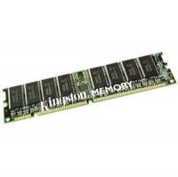
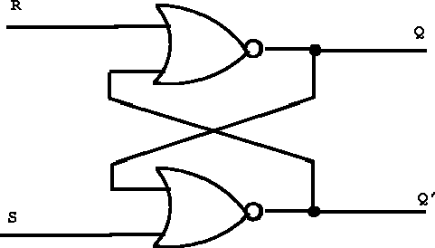
Different kinds of Random access Memory (RAM)
Random access memory (RAM): data will disappear after power down.
Static RAM (SRAM): each bit is a flip-flop, fast but expensive.
Dynamic RAM (DRAM): each bit is a small capacitor, and is needed to be recharged regularly; slower but cheap. To be used as primary memory in a computer.
http://thalia.spec.gmu.edu/~pparis/classes/notes_101/img111.gif
http://www.prontotech.com/product/kingston-8gb-dram-memory-module-p_1732875237

Slide 9
Different kinds of Read Only Memory (ROM)
Read only memory (ROM)
UV-EPROM
EEPROM
FLASH ROM

Slide 10
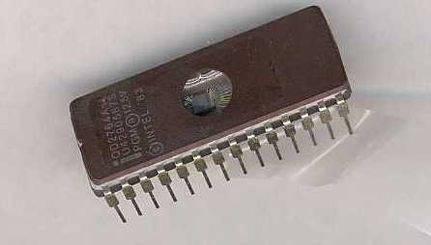
UV-EPROM
Data can be erased by putting it under strong Ultra-Violet (UV) light for 1/2 hours.

Slide 11

Flash memory
Block based read/write, e.g. one block can be 512 or 1024 bytes, etc.
Read/write is slower than DRAM, so it cannot be used as the primary memory of a computer.
www.sandisk.com

Slide 12
Exercise 0
What are these memory types: (DRAM, SRAM, ROM) in a computer? Explain why.
Central Processing Unit
CPU
Registers: memory type = _______?
Primary memory for storing program and data: memory type=______?
Registers 暫存器
Firmware (basic input/output system or BIOS )
memory type=___________?

Slide 13
3) Concepts of address, data and program running
Address-- tells you where to find the storage.
Data-- is the content stored in the address.

Slide 14
Exercise 1: Binary number and hex number
Binary | Decimal | Hex
0000 | 0 | 0
0001 | 1 | 1
0010 | 2 | 2
0011 | 3 | 3
0100 | 4 | 4
0101 | 5 | 5
0110 | 6 | 6
0111 | 7 | 7
1000 | 8 | 8
1001 | 9 | 9
1010 | 10 | A
1011 | 11 | B
1100 | 12 | C
1101 | 13 | D
1110 | 14 | E
1111 | 15 | F
A binary number can be 1 or 0
4 binary numbers make up a hexadecimal (hex) number (0->F)
Exercise1
Convert 3AH into binary .
Convert a binary number 100001011100B into hex and decimal.

Slide 15
Memory is like a tall building Address cannot change; content (data) can change
Address content, e.g. A 64K-byte RAM
16-bit Address (H=Hex) | 8-bit content (data)
FFFF H | 35H
FFFE H | 23H
… | …
0ACD H | 24H
… | …
0001 H | 32H
0000 H | 2BH

Slide 16
Memory for storing program and data (An 8-bit machine)
16-bit Address (H=Hex) | 8-bit content (program /data)
FFFF H | 35H
FFFE H | 23H
… | …
0ACD H | 24H (do something)
… | …
0001 H | 32H
0000 H | 2BH (goto 0ACDH)
Basic concept Memory is like a tall building Address cannot change; content (data) can change
After power up , goto 0000H , run
instructions in data

Slide 17
Two important modules in a 8-bit CPU (because data is 8-bit, e.g. Intel 8051): Program counter and registers
A Central Processing Unit (CPU) has
PC : program counter to keep track the program
R0, R1, etc, for general purpose usage
Memory
(data is 8-bit)
An 8-bit CPU (Intel 8051)
Registers (8 bits):
PC: program counter
R0 (general purpose)
R1 (general purpose)

Slide 18
Program counter (PC)
After CPU reset (power up) , PC=0000H, so the first instruction is always at 0000H.
After each instruction is run,
PC increments once, or
PC is set by the instruction it just executed. E.g. goto to a new address.

Slide 19
How does a computer work? What is the content of Program counter (PC) after each step?
16-bit Address (H=Hex) | 8-bit content (data)
FFFF H | 35
FFFE H | 23
… | …
0ACD H | 24 (goto FFFF)
… | …
0001 H | 32
0000 H | 2B (goto0ACD)
Program is in memory
Inside an 8-bit Central Process.Unit
Program counter (16 bits):
PC xxxxH
step3
General purpose registers ( 8bits): | R0=xxH R1=yyH …etc.
step2
After power up
PC=0000H
step1

Slide 20
Exercise2 : A simple program , fill in ‘?’
After power up, the first instruction is in 0000H, PC=0000H
Address (H=Hex) | 8-bit content (data)=instructions (Hex) | PC before Running the instruction (hex) | PC after Running the instruction (hex)
0BC8 | Instruction k = 25: (meaning R0<=R0+1) | ? | ?
… | …
0AC1 | …
0AC0 | Instruction j = 24 (meaning :goto 0BC8) | ? | ?
… | …
0001 | Instruction 2=xx
0000 | Instruction1=2B (meaning : goto 0AC0H) | ? | ?

Slide 21
Exercise 3: Program to find 2+3=?, Fill in ‘?’
PC=program counter; R0=general purpose register 0
Address (H=Hex) | 8-bit content (data) The machine code is make up for this example | Before the instruction is run |  | After the instruction is run
 |  | PC | R0 | PC | R0
0F00 |  | What is the Content after the program is run?
0AD3 | 3F=stop | 0AD3 | ? | ? | ?
0AD2 | C0=Save R0 into address location 0F00 and clear R0 | 0AD2 | ? | ? | ?
0AD1 | 2E=Add 2 to Reg .R0 | 0AD1 | ? | ? | ?
0AD0 | 15=Move 3 into Reg. R0 | 0AD0 | ? | ? | ?
… | …
0001 | …
0000 | 2B=Goto address 0AD0 | 0000 | 0 (after reset) | ? | ?

Slide 22
Memory in a 32-bit machine
Moving from 8-bit to 32-bit:
The ARM processor example

Slide 23
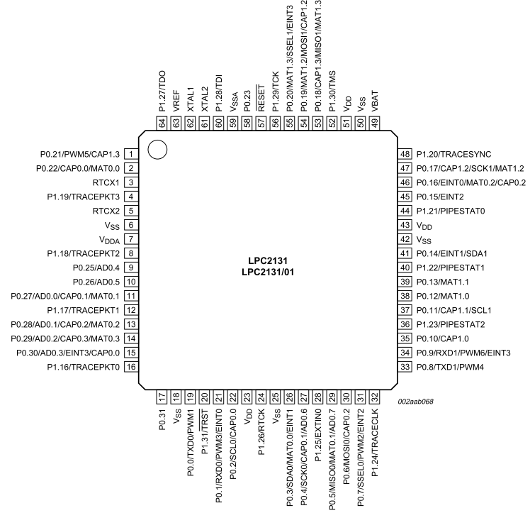
ARM chip

Slide 24
Memory
We will learn how to use memory in the ARM microcontroller.
We know that the data size is 8-bit for all memory systems (in PC or mainframe alike).
So each location has 8 bits.
We can deal with them in n-bit groups called words (typically 8, 16, 32 or 64 bits)

Slide 25
Address in a 32-bit machine (e.g. ARM7)
The address is 32-bit.
So the address range is from 0000 0000(hex) to FFFF FFFF(hex) totally 2^32=4G locations.
The data is also 32-bit.
So each data is xxxx xxxx (hex)
But the memory is arranged as 8-bit for one location. So how to do it?
Solution: Arm7 uses 4 address locations to access a 32-bit (4 bytes) data.

Slide 26
Rules/Examples
Address
data
Each location must be 8-bit.
For a 32-bit word, you are referring to 4 locations.
0000 0003H
0000 0002H
0000 0001H
0000 0000H
A 16-bit word
(0000 0002->
0000 0003H)
32-bit
Word
(0000 000 ->
0000 0003H)
One byte
At
0000 0001H
One byte
at
0000 0000H

Slide 27
Organization of memory in ARM
n
Address
0xFFFF FFFC
0xFFFF FFF8
=32bits (4 bytes)
last 32-bit word
•
•
•
i
th word
0x0000 0010
0x0000 000C
0x0000 0008
0x0000 0004
0x0000 0000
•
•
•
second 32-bit word
1Byte 1 Byte 1 Byte 1 Byte
First 32-bit word
Address is
incremented by 4
n
=32bits (4 bytes)

Slide 28
Compare 8-bit (e.g.8051) and 32-bit (Arm7) machines
examples
An 8-bit machine program (e.g. 8051)
Address (H=Hex) | Each data is 8-bit (1 byte)
0F00 | 13
: | :
0AD2 | 21
0AD1 | 22
0AD0 | 89
… | …
0001 | 4A
0000 | 2D
A 32-bit machine program (e.g. ARM)
Address (H=Hex) | Each data is 32-bit (4 bytes)
1E00 0ADC | 1123 556D
1E00 0AD8 | 0012 2A3F
1E00 0AD4 | 2134 5678
1E00 0AD0 | 3A11 89A1
:
0000 0008 | 1122 3344
0000 0004 | 9870 A178
0000 0000 | 0000 002A
Address is incremented by 4
Address is incremented by 1

Slide 29
Integers and Characters
32 bits
•
•
•
b
31
b
30
b
1
b
0
Sign bit:
b
31
=
0
for positive numbers
b
31
=
1
for negative numbers
(a) A signed integer
8 bits
8 bits
8 bits
8 bits
ASCII
ASCII
ASCII
ASCII
character
character
character
character
(b) Four characters

Slide 30
Exercise 4: More/less significant bytes
Consider the hexadecimal (base 16) 32-bit number 12342A3F(H)=1x16⁷+2x16⁶+3x16⁵+4x16⁴+2x16³+10x16²+3x16¹+15x16⁰
This number has four bytes 12, 34, 2A, 3F (4x8=32-bits)
Bytes/bits with higher weighting are “more significant” e.g. the byte 34 is more significant than 2A
Bytes/bits with lower weighting are “less significant”
We also use terms “most significant byte/bit” and “least significant byte/bit”
Excise4: For 12342A3F(H)
Write the binary number.
What is the most significant byte/bit?
What is the least significant byte/bit?

Slide 31
Big/little endian
Two different ways: byte addresses are assigned across words
more significant bytes first (big endian)
less significant bytes first (little endian)
ARM allows both big and little endian addresses
LPC2100 allows big and small endians

Slide 32
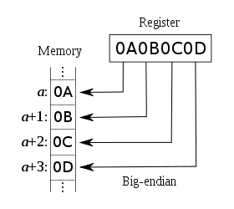
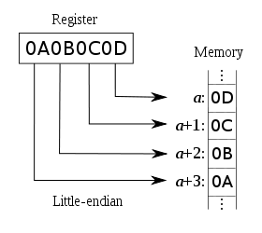
Examples From http://en.wikipedia.org/wiki/Endianness
more significant bytes first (big endian)
less significant bytes first (little endian)
Most significant
least significant

Slide 33
Exercise 5, fill in ‘?’
Save 0x2EAB057E in memory starting from 0x4000
Address (data in each address location must be 8-bit) | Little endian data | Big endian data
0x4000 | 7E | ?
0x4001 | ? | ?
0x4002 | ? | ?
0x4003 | ? | 7E

Slide 34
Word alignment
32-bit words align naturally at addresses 0, 4, 8 …
These are aligned addresses
Unaligned accesses are either not allowed or slower e.g. read a 32-bit word from address 1 (why?)
E.g 0x2EAB057E from 0x4000 is aligned
E.g 0x2EAB057E from 0x4001 is misaligned
In ARM
A word = 32-bits, half-word = 16 bits
Words aligned on 4-byte boundaries i.e. word addresses must be multiples of 4
Half words aligned on even byte boundaries

Slide 35
Example of word alignment
32-bit words align naturally at addresses 0, 4, 8..etc
That means a (address)= 0,4,8,… or
a(address)=4N where N=integer
a is a multiple of N

Slide 36
End

Slide 37
References/ reading exercise
http://www.howstuffworks.com/computer-memory.htm
ARM versus Intel: a successful stratagem for RISC or grist for CISC's tricks?
http://www.edn.com/design/integrated-circuit-design/4369610/ARM-versus-Intel-a-successful-stratagem-for-RISC-or-grist-for-CISC-s-tricks-

