Slide 1
Chapter 5: ARM Assembly Directives and the use of stack
CEG2400 - Microcomputer Systems

Slide 2
Introduction
Learn how to read a program
Directives
Subroutine calls and stack
Reference: [1] ARM system-on-chip architecture by Steven Furben 2nd ed. Pearson

Slide 3
Overview
Compilation and assembly processing
Directives
Subroutines
  i) subroutines
  ii) Stack
  iii) Nested Subroutines

Slide 4
Function of assembly language
assembly
language
e.g.
Mov, ldr
Object code
1001011001101..
0101011110001..
No specific
location
High-level
language
C or C++ etc
e.g.
If, then else
Compiler
Assembler
linker
Executable
Machine code
1001011001101..
0101011110001..
With specific location

Slide 5
Software Tools
Compiler : C or C++ → assembly language
  E.g. For (i=0;i<10;i++) → MOV r3, #10….
Assembler: Assembly language →object code
  MOV r3, #10 → 12457891, 234567231,..(with no specific memory locations)
Linker turns object code into an executable file. (T1.exe) (With specific memory locations)

Slide 6
2) Directives
In a program you see either
  Assemble instructions for the processor to run, e.g. LDR, MOV..
  Directives for the assembler to assemble your program
    E.g. AREA: fix the address of your program and data
We will learn
  AREA
  END
  EQU
  DCD (Define Constant Data) , DCB, DCW , DCS.

Slide 7
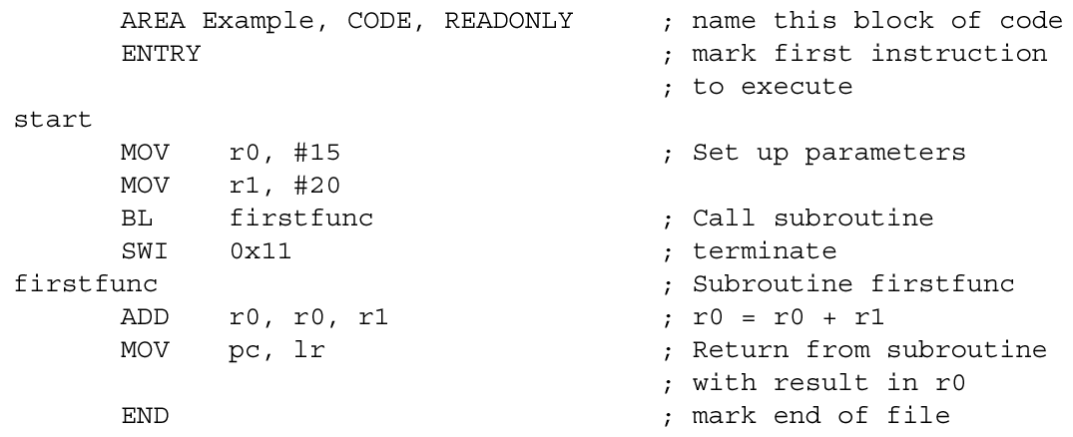
Example of Directives
(E.g. AREA, ENTRY & END Assembly Directives)
Not instructions but help to assemble programs
meaning this is a program to be placed at ROM
T1.s

Slide 8
AREA directive
AREA section_name {,attr}{,attr}...
Example
Addresses | AREA type
0X4000 FFFF- 0x4000 0489 | Data
0x4000 0488- 0x4000 0000 | Stack
0x0000 7FFF- 0x0000 0000 | Code (program)
Directives are instructions to the assembler program, NOT to the microprocessor
AREA Directive - specifies chunks of
  data or
  code or
  Stack etc.

Slide 9
The hardware system
Example:
Microcontroller: ARM7 (Philip’s LPC 213x)
ROM (for code : readonly) : (32K)
0000 0000 →0000 7FFFH
CPU
RAM (for data : readwrite): (64 K)
4000 0000 →4000 FFFFH

Slide 10
DCD (Define Constant Data)
DCD (Define Constant Data) Reserve a word (32 bit value)
DCB (Byte) Reserve a 8-bit value
DCW (word) Reserve a 16-bit value
DCS (string) Reserve a string of 255 bytes
The memory data has to be initialized externally but not by these directives. That means, DCD tells the rest of the program such data exist but not initializing them. In practice:
  In ROM, we have to program these data by a hardware programmer
  In RAM, they have to be written by some code using “STR” commands.
Assembly examples:
  valuex1 DCD 0,1,5,4,0xffffeeee; reserved five 32-bit memory locations with 5 initialized values 0,1,5,4,0xffffeeee.
  In this example, the symbolic name of the first location is valuex1.

Slide 11
Exercise5.1A
Testx.s
EQU : define a constant, so value1=0xE000C000
Area for data, why READWRITE is used?
DCD = allocate 4
bytes for each data.
What is the effect of this?
Value1 EQU 0xE000C000
AREA |.data|, DATA, READWRITE
Table3 DCD 0x1234ABCD, 0x34560123 ; declare two 32-bit integers
align
AREA |.text|, CODE, READONLY
EXPORT __main
__main nop;
BL iuart0
mov r7,#0x02 ;
loop ldr r0,=value1;
:
add r7,#1
B loop
END
Area for CODE (program),
Why READONLY is used?
End of code

Slide 12
Question: 5.1B: Addresses, based on Testx.s , if
ROM: 0000 0000 →0000 7FFFH
RAM: 4000 0000 →4000 FFFFH, fill in boxes with”?’
Table3 DCD 0x1234ABCD, 0x34560123 ;
Address (Hex) | Symbolic name | Content (little Endian: less significant byte at lower address) | Memory type (RAM or ROM)
? | Table3 | List 8 bytes from 0x4000 0000 0x40000000:? 0x40000001:? 0x40000002:? 0x40000003:? 0x40000004:? 0x40000005:? 0x40000006:? 0x40000007:? | ?
? | __main |  | ?

Slide 13
3) Subroutines: A technique for writing better assembly programs
i) Subroutines
ii) Use stack to store registers
iii) Nested Subroutines

Slide 14
(i) Subroutines
Subroutines allow you to modularize your code so that they are more reusable.
The general structure of a subroutine in a program is:

Slide 15
Subroutine (con't)
BL subroutine_name (Branch-and-Link) is the instruction to jump to a subroutine. It performs the following operations:
  1) It saves the PC value (which points to the next instruction) in r14. This holds the return address.
  2) It loads PC with the address of the subroutine. This effectively performs a branch.
BL always uses r14 to store the return address. r14 is called the link register.
Return from subroutine is simple: - just put r14 back into PC (r15). (e.g. MOV pc, r14)

Slide 16
Use stack to store registers
Example
Save R0-R2,R14 on stack
R0=1
R2=3
Subroutine:sub1()
R0=x
R2=y
Free to use R0-R2, R14.
R14 may be used for
nested subroutine calls
R0=1
R2=3
(no change
before and after
sub1() is called)
Retrieve R0-R2,R14 from stack

Slide 17
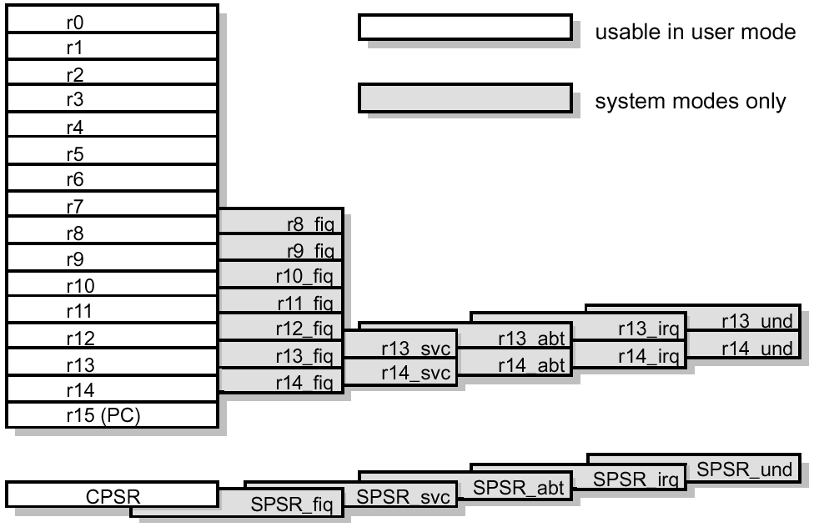
ii) Stack -- Last in first out memory
Multiple store / load
  STMED
  LDMED
Stack example
Address (H) | Data
4000 0488 | :
:
4000 0008 | :
4000 0004 | :
4000 0000 | :
Stack point (R13)

Slide 18
Stack Push operation
Store multiple empty descending
STMED instruction
“Empty” means Stack Pointer is
pointing to an empty location after the operation
SUB1 STMED r13!, {r0-r2, r14} ; push
;work & link registers
It stores data on stack and decreases r13
New
Old
Old
New

Slide 19
Stack Pop operation
Load multiple empty descending
LDMED instruction
LDMED r13!, {r0-r2, r14} ; pop work &
;link registers
It restore data on Registers and increases r13
Old
New
New
Old

Slide 20
(iii) Nested Subroutines
Since the return address is held in register r14, you should not call a further subroutine without first saving r14.
It is also a good software practice that a subroutine does not change any current register values (of the calling program) except when passing results back to the calling program.
  This is the principle of information hiding: try to hide what the subroutine does from the calling program.
How do you achieve these 2 goals? Use a stack to:
  Preserve r14
  Save, then retrieve, the values of registers used inside a subroutine

Slide 21
Preserve data inside subroutine using STACK
Stack (Pointed by r13) for subroutine
BL stores return address at link reg. r14
Main program
Subroutine sub1
Using r0-r2
e.g. r0=value1
BL stores return-address at link reg. r14
push r0-r2,r14 into stack
BL sub1
You may use r0-r2 freely here
e.g. r0=value2
r0-r2 values
are preserved;
not changed
by subroutine
i.e. r0=value1
pop r0-r2,r14 out of stack
Mov r14 into PC will enable it to
go back to the main program.
r0=value1

Slide 22
Details of how to preserve data inside a subroutine using STACK
BL SUB1
…..
SUB1 STMED r13!, {r0-r2, r14} ; push work & link registers
…. ;stmed=store multiple empty descending
BL SUB2 ; jump to a nested subroutine
…
LDMED r13!, {r0-r2, r14} ; pop work & link registers
MOV pc, r14 ; return to calling program
Old
New
New
Old

Slide 23
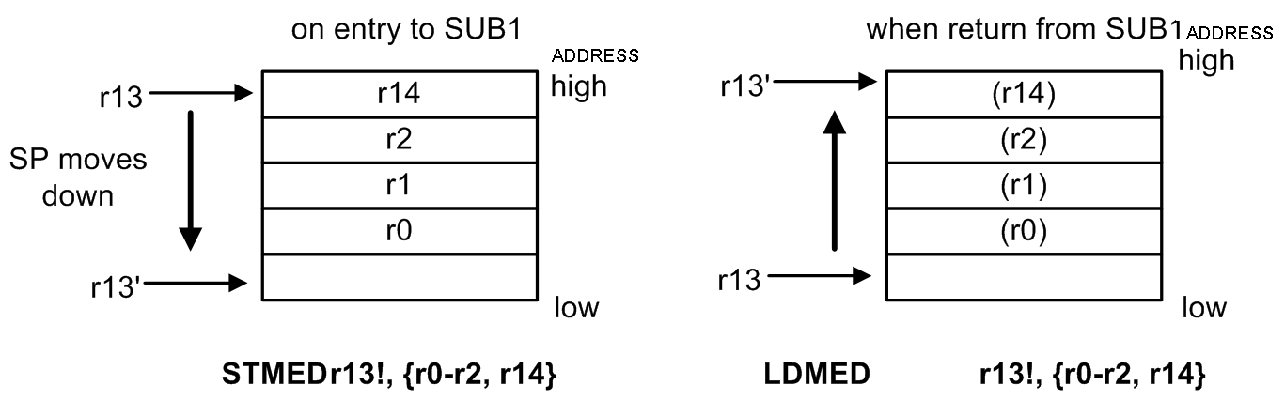
STMED=store multiple empty descending
LDMED=Load multiple empty descending
Memory Address Descending and pointing at an empty space
Old
New
New
Old

Slide 24
Exercise 5.2
Old
New
New
Old
Push stack (save registers)
Pop stack (restore registers)
If SP (r13) is 00340080H before executing STMEDr13!, {r0-r2,r14}
Where are r0,r1,r2,r14 stored, and what is r13’ after STMEDr13!, {r0-r2,r14} is executed?
What is the value of the stack point SP(r13) after LDMED r13!,{r0-r2,r14} is executed?

Slide 25
Different versions of STM
(Store Multiple Memory) see http://www.cse.cuhk.edu.hk/%7Ekhwong/www2/ceng2400/ARM_Instruction_quick_reference.doc
They are:
  STMFD
  STMED
  STMFA
  STMEA
<Addressing_mode>
Full Descending | FD
Empty Descending | ED
Full Ascending | FA
Empty Ascending | EA

Slide 26
Difference between Empty and Full (in STMED and STMFD) of Stack Push operations
Ref: http://computing.unn.ac.uk/staff/cgmb3/teaching/CM506/ARM_Assembler/AssemblerSummary/STACK.html
Empty:
Store multiple empty descending
STMED instruction
STMED r13!, {r0-r2, r14} ;
Full:
Store multiple full descending
STMFD instruction
STMFD r13!, {r0-r2, r14} ;
Old
Old
New
New
“Empty” means Stack Pointer is
pointing to an empty location
“Full” means Stack Pointer is
pointing to a full (non-empty) location

Slide 27
Difference between Ascending and Descending
(in STMFA and STMFD) of Stack Push operations
Ref: http://computing.unn.ac.uk/staff/cgmb3/teaching/CM506/ARM_Assembler/AssemblerSummary/STACK.html
Ascending:
Store multiple full ascending
STMFA r13!, {r0-r2, r14} ;
Descending
Store multiple full descending
STMFD r13!, {r0-r2, r14} ;
new
old
old
new
“ascending” means the address
holding the registers is ascending
“descending” means the address
holding the registers is descending

Slide 28
Subroutine nesting
Nesting: calling a subroutine (sub2) inside a subroutine (sub1)
main
Sub1
e.g. Average n numbers
Sub2
e.g. ‘+’Add function

Slide 29
Effect of subroutine nesting after sub2 returns to main, SP should remain the same
SUB1 calls another subroutine SUB2. Assuming that SUB2 also saves its link register (r14) and its working registers on the stack, a snap-shot of the stack will look like:-
main
High
address
Low
address
Sub1
Sub2

Slide 30
Exercise on stack size limits
For this stack size, how many nested subroutines (each sub1 uses 4x 32bits=16 bytes) calls are allowed?
Total allowed Stack Size=0x488=4*(2^8)+8*(2^4)+8=1024+128+8=1160 bytes.
Total_size / each_call_size=
1160/16=72.5 bytes
So 72 nested calls are allowed.
If you do 73 nested calls, it will result in stack overflow.
Example: ARM7 (LPC213x)
Addresses | AREA type
0X4000 FFFF- 0x4000 0489 | Data (=RAM)
0x4000 0488- 0x4000 0000 | Stack (RAM)
0x0000 7FFF- 0x0000 0000 | Code (startup program) (=ROM) E.g. in startup.s of LPC2131

Slide 31
;http://www.cse.cuhk.edu.hk/%7Ekhwong/www2/ceng2400/ex5a_2400_qst.txt
ex5_2400 self study prohramming exercises for ch 5 of CENG2400. It is for your own revision purpose, no need to submit answers to tutors.
;1) create a project based on this .s code
;2) In keil-ide, use project/rebuild all target files to build the project
;3) use Debug / run_to_cursor_line to run the top line of the program,
;4) In Debug mode/view/memory_windows,use the single step mode to view the changes of memory locations( from 0x4000041c),registers after the execution of each statement.
;5) Answer the questions and explain the observations and results.
;Note: top of stack is at 0x40000428 in lpc213x systems.
;This exercise demonstrates how stack is used in subroutine call to preserved registers contents
; declare variables New test12D
AREA |.data|, DATA, READWRITE
Data1p DCD 0, 0, 0, 0, 0, 0, 0, 0, 0, 0
align
; User Initial Stack & Heap
AREA |.text|, CODE, READONLY
EXPORT __main
__main ;
loop1 ;
MOV r0, #1 ;save 1 into r0
MOV r1, #2 ;save 2 into r1
MOV r2, #3 ;save 3 into r2
;question1:what is the value in r13 now?
BL subroutine
;question5:what is the value in r0 now?
NOP
B loop1
subroutine STMED r13!, {r0-r2,r14} ;save r0,r1,r2,r14 in stack
;question2:what is the value in r13 now and why?
saved in stack
; and r13-decremented 4x4=16=0x10 times , so 0x40000428-0x10=0x40000418
;r13-
;question3:what are stored in the stack ?
MOV r0,#4 ;save 4 into r0
MOV r1,#5 ;save 5 into r1
MOV r2,#6 ;save 6 into r2
LDMED r13!,{r0-r2,r14} ;get back r0,
;r1,r2,r14 from stack
;question4:what is the value in r13 now?
BX LR
END

Slide 32
;http://www.cse.cuhk.edu.hk/%7Ekhwong/www2/ceng2400/ex5b_2400_qst.txt, test5b.s
;This programs shows how stack can be used to save register
;values during nested subroutine calls
;each subroutine-call lowers the stack pointer one level (16 bytes in this is example)
;Exercise: Run the program using single step, observe the changes of the stack pointer (r13)
; and contents of the stack (RAM memory locations from address 0x0000 0408)
; declare variables New test12D
AREA |.data|, DATA, READWRITE
Data1p DCD 0, 0, 0, 0, 0, 0, 0, 0, 0, 0
align
; User Initial Stack & Heap
AREA |.text|, CODE, READONLY
EXPORT __main
__main LDR R0, =Data1p
mov r3,#0
mov r4,#0
mov r5,#0
loop MOV r0, #0xa1
MOV r1, #0xa2
MOV r2, #0xa1
BL subroutine1
B loop
subroutine1 STMED r13!, {r0-r2,r14}
add r3,#1
add r4,#2
add r5,#3
MOV r0,r3
MOV r1,r4
MOV r2,r5
BL subroutine2
LDMED r13!,{r0-r2,r14}
BX LR
subroutine2 STMED r13!, {r0-r2,r14}
add r3,#1
add r4,#2
add r5,#3
MOV r0,r3
MOV r1,r4
MOV r2,r5
LDMED r13!,{r0-r2,r14}
BX LR
END

Slide 33
End

Slide 34
Appendix

Slide 35
Appendix 1. ASCII table
Columns
MSB 4-bit (nibble)
Rows
LSB 4-bit (nibble)
 | 0 | 1 | 2 | 3 | 4 | 5 | 6 | 7 | 8 | 9 | A | B | C | D | E | F
0 | NUL | SOH | STX | ETX | EOT | ENQ | ACK | BEL | BS | HT | LF | VT | FF | CR | SO | SI
1 | DLE | DC1 | DC2 | DC3 | DC4 | NAK | SYN | ETB | CAN | EM | SUB | ESC | FS | GS | RS | US
2 | SP | ! | " | # | $ | % | & | ' | ( | ) | * | + | , | - | . | /
3 | 0 | 1 | 2 | 3 | 4 | 5 | 6 | 7 | 8 | 9 | : | ; | < | = | > | ?
4 | @ | A | B | C | D | E | F | G | H | I | J | K | L | M | N | O
5 | P | Q | R | S | T | U | V | W | X | Y | Z | [ | \ | ] | ^ | _
6 | ` | a | b | c | d | e | f | g | h | i | j | k | l | m | n | o
7 | p | q | r | s | t | u | v | w | x | y | z | { | | | } | ~ | DEL
E.g. 41Hex = ‘A’; 6BHex= ‘k’

Slide 36
send only ascii numbers to screen for display
HexOut ,e.g.output hex “1F230E2Ah” to screen [1]
; Subroutine HexOut - Output 32-bit word as 8 hex numbers as ASCII characters
; Input parameters: r1 contains the 32-bit word (8 hex numbers) to output
; Return parameters: none
1 HexOut STMFD r13!, {r0-r2, r14} ; save working registers on stack
2 MOV r2, #8 ; r2 has nibble (4-bit digit) , loop 8 tines
3 Loop MOV r0, r1, LSR #28 ; get top nibble by shifting right 28 bits
4 CMP r0, #9 ; if nibble <= 9, then
5 ADDLE r0, r0, #"0" ; convert to ASCII numeric char “0”=30h
6 ADDGT r0, r0, #"A"-10 ; else convert to ASCII, “A”-10=41h-10=37h
7 BL WriteC ; print character
8 MOV r1, r1, LSL #4 ; shift left 4 bits to get to next nibble
9 SUBS r2, r2, #1 ; decrement nibble count
10 BNE Loop ; if more, do next nibble
11 LDMFD r13!, {r0-r2, pc} ; retrieve working registers from stack
12 ; … and return to calling program
13 END

Slide 37
Details
Line 3, R1=1F230E2Ah, so R0=00000001h
For the first digit =1h
At line 4, 1h is less than 9, so line 5 is executed
ADDLE r0, r0, #"0” ; "0”=30h
R0=1h+30h=31h = character ‘1’ in ASCII
For the second digit ‘F’
Fh=15 is more than 9, so line 6 is executed, r0=Fh+37h=46h = character ‘F’ in ASCII

Slide 38
FAQ1 on directives
1. Question What is DCD and how to use it?
Answer
Answer:
DCB Reserve a 8-bit value
DCW Reserve a 16-bit value
DCD Reserve a word (32 bit value)
DCS Reserve a string of 255 bytes
e.g
valuex DCD 0,1,5,4,0xffffeeee; reserved five 32-bit memory locations with 5 initialized values 0,1,5,4,0xffffeeee. The symbolic name of the first location is valuex.

Slide 39
FAQ1 on directives
2. Question on directives to define the program
How to read the beginning of the following typical ARM program?
1) AREA |.data|, DATA, READWRITE; define RAMspace from0x40000000
2)value1 DCD 0, 0 ; declare two 32-bit memory space
3) align ; align the following address at a 4-byte boundary
4);; so the address here is at a 4 byte boundary
5)
6); User Initial Stack & Heap ;if needed you may your heap/stack space
7) AREA |.text|, CODE, READONLY ; define program from 0x0
8)
9) EXPORT __main ; if a c-prohram calls this .s,it is the entry
10)__main nop;BL iuart0
11) ;BL idata ;
12) mov r7,#0x02 ; uinit to 0x02, mov r7,0x02 is wrong
Answer:
Line1) Define working RAM memory space, lpc2131 is from 0x40000000.
Line2) Use “DCD 0,0”, to declare a space of two integer (32-bit each) variables , the symbolic name of the first is “value1” at address “=value1”. They are initialized as 0(0x00000000) and 0 (0x00000000).
Line3) “align” is added to make the address following this to be at a 4-byte boundary (the address dividable by 4)
Line6) you may add directives to reserve RAM space for heap and stack
Line7) program starts from here, in arm-lpc2131, it is from address 0x0.
Line9) EXPORT __main ;if a c-program calls this .s,it is the entry

