Slide 1
Chapter 7: Parallel port (General Purpose Input Output, GPIO) --Driving Parallel Loads
CEG2400 - Microcomputer Systems

Slide 2
Practical digital circuit interfacing
Kh wong

Slide 3


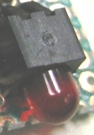
To study
How to interface a digital input switch?
How to interface LEDs?
Produce a stable 5V power source from 9V or higher
Produce a 3.3V power supply from an unstable 5V source
Interface a 5V output to a 3.3 V input
Interface a 3.3V output to a 5V input

Slide 4
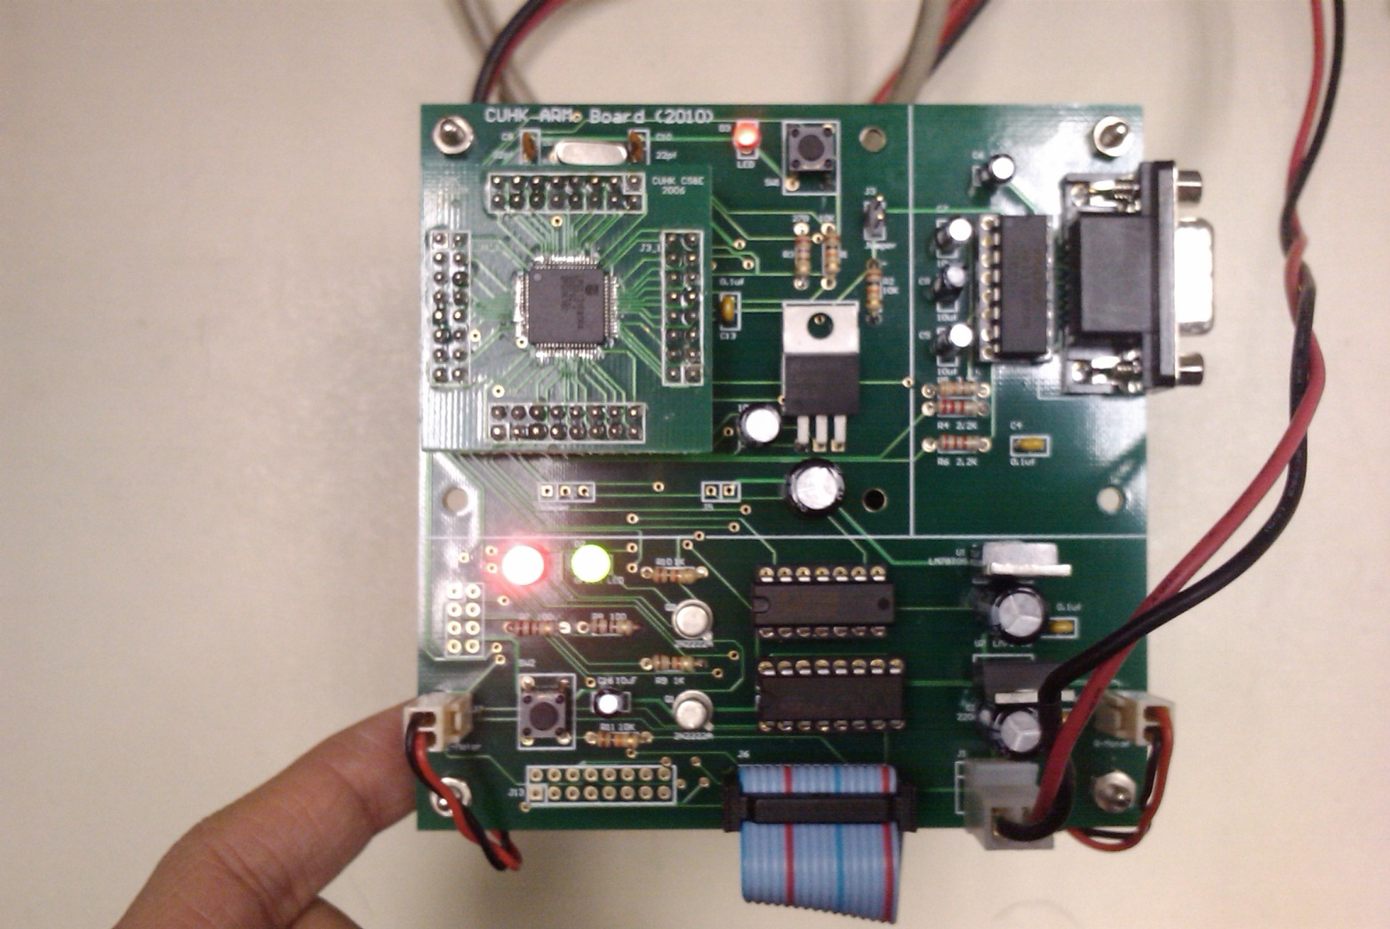
Our experimental kit http://www.youtube.com/watch?v=StWCTTqiTX0&feature=youtu.be http://www.youtube.com/watch?v=zMBn_UASS-E
Arm board
red led
green led
switch

Slide 5
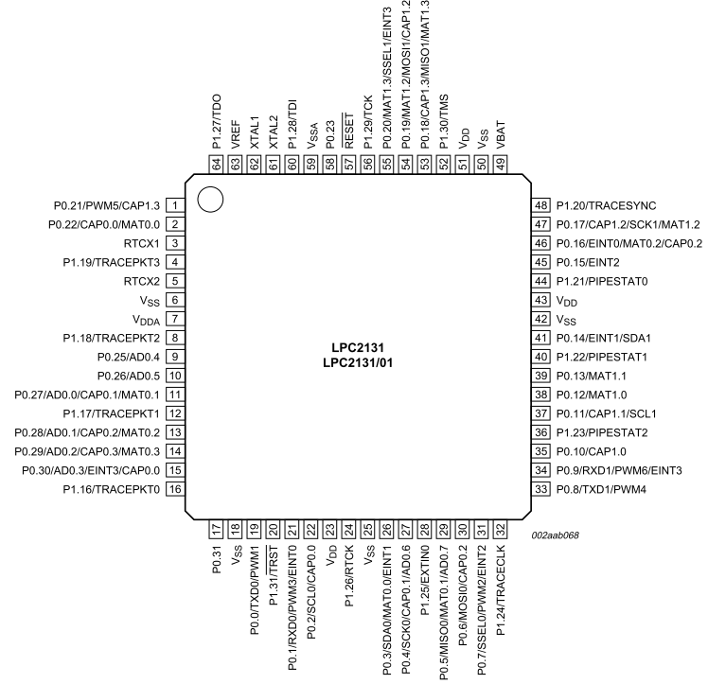
Our testing board
note: a pin may have different functions,
you need to initialize it by software before use.

Slide 6
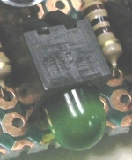

Driving LEDs from a 3.3V system

Slide 7
1) Interface SW1 to a digital input -- use Resistor-Capacitor (RC) circuit to reduce denounce
De-bounce problem: When SW1 is being depressed, the contact is open and closed many times before fully closed.
Software solution see appendix debounce1.c
Problem:
Many pulses (rising edges)
Voltage
at p0.3
3.3V
Without C3
With C3
3.3V
Time

Slide 8

2) To interface a 3.3V digital output to Light emitted Diode (LED)s
Each LPC2131 (ARM7) can drive current at
IOH= -4mA, IOL=4mA (less than the minimum value [10 mA] to drive an LED)
Use transistor to enhance output to drive an LED.

Slide 9

Warning
You cannot drive directly an LED from a GPIO (General Purpose Input Output) pin of a LPC2131(ARM7) microcontroller
The current required by the LED (>10mA) may cause damage to the GPIO circuitry inside the LPC2131(ARM7) microcontroller
Solution: use transistors or 74LS244 line buffers to amplifier the current to drive the LEDs

Slide 10
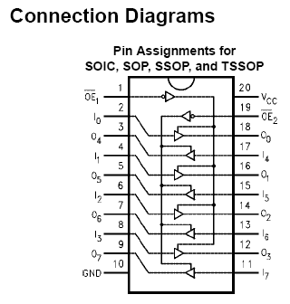
You may use 74LS244 to drive the LEDs (a little expensive solution)
http://ecee.colorado.edu/~mcclurel/sn74ls240rev5.pdf

Slide 11

Cheaper solution: use transistors (instead of 74LS244 ) to drive the LED from the GPIO (General Purpose Input Output)
GPIO (at p0.22) side
Each output can drive 4mA current
P0.22 drive (3.3-0.7)V/ 1K Ω =2.6mA
LED side
Voltage drop of LED is 2V
(3.3-2)V/100Ω=13mA (bright enough)
Current gain 13mA/2.6mA=5 times
3.3V
LED
Voltage
drop 2V
0.7V

Slide 12
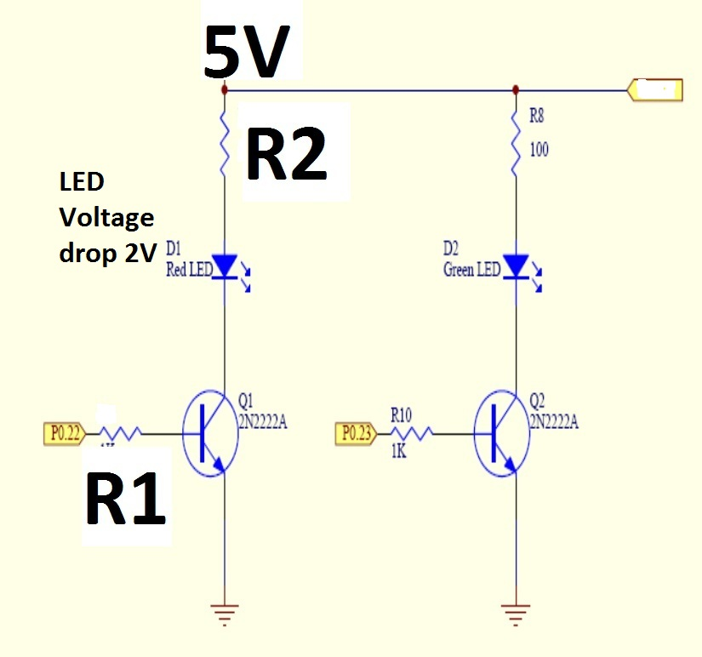
Exercise 7.1
When P0.22 is high (3.3V), calculate the current passing through R2 when the power supply is 5V and R1=2K and R2=200 Ohms .

Slide 13
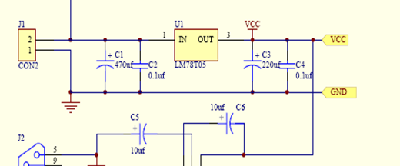
3) Produce a stable 5V power source from an unstable 9V (flat battery)
Purpose: 9V source can be unstable but output is a stable 5V
Method: Use 7805 (LM-78T05) to step down
Unstable
9V +
0
Stable 5V

Slide 14
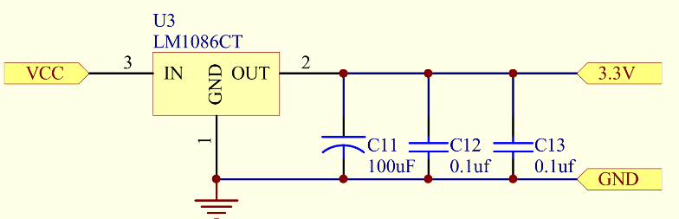
4) Produce a 3.3V power supply from an unstable 5V source– using LM1086CT
The 5V in the circuit may contain noise because it is being used by motors etc.
Use LM1086 to produce a stable 3.3V
Unstable
5V
Drive motors

Slide 15
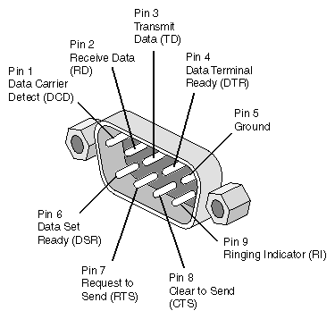


5) Working with different voltage standards
Different standards
RS232
High=+10V
Low= -10V
MAX232
(Transistor–Transistor-level
TTL level)
High = 5V
Low =0V
LPC213x (Arm7 MCU)
High=+3V
Low=0V

Slide 16
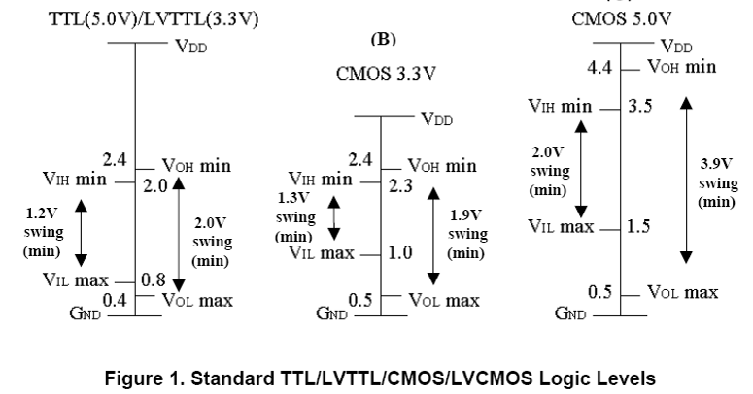
Driving TTL from 3.3V
When driving one type of logic from another, need to check voltages and currents are sufficient to do so at the speed that you desire. Level shifters can be used for interfacing.
CEG2400 Ch7: Driving Parallel Loads V1a

Slide 17
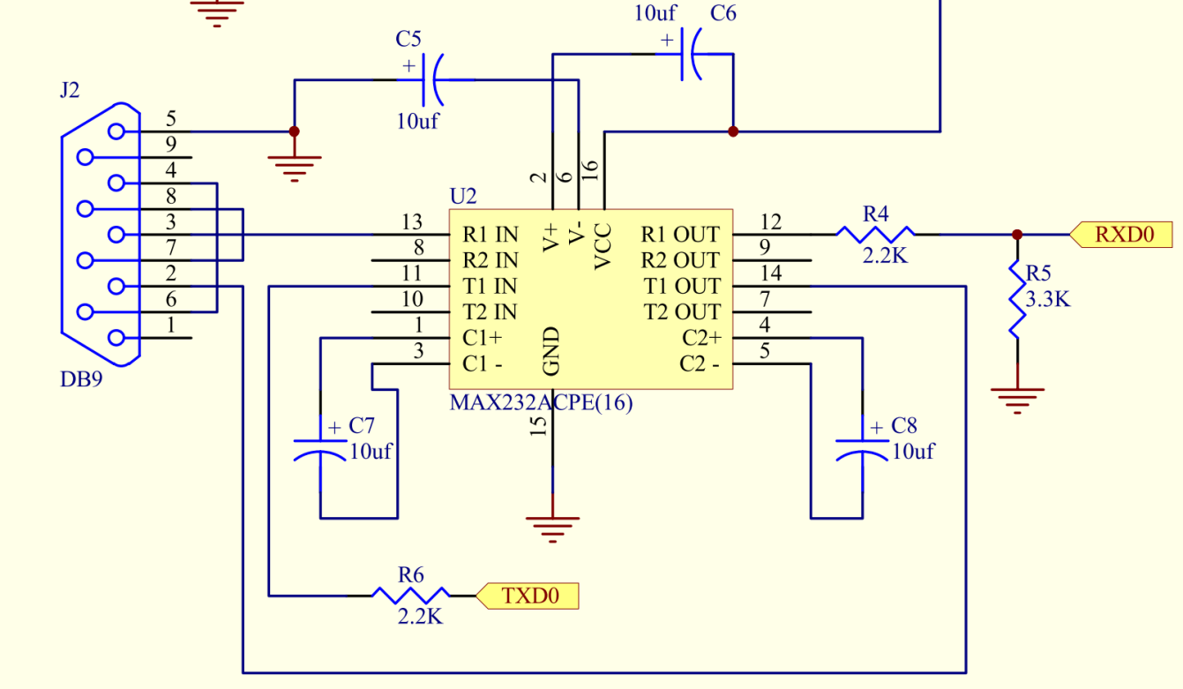
5) i) Interface a +/-10V standard to 5V (by MAX232), and ii) from Max232 to LPC2131 :convert a 5V to a 3.3 V input
R1 out (0-5V , output of MAX232)→RXD0 (0-3.3V, input of ARM-LPC2131)
Use R4,R5 voltage divider to step down from 5V to 3.3V, otherwise it will damage the 3.3V input
0->5V output
To
LPC213x
0->3.3V
Input
of
LPC2131:
High=3.3V
Low=0V
From
RS232 standard
input
High= +10V
Low= -10V
MAX232

Slide 18
6) Interface a 3.3V output to a 5V input
TXD0 out(0-3.3V,output of ARM-LPC2131) →T1 IN (0-5V, input of MAX232)
Use R6 (2.2K) , for protection reason
To protect it against accidently short to 5V or ground.
0->5V input
To
RS232 standard
output
High= +10V
Low= -10V
LPC2131
Output:
0->3.3V

Slide 19
Exercise 7.2
What is the voltage drop of an LED if the color is
Red, (see http://en.wikipedia.org/wiki/Light-emitting_diode )
Blue,
White ?
Draw the circuit for driving a Blue LED by an output of an LPC2132-ARM7 output pin. The power supply is 5V.
Why the Vcc of ARM7 processors are usually set to 3.3V?
How do we provide a power supply for an LPC2131-ARM7 processor from a 9V source?

Slide 20
Part 2
Use of LPC2131(ARM7) –GPIO (General Purpose Input Output) to drive an LED and read a switch

Slide 21
General Purpose Input Output (GPIO)
P0.0->P0.31, P1.16->P1.31 can be GPIO pins
Refer to http://www.nxp.com/acrobat_download/usermanuals/UM10120_1.pdf for LPC213x (ARM7) specific info
21

Slide 22
Our experimental kit
http://www.youtube.com/watch?v=zMBn_UASS-E
Arm board
red led
green led
switch

Slide 23
Our testing board
P0.22
P0.23
P0.20

Slide 24
Driving LEDs from a 3.3V system (Green LED is not used here)
P0.22
P0.23
P0.20

Slide 25
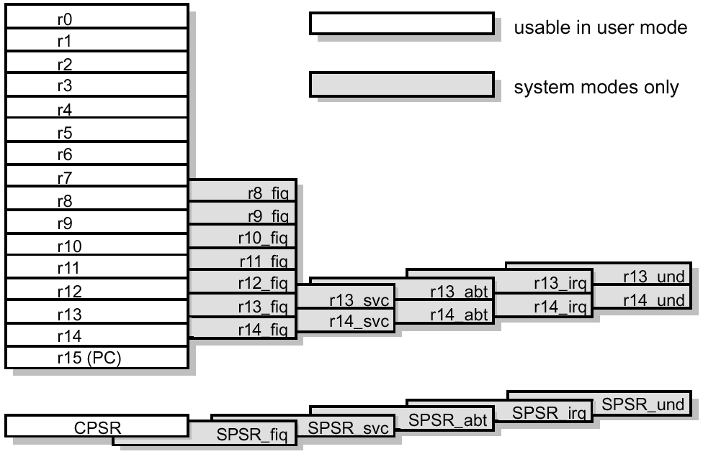
Remind you that ARM has
32-bit memory addresses (0x0000 0000 to 0xFFFF FFFF)
Some addresses are for special functions
Registers (R0-R15) ..etc

Slide 26

Send data to GPIO (General Purpose Input Output) registers
; GPIO Port 0 Register address
;
IO0DIR EQU 0xE0028008; IO direction
IO0SET EQU 0xE0028004; turn on the bits
IO0CLR EQU 0xE002800C;turn off the bits
IO0PIN EQU 0xE0028000; pin assignment

Slide 27
The experiment software in
Assembly or
C

Slide 28
(i) To drive the GPIO (General Purpose Input Output) using assembly
Step0:
After power, by default, IO pins are set in GPIO mode
Step1:
set GPIO bit direction
Loop Step2:
Read IO pins, check Sw1 status
If sw1 is depressed , goto step4
Step3:
Turn off LED if sw1 is not depressed, goto loop
Step4:
Turn on LED if SW1 is depressed, goto loop

Slide 29
A simple assembly program GPIO.s (similar to led_sw3.s) When SW1 is depressed, RED-LED is on
Define registers
Main steps
; GPIO Port 0 Register address
;
IO0DIR EQU 0xE0028008
IO0SET EQU 0xE0028004
IO0CLR EQU 0xE002800C
IO0PIN EQU 0xE0028000
;
RED_LED EQU 0x00400000; p0.22=RED LED
SW1 EQU 0x00100000; p0.20 as SW1
;
;-------------------------------------------------------------
; User Initial Stack & Heap
AREA |.text|, CODE, READONLY
EXPORT __main
__main
1) LDR R1, =RED_LED; p0.22 as output
2) LDR R0, =IO0DIR
3) STR R1,[R0];
4)loop LDR R3, =IO0PIN; read SW1 (p0.22)
5) LDR R3, [R3]
6) TST R3, #SW1;if SW1 depressed R3=0
7) BEQ onled ;if SW1 depressed LEDon
8);
9) LDR R1, =RED_LED ;otherwise LEDoff
10) LDR R0, =IO0CLR
11) STR R1,[R0]
12) B loop
13)onled;------ON LED---------
14) LDR R1, =RED_LED; on the LED
15) LDR R0, =IO0SET
16) STR R1,[R0]
17) B loop
18) END

Slide 30
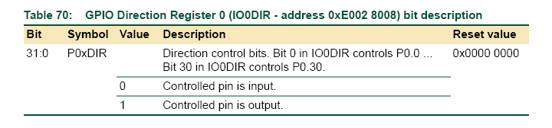
Define registers
; GPIO Port 0 Register address
IO0DIR EQU 0xE0028008; IO direction
IO0SET EQU 0xE0028004; turn on the bits
IO0CLR EQU 0xE002800C;turn off the bits
IO0PIN EQU 0xE0028000; address to read pin status
;
;RED_LED EQU 0x00400000; p0.22=RED LED (out)
; in binary =0000 00000100 0000 0000 0000 0000 0000b, so p0.22=out
; by default (reset value) others pins are inputs, so p.20=input
SW1 EQU 0x00100000; p0.20 as SW1(input) by default reset value

Slide 31
Main steps
Step1: set direction of
GPIO pins
p.0.22=output to drive LED
Other pins are inputs
Including
P0.20=input from sw1
1) LDR R1, =RED_LED; p0.22 as output
2) LDR R0, =IO0DIR
3) STR R1,[R0];
4)Loop LDR R3, =IO0PIN; read SW1 (p0.20)
5) LDR R3, [R3]
6) TST R3, #SW1 ;if SW1 depressed (low)
7) BEQ onled ; if SW1 depressed LEDon
8);
9) LDR R1, =RED_LED;otherwise LEDoff
10) LDR R0, =IO0CLR
11) STR R1,[R0]
12) B loop
13)Onled;-----------------------
14) LDR R1, =RED_LED; on the LED
15) LDR R0, =IO0SET
16) STR R1,[R0]
17) B loop
18) END
Step2:
Read IO pins and check
Sw1 status
Parallel port (GPIO) --Driving Parallel Loads
Step3:
Turn off LED if sw1 is not depressed
Step4:
Turn on LED if SW1 is depressed

Slide 32
Step1: set GPIO (General Purpose Input Output) bit direction
1) LDR R1, =RED_LED; p0.22 as output
2) LDR R0, =IO0DIR
3) STR R1,[R0];
Step1: set direction of
GPIO pins
p.0.22=output to drive LED
Other pins are inputs
Including
P0.20=input from sw1
;RED_LED EQU 0x00400000; p0.22=RED LED (out)
; binary =0000 0000 0100 0000 0000 0000 0000 0000b, assigns bit 22 as out
; others as inputs

Slide 33
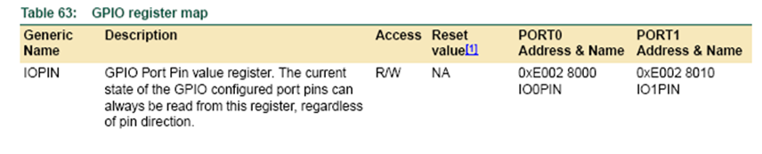
Step2a: Read IO pins, check Sw1 status
Memory location IOPIN holds the status of Input/output Pins P0.x
I.e.
P0.0 is bit 0 of IOPIN
P0.1 is bit 1 of IOPIN
:
P0.20 is bit 20 of IOPIN
Open=1
Closed=0
33

Slide 34
Recall: TST and BEQ
TST
Same as AND (logical AND) except result of operation is not stored.
Only the condition code bits (cc) {N,Z,C,V} in CPSR are changed.
updates the N and Z flags according to the result
Does not affect the C or V flags.
BEQ
Branch if result equal to zero (branch if Z=1)
34

Slide 35
Step2b: Read IO pins, check Sw1 status
4)Loop LDR R3, =IO0PIN; read SW1(p0.20=bit20 of IOPIN)
5) LDR R3, [R3]
6) TST R3, #SW1 ;if SW1 depressed (IOPIN=0)
;(R3=0) and (#SW1) result is 0, Z flag =1
7) BEQ onled ;if SW1 pressed LEDon,(branch if Z=1)
;If bit 20 of R3 is zero (key depressed) then the zero flag will set by “TST R3,#SW1” and this causes the BEQ to branch to ledon.
See http://www.keil.com/support/man/docs/armasm/armasm_cegbhjcj.htm
Read all 32 GPIO p0.0-P0.31 into R3
Since SW1 EQU 0x00100000; p0.20 (bit20 of IO0PIN)as SW1(input)
Test using TST R3, #SW1 ;meaning“R3 and 0x00100000”→status, check only p0.20
If it is on branch to onled
35

Slide 36
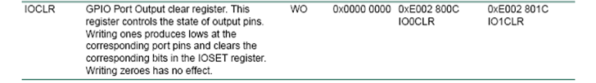
Step3:Turn off LED if sw1 is not depressed Defined earlier IO0CLR EQU 0xE002800C RED_LED EQU 0x00400000; p0.22=RED LED
9) LDR R1, =RED_LED ; otherwise LEDoff
10) LDR R0, =IO0CLR
11) STR R1,[R0]; writes 0x400000 into IO0CLR
; bit 22(p0.22 of IOPIN cleared
12) B loop

Slide 37
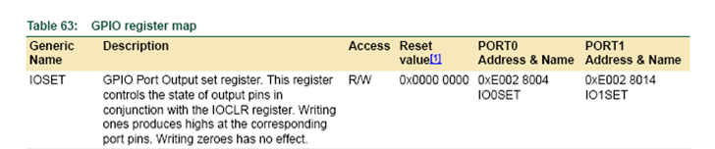
Step4:Turn on LED if SW1 is depressed Defined earlier IO0SET EQU 0xE0028004 RED_LED EQU 0x00400000; p0.22=RED LED
13)Onled;-----------------------
14) LDR R1,=RED_LED; on the LED
15) LDR R0, =IO0SET
16) STR R1,[R0]; writes 0x400000 into IO0SET
; bit 22(p0.22) of IOPIN set
17) B loop
18) END
37

Slide 38
Exercise 7.3a: Key is not_depressed (key released) IOPIN=0x100000 (bit 20 is 1) Show R0,R1, CPSR( N,Z,V,C ) Current Program Status Register =CPSR, N=negative, Z=zero, V=overflow, C-carry
IO0DIR EQU 0xE0028008
IO0SET EQU 0xE0028004
IO0CLR EQU 0xE002800C
IO0PIN EQU 0xE0028000
RED_LED EQU 0x00400000; p0.22=RED LED
SW1 EQU 0x00100000; p0.20 as SW1
;Fill in the blanks
;_________________________________ R0 , R1 , R3 , NZVC
4)Loop LDR R3, =IO0PIN; read SW1 ; ______________________________
5) LDR R3, [R3] ;______________________________
6) TST R3, #SW1;if SW1 depressed 0 ;______________________________
7) BEQ onled ;if SW1 depressed LEDon ;______________________________
8);
9) LDR R1, =RED_LED;otherwise LEDoff ; ____________________________
10) LDR R0, =IO0CLR ; _____________________________
11) STR R1,[R0] ; _____________________________
12) B loop ; _____________________________
13) onled;------ON LED------------------------
14) LDR R1, =RED_LED; on the LED ; _____________________________
15) LDR R0, =IO0SET ; _____________________________
16) STR R1,[R0] ; _____________________________
17) B loop ; _____________________________
18) END

Slide 39

Exercise 7.3b: Key is depressed IOPIN=0x00000000 (bit 20 is 0) Show R0,R1, CPSR( N,Z,V,C ) Current Program Status Register =CPSR, N=negative, Z=zero, V=overflow, C-carry
IO0DIR EQU 0xE0028008
IO0SET EQU 0xE0028004
IO0CLR EQU 0xE002800C
IO0PIN EQU 0xE0028000
RED_LED EQU 0x00400000; p0.22=RED LED
SW1 EQU 0x00100000; p0.20 as SW1
;Fill in the blanks
;_________________________________ R0 , R1 , R3 , NZVC
4)Loop LDR R3, =IO0PIN; read SW1 ; ______________________________
5) LDR R3, [R3] ;______________________________
6) TST R3, #SW1;if SW1 depressed 0 ;______________________________
7) BEQ onled ;if SW1 depressed LEDon ;______________________________
8);
9) LDR R1, =RED_LED;otherwise LEDoff ; ____________________________
10) LDR R0, =IO0CLR ; _____________________________
11) STR R1,[R0] ; _____________________________
12) B loop ; _____________________________
13) onled;------ON LED------------------------
14) LDR R1, =RED_LED; on the LED ; _____________________________
15) LDR R0, =IO0SET ; _____________________________
16) STR R1,[R0] ; _____________________________
17) B loop ; _____________________________
18) END

Slide 40
Exercise 7.4 : Modify the previous program to initialize the IO pins for the following circuit (Green LED is not used here)
P0.6
P0.5

Slide 41
(i) To drive the GPIO (General Purpose Input Output) Using C
A much simpler solution
41

Slide 42
A simple C program GPIO.c When SW1 is depressed, RED-LED is on
#include <lpc21xx.h> //define IO0PIN ,IO0DIR.. Etc
// see http://www.keil.com/dd/docs/arm/philips/lpc21xx.h
#define RED_LED 0x00400000 //set p0.22 as RED LED
#define SW1 0x00100000 //set p0.20 as SW1
int main(void)
{ long tmp; // variable for temp storage of port 0 status
IO0DIR = RED_LED; // set p0.22 as output
while(1)
{ tmp =IO0PIN & SW1;//read SW1(p0.20)depressed=0
if(tmp==0) ; What happens “if (tmp!=0)” is used?
IO0SET = RED_LED; //if SW1 pressed LED is on
else IO0CLR = RED_LED; // otherwise off the LED
}
}

Slide 43
Summary
Learned how to interface parallel GPIO (General Purpose Input Output) loads
Learned how to drive LEDs using the ARM MCU

Slide 44
Appendix

Slide 45
Our robot
Circuits of this chapter are from this design

Slide 46
Led_sw3.s Improved version
; led_sw3.s :Testing GPIO_0 for input/output to be run on the LPC2131 board
;(ver. 2013)
;
;Exercise1 : run this program, you should see:
; When you press the button (sw3), the LED(D1) is on, otherwise LED(D1) is off.
;
;Exercise2: Modified the program so your output is reversed:
; When you press the button (sw3), the LED(D1) is off, otherwise LED(D1) is on.
;
;Exercise3: Modified the program, so you you can use sw4 (P0.11) to control LED D2 (P0.21)
; as in exercise 1.
;Exercise4: Modified the program, so when you press sw3 once ,
; the LED(D1) will toggle (change state from on_to_off or off_to_on)
;
; Note: LED(D1) is at GPIO P0.10, sw3 is at GPIO P0.20 (also for EINT3 external interrupt input)
; Note: LED(D2) is at GPIO P0.11, sw4 is at GPIO P0.21
; Note: LED(D3) is at GPIO P0.12, sw5 is at GPIO P0.22
; Note: LED(D4) is at GPIO P0.13, sw6 is at GPIO P0.23
AREA |.data|, DATA, READWRITE
IO0DIR EQU 0xE0028008 ; pin direction
IO0SET EQU 0xE0028004 ; pin value set
IO0CLR EQU 0xE002800C ; pin value clear
IO0PIN EQU 0xE0028000 ; pin value read & write
RED_LED EQU 0x00000400; 0100,0000,0000B p0.10=RED LED
SW3 EQU 0x00100000; 0001,0000,0000,0000,0000,0000B,p0.20 is SW3
AREA |.text|, CODE, READONLY; User Initial Stack & Heap
EXPORT __main
__main ; set p0.22(red led) as output using the IO0DIR register
LDR R1, =RED_LED
LDR R0, =IO0DIR
STR R1,[R0];
loop LDR R3, =IO0PIN; target at the IO0PIN register
LDR R3, [R3]; load IO0PIN value to R3 register
; if the switch is depressed, corresponding pin value is 0
TST R3, #SW3;test on pin 20 of IO0PIN to see if SW3 is depressed
BEQ onled ;if IO0PIN[20]=0, go to onled to light the led
;otherwise LEDoff
offled LDR R1, =RED_LED
LDR R0, =IO0CLR
STR R1,[R0]
B loop
;------ON LED---------
; write 1 in the 22nd bits of IO0SET to turn on the LED
onled LDR R1, =RED_LED
LDR R0, =IO0SET
STR R1,[R0]
B loop
END

Slide 47
USB-LPC2131 board testing procedure
USB-LPC2131 board testing procedures, based on the LPC2131 board (version 2012) and led_sw3.s.
Build the project files for led_sw3.s as before.
In uvision4>> project >>rebuild all target files>> if there is 0 errors and 0 warning, your program is ok.
If you configured the USB-serial sys. before, skip the next step.
Install the USB-Serial driver to your PC: Follow " Installation of Philips Flash Utility " as shown in the next slide.
Procedures to download the hex program to the LPC2131 board.
Power on the board.
slide sw2 (slide switch) of your board to “opposite side of program”.
Press reset on the LPC2131 board.
In uvision4>> >>Flash >>”click on” download>> Then you will see the download animation (a blue bar is sliding horizontally). It means your program is downloaded successfully to the LCP2131 board.
Procedure to run the program:
Slide sw2 (slide switch) of your lpc2131 board to “program”, press reset again and your program is running. For led_sw3.s, when you press sw3, the LED (D1) should be on. Otherwise it is off.

Slide 48
--- Installation of Philips Flash Utility and the USB-Serial driver ---
Install Philips Flash Utility Installation . run " Philips Flash Utility Installation.exe "
Install USB-serial driver
Download the driver from http://www.ftdichip.com/Drivers/CDM/CDM20828_Setup.exe
To check if the usb-serial driver is working , plug the lpc2131 board to the PC through the USB cable given. Win7 will recognize the USB device and In win7>>control panel>>system>>device manager, you should see this under “Ports(COM & LPT) list as a com device, e.g. com4.
Configure the tools: In vison4>> Flash >> Configure flash tool>>
Select “Output” >> click on the "create HEX file" box.
Select “linker” >> "click on the "USE MEMORY Layout from target Dialog box"
Select “Utilities”>>
Enter “Argument” as
"#H" ^X $D COM4: 57600 1” ,
if com4 is used (for the USB port, see win7>>control_panel>>system>>device manager to find out )
Enter “Command” the LPC210x_ISP.exe you installed earlier. E.g. “C:\Program Files (x86)\Philips Semiconductors\Philips Flash Utility\LPC210x_ISP.exe”
on the lpc2131 board,
Power on, plug in the usb cable to the computer.
Slide the switch sw1 to (opposite side of program).
Press reset. In uvision 4, choose “Flash >> download “, for downloading the code to the board.
Slide sw2 (slide switch) of your lpc2131 board to “program”
Press reset again of the LPC2131 board to run the target program.

Slide 49
Appendix
Alternative set bit method in “C”. The command “<<“ is a left shift instruction in the “C” language
Y=0x1<<21;//left shift 21 bits, this sets bit21=1 and other bits= 0
Example: Before shift
Y=0x1=0000 0000 0000 0000 0000 0000 0000 0001 (Binary)
After shift
Y= 0000 0000 0010 0000 0000 0000 0000 0000 (Binary)
bit 31 bit 21 bit0
Exercise: set bit 9 of register R to be 1, other bits to be 0.
Answer=0x1<<9;
So R=0000 0000 0000 0000 0000 0010 0000 0000 (Binary)
=0x200
Bit9 =1

Slide 50
Software solution debounce1.c
#include <lpc213x.h> //debounce1.c
#define RED_LED 0x00000400 //set p0.10 as RED LED
#define SW3 0x00100000 //set p0.20 as SW3
int main(void)
{ long tmp; // variable for temporary storage of port 0 status
int flag;
IO0DIR = RED_LED; // set p0.10 as output
tmp = IO0PIN & SW3; // read SW3 (p0.20)
while(1)
{ while(tmp==0) tmp = IO0PIN & SW3; // wait SW3 (p0.20) change to high
while(tmp!=0) tmp = IO0PIN & SW3; // wait SW3 (p0.20) change to low
if(flag==0)
{ flag = 1;
IO0SET = RED_LED; //turn on LED }
else { flag = 0;
IO0CLR = RED_LED; //turn off LED }
}
}

