Slide 1
Chapter 10 Timer and external hardware interrupts
CEG2400 - Microcomputer Systems
http://www.nxp.com/documents/user_manual/UM10120.pdf
Demo video
http://www.youtube.com/watch?v=nAT2FhYwPx0&feature=youtu.be
http://www.youtube.com/watch?v=GzommZ3adk8&feature=youtu.be

Slide 2
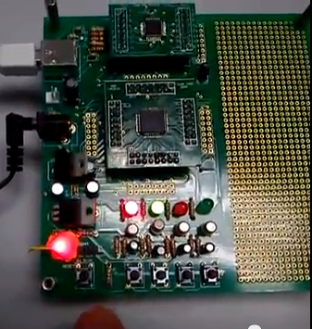
Timer_int_demo13a.c
The experiment of blinking a red LED
timer_int_demo13a.c
Demo videos:
http://www.youtube.com/watch?v=nAT2FhYwPx0&feature=youtu.be
http://www.youtube.com/watch?v=GzommZ3adk8&feature=youtu.be
Arm board
2012
red led
green led
switch
CEG2400 Ch7: Driving Parallel Loads V1a

Slide 3
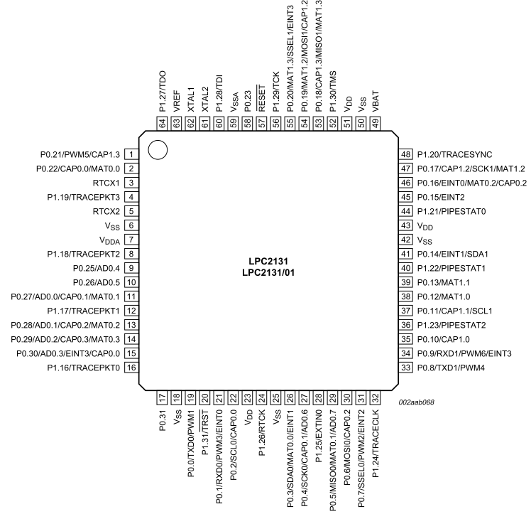
Our testing board
P0.10
Red _LED
P0.11
Green_LED
P0.20 (EINT3), pin 55
SW3
CEG2400 Ch7: Driving Parallel Loads V1a
3

Slide 4
The timer driven interrupt
concept

Slide 5

Blink LED Interrupt Service Routine ISR( ) the concept
Main( )
{
Setup( );
:
:
}
A timer sends out interrupt requests regularly at 10Hz, hence ISR() runs once every 1/10 seconds
At each Interrupt Service Routine ISR
  __irq isr_Timer0()
  {
  change state of LED
  //—so the LED blinks
  }
ISR( ) isr_Timer0()
{
:blink
LED
:
}
Timer0
Interrupt
the
MCU
LPC2131

Slide 6
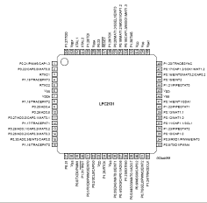
Blink LED Interrupt Service Routine ISR with program details
Main()
{ Init_IO_pins();
init_serial_port();
void init_timer_Eint();
Do something
while(1)
{
:
:
:
:
:
:
}
}
Timer0 set
//Timer0 interrupt
__irq isr_Timer0()
{
:
}
Blink red-led
timer0
Notes:
The software has two parts
The main() program that initializes the timer and interrupt
The interrupt service routine __irq() blinks the LED at 1HZ
The main() after initialized the timer and interrupts can do something else, like some calculations or idling by running an endless loop , such as “while(1){ }”.
The main() program is being interrupted at a regular basis, 1 Hz,
The __irq() toggles the state of the LED, turning it on or off at 1HZ
void __irq IRQ_Exception()
{ timeval++;
//Blink the Red LED
if((timeval%2)==0) IO0SET|=RED_LED; //turn on LED if timeval is even
else IO0CLR|=RED_LED; //turn on LED if timeval is odd
T0IR = 1; // Clear interrupt flag
VICVectAddr = 0; // Acknowledge Interrupt
}

Slide 7
Explanation
The software has two parts
  The main() program initializes the timer and interrupt
  The interrupt service routine __irq() blinks the LED at 10HZ
After initialization the code in main() can do something else, like some calculations or idling by running an endless loop , such as “while(1){ }”.
The main() program is being interrupted at a regular basis, 10 Hz,
The __irq() toggles the state of the LED, turning it on or off at 10/2HZ
void __irq isr_Timer0()
{
timeval++;
//Blink the Red LED
if((timeval%2)==0) IO0CLR|=D1_red_led;
else IO0SET|=D1_red_led;
T0IR = 1; // Clear interrupt flag
VICVectAddr = 0; // Acknowledge Interrupt
}

Slide 8
Why do we use timer interrupt?
Example of blinking an LED
//Software delay loop method
Main()
{
For (;;)
{ On_LED;
delay_100ms_loop();
Off_LED;
delay_100ms_loop(); }
}
Problems
  Delay not accurate, because different interrupts (UART, TIMER..etc) may occur in between statements
  Exact delay is difficult to calculate, because
    delay_100ms_loop()
    { for (i=0; i<x; i++)
    for (j=0; j< 1000; j++)
    {some instructions depends on how you write them;}
    //difficult to estimate x to make delay 100ms
    }
  Solution: use timer interrupt

Slide 9
What is timer interrupt?
_isr( )=Interrupt Service Routine
Interrupt occurs
Match reg0 (MR0)
T0MR0 =1382400
Connected
Inside
ARM7-
LPC213x
Timer
CounterTC
Main ()
{
:
Doing something
:
}
=
10Hz
PCLK=
13.824MHz
TIMER_OUTPUT
An output pulse
will be generated
when TC=T0MR0 match
reset
At each rising edge
of TIMER_OUTPUT pulse,
ISR( ) executes once.
So _ISR( ) executes 10 times
per second
_isr( )//Interrupt service routine
{
.. some tasks…
}//when finished,
//goes back to main

Slide 10
Overview of timer_int_demo13a.c
We will introduce the program in this order
Part 1: header
Part 5: Main()
Part 4: Init_timer_Eint (void)//init timer and external interrupt
Part 2: isr_Timer0()//timer interrupt service routine
Part 3: isr_Eint3() //external interrupt service routine, discussed in last chapter

Slide 11
//timer_int_demo13a.c
//part 1: header: ////////////////////////////////////////
#include <lpc21xx.h>
extern void init_timer_Eint(void);
#define D1_red_led 0x400//define p0.10 as Red LED(D1_red_led) output
#define D2_green_led 0x800//define p0.11 as Green LED(D2_green_led) output
//define global variables
long timeval;
long exint;
/////////////////////////////////////////////////////////
//part2 : Timer Interupt service routine ////////////
void __irq isr_Timer0()
{timeval++;
//Blink the Red LED
if((timeval%2)==0) IO0CLR|=D1_red_led;
else IO0SET|=D1_red_led;
T0IR = 1; // Clear interrupt flag
VICVectAddr = 0; // Acknowledge Interrupt
}
///////////////////////////////////////////////////////////
//part3 : External Interrupt service routine for EINT3
void __irq isr_Eint3()
{ exint++;
//Google the Green LED external int. (EINT3 ) is triggered
// when pin p0.20 has transition from 1 to 0
if((exint%2)==0) IO0CLR|=D2_green_led;
else IO0SET|=D2_green_led;
EXTINT = 0x08; // Clear EINT3 flag
VICVectAddr = 0; // Acknowledge Interrupt
}
//part4 :Init Timer interrupt////////////////////////////
void Init_timer_Eint (void) {
T0PR = 0; // set prescaler to 0
T0MR0 =1382400; // set interrupt interval to 100ms
// Pclk/10Hz = (11059200 x 5)/(4 x 1000)
T0MCR = 3; // Interrupt and Reset on MR0
T0TCR = 1; // Timer0 Enable
VICVectAddr0 = (unsigned long)isr_Timer0;
// set interrupt vector slot 0—(highest priority)
VICVectCntl0 = 0x20 | 4; // use it for Timer 0 Interrupt
VICIntEnable = 0x00000010; // Enable Timer0 Interrupt
// For init. Exint3----------------------------------------------------
EXTMODE=0x08; // set EINT3 as edge trigger
VICVectAddr1 = (unsigned long)isr_Eint3;
// set interrupt vector slot1— 2nd highest priority
VICVectCntl1 = 0x20 | 17; // use it for EINT3 Interrupt
VICIntEnable |= 0x00020000; // Enable EINT3 interrupt
EXTINT = 0x08; // Clear EINT3 flag
}
///////////////////////////////////////////////////////////////
//part5 :main program///////////////
int main(void)
{
PINSEL1 |= 0x00000300; // set p0.20 as EINT3 external interrupt input
//Init_Serial_A();-------------------------------------- // Init COM port
Init_timer_Eint(); // Init Timer 0 & EINT3
IO0DIR|=D1_red_led; // p0.10 red led
IO0DIR|=D2_green_led; // p0.11 green led
while(1) { //endless loop, do nothing
}
}

Slide 12
Part 1 : Header include header<lpc21xx.h> declare constants and variables
//timer_int_demo13a.c
//part 1: header: ////////////////////////////////////////
#include <lpc21xx.h>
extern void init_timer_Eint(void);
#define D1_red_led 0x400//define p0.10 as Red LED(D1_red_led) output
#define D2_green_led 0x800//define p0.11 as Green LED(D2_green_led) output
//define global variables
long timeval;
long exint;

Slide 13
Part 5: Main ( )
//part5 :main program///////////////
int main(void)
{ PINSEL1 |= 0x00000300;// p0.20 as EINT3 external interrupt
Init_timer_Eint(); // Init Timer 0 & EINT3
IO0DIR|=D1_red_led; // p0.10 red led
IO0DIR|=D2_green_led; // p0.11 green led
while(1) { //endless loop, do nothing
}
}

Slide 14
What is the meaning of the statement
PINSEL1 |= 0x00000300; ?
Answer: //setup p0.20 as EINT3 external interrupt
In main() {…
PINSEL1 |= 0x00000300;// p0.20 as EINT3 (pin55)external interrupt 3
…..}
0x300=11 0000 0000B, so bit 9,8=11B
PINSEL1

Slide 15
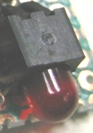
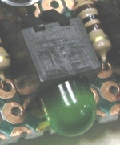
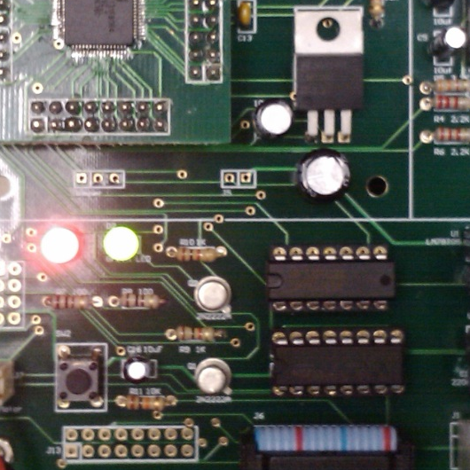


The Red, Green LEDs
P0.10
Red _LED
P0.11
Green_LED
P0.20 (EINT3)
SW3
15

Slide 16
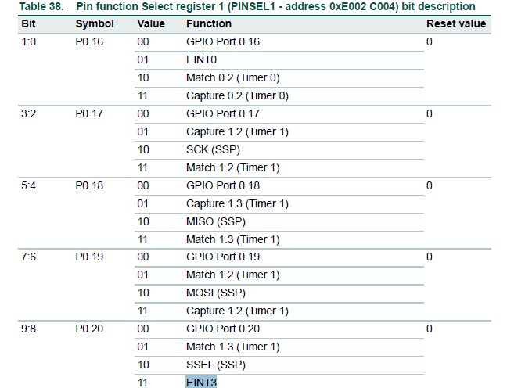
Student ID:__________,Date:_____________
Name: _______________
CENG2400, Exercise 10, Timer interrupt
Exercise10.1a: How to use EINT0 as the external interrupt input rather than EINT3? ANSWER:?____________,
_____________________
Exercise10.1b: How to modify the hardware for the above change?
ANSWER:?_________
Exercise10.1c: How to change the program if the red LED is connected to p0.12?
ANSWER:?_________

Slide 17

Learn to use timer and interrupt
A timer sends out interrupt requests regularly
Timer0
Interrupt
the
CPU
=
ARM7-LPC213x

Slide 18
What is a timer?
Like an alarm clock
After programmed, it sends out regular signals to interrupt the Central Processing Unit (CPU).
How to program the system?
  Set frequency of timer
  Set the MCU to receive interrupt from timer.

Slide 19
The timer is a 32-bit binary counter
So what is a binary counter?
Time Q0 Q1 Q2 Q3
0 0000
1 0001
2 0010
3 0011
4 0100
5 0101
6 0110
7 0111
8 1000
9 1001
1010
11 1011
12 1100
13 1101
14 1110
15 1111
0000
0010
0011
:
:
Example
a 4-bit counter, output changes at each rise edge of clock
A 32-bit counter has Q0-Q31 (32 outputs)
clock
4 output
Q0 Q1 Q2 Q3
Time 1 2 3

Slide 20

Example: 4-bit Asyn. Clock Counter
Plot count, and check delay
FF=D-type flip flop
Count(0)
Count(1)
Count(2)
Count(3)
D(0)
D(1)
D(2)
D(3)
FF
FF
FF
FF
clock
Q(0)
ck
ck
Q(2)
ck
Q(3)
ck
Q(1)
reset
clock
Q(0)
Q(1)
Q(2)
Q(3)

Slide 21
How to use the timer?
Like an alarm clock
After programmed, it sends out regular signals to interrupt the Central Processing Unit (CPU).
How to program the system?
  Set frequency of timer
  Set the MCU to receive interrupt from timer.

Slide 22
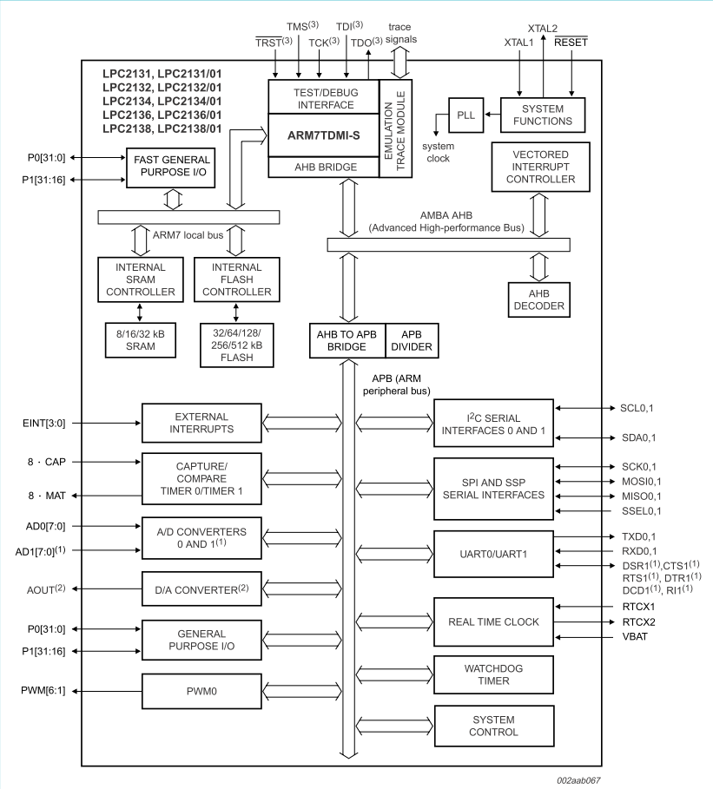
Where is the timer?
The timer
Is inside
ARM7-
LPC213x

Slide 23

The ARM_LPC213x has an PCLK=13.842MHz for peripheral devices
The peripheral clock is 13.824MHz if your crystal oscillator is 11.0592MHz
ARM7-LPC213x
Important registers
T0MR0
T0MCR
T0TCR
F_{OSC}
11.0592MHz
F_{OSC}x5/4=
CCLK/4=
PCLK =
for peripherals
13.824MHz
F_{OSC}x5/4 =
11.0592MHz x5/4
13.824MHz
The peripheral
Clock (PCLK )
for timer/counter
etc.

Slide 24
Part 4 ---init timer for interrupt in timer_int_demo13a.c
cclk=M*Fosc, M=5
pclk=cclk/4
Pclk=11059200*5/4
13.824MHz
void Init_timer_Eint (void) {
// ----------------------Timer interrupt initialization----------
T0PR = 0; // set prescaler to 0
//T0MR0 =1382400;// T0MR0=Pclk/(desired_freq)=13824000/10=10Hz
// where Pclk= 11059200 x 5/4= 13.824MHz
T0MR0 = 13824000;//T0MR0 = 13824000;will output 1HZ;
//T0MR0 =2764800;//will output 5Hz;
T0MCR = 3; // Interrupt and Reset on MR0
T0TCR = 1; // Timer0 Enable
VICVectAddr0 = (unsigned long)isr_Timer0; //name of the ISR function
VICVectCntl0 = 0x20 | 4; // use it for Timer 0 Interrupt
VICIntEnable = 0x00000010; // Enable Timer0 Interrupt
// ----------------------External interrupt initialization--------------------------------
// For init. Exint3 ---------Studied in the last chapter before
EXTMODE=0x08; // set EINT3 as edge trigger
VICVectAddr1 = (unsigned long)isr_Eint3; // set interrupt vector in 1
VICVectCntl1 = 0x20 | 17; // use it for EINT3 Interrupt
VICIntEnable |= 0x00020000; // Enable EINT3 interrupt
EXTINT = 0x08; // Clear EINT3 flag
}
Setup interrupt vector 0
VICVectAddr0, it becomes the highest priory interrupt)
VICVectAddr01=2nd highest priority etc
Usually:You only need to change lines in these
Boxes for your own application, see appendix.

Slide 25
Examples for setting T0MCR
--You change T0MR0=(13824000/desired freq) to change interrupt frequency
T0MR0 Frequency of timer interrupt
1382400 10Hz
13824 1000Hz
?________ 5Hz
?________ 20Hz
Answer: T0MCR =2764800 for 5HZ,
T0MCR =691200 FOR 20Hz
In our lab 10Hz is used
You may try different frequencies

Slide 26
Exercise 10.2: Example and concept of a timer/counter
The timer/counter increments at a rate of PCLK=13.824MHz, when the output of the counter matches T0MR0 , an output pulse is generated , the timer/counter is reset to 0 and start counting again.
Exercise 2a: If Fosc is 12MHz, what is the value for PCLK?
  Answer :?____________________
  Exercise 2b: If PCLK=13.824MHz , what is the frequency of the output when T0MR0=13824000?
Answer :?____________________
Exercise 2c: If PCLK=13.824MHz , how to generate a frequency of 150Hz using the timer
Answer :?________________________
Exercise 2d: How to change the program if the isr function is called “isr_timer_xyz”
Answer :?________________________
cclk=M*Fosc, M=5
pclk=cclk/4
Pclk=11059200*5/4
13.824MHz

Slide 27
Part 2: Timer Interrupt service routine
/////////////////////////////////////////////////////////
//part2 : Timer Interrupt service routine ////////////
void __irq isr_Timer0()
{timeval++;
//Blink the Red LED
if((timeval%2)==0) IO0CLR|=D1_red_led;
else IO0SET|=D1_red_led;
T0IR = 1; // Clear interrupt flag
VICVectAddr = 0; // Acknowledge Interrupt
}

Slide 28
Part 3: void __irq isr_Eint3()
//studied before in the last chapter
//part3 : External Interrupt service routine for EINT3
void __irq isr_Eint3()
{ exint++;
//Google the Green LED external int. (EINT3 ) is triggered
// when pin p0.20 has transition from 1 to 0
if((exint%2)==0) IO0CLR|=D2_green_led;
else IO0SET|=D2_green_led;
EXTINT = 0x08; // Clear EINT3 flag
VICVectAddr = 0; // Acknowledge Interrupt
}

Slide 29
A little summary
The timer is a hardware module inside ARM7_LPC213x
The timer generates a 10Hz clock at TIMER_OUTPUT
At each rising edge of TIMER_OUTPUT
  the interrupt service routine _ISR() is executed once,
  so the _ISR is being executed 10 times per second

Slide 30
The CPU runs instructions of main() and ISR() sequentially.
--M1,M2..etc are statements in main()
--I1,I2,I3,are ISR statements inside an ISR(), they will run once in every 100ms
ISR() //interrupt service routine 10Hz
{
  I1
  I2
  I3
}
E.g.
:
Setup();
  M1
  M2
  M3
    I1
    I2
    I3
  M4
  M5
    I1
    I2
    I3
  M6
  M7
  M8
  M9
    I1
    I2
    I3
  M10
  M11
Main()
{
  setup();
  M1
  M2
  M3
  M4
  M5
  M6
  M7
  M8
  M9
  M10
  M11
  M12
  M13
  :
100ms
Executes ISR in every 100ms
Xms
Yms
Exercise 3
What are the values of X and Y in ms?
Answer:?_________

Slide 31
SOFTWARE HARDWARE
Time delay vs timer interrupt method
Software Delay method
Blink Frequency not accurate
Hardware timer interrupt method
Blink Frequency actuate
//Delay loop method
Main()
{
For (;;)
{ On_LED;
delay_100ms_loop();
Off_LED;
delay_100ms_loop(); }
}
Main( )
{
Setup( );
:while(1)
do
Something;
:
}
//Timer interrupt rate 10Hz
ISR( ) isr_Timer0()
{
:blink
LED
:
}
Timer0
Interrupt
the
MCU
Accurate delay loops are difficult to
implement using software delay
LPC2131

Slide 32
Explanation
You may use delay loop to implement an LED blinking program, but how do you write the delay_10ms_loop in the following code?
    delay_100ms_loop()
    { for (i=0; i<x; i++)
    for (j=0; j< 1000; j++)
    {some instructions;}
    //difficult to estimate x
    }
Some instructions are used to consume time, they may include instructions like add, load, store etc. But it is very difficult to calculate the exact delay time. Because
  some instructions may run at different speeds in different CPUs.
  If you are using a new CPU that runs faster (e.g. the clock is not 11MHz but 22 MHz) the delay will be shorter, then you have to recalculate x again to make sure the delay loop occupies 100ms.
  The solution is to use the timer, after programmed, the timer interrupts the CPU at a 10 Hz frequency and the time is always correct. Even when you change the system clock the timer will still be interrupting the CPU at 10Hz and the blinking frequency will not be changed.

Slide 33
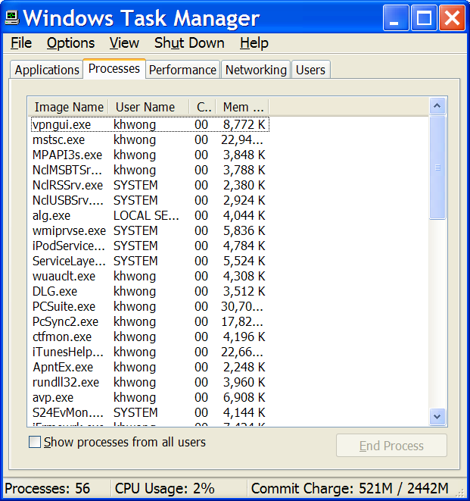
Application: Scheduler of an
Operating system
In time sharing operating systems e.g. Windows, Unix
A simplified model
1KHz interrupt rate
process1
A scheduler
process2
process3
Proces1 Process2 Process3 Process1
Time (ms)
1 2 3 4
Interrupts and runs the interrupt service routine
http://en.wikipedia.org/wiki/Scheduling_(computing)

Slide 34
Explanation
Another application is the scheduler of the operating system.
A scheduler is a program that feeds the CPU with a process at one time using a scheme so that processes are run in a fair and balanced manner.
The scheduler is an essential part of all time-sharing operating systems, such as Windows, Unix, MacOS.
For example you may see how the CPU is scheduled to run different processes using the Windows-task-manager.
In our example, a timer is programmed to make interrupt requests to the CPU at 1KHZ, so the first process will be run for 1 ms, and then the second for the next 1ms etc.
Nearly all operating systems use the timer to implement the scheduler in the core of the operating system called the kernel.

Slide 35
Limitation of interrupt
Usually stack is used in the interrupt service routines isr()
Maximum Interrupt rate allowed: Stack will overflow if interrupt rate is too high.
main( )
{
…
}
1st Interrupt
2 ^{nd} Interrupt
3rd interrupt
Will hang
since the stack will overflow.
If no return from interrupt (reti)
occurs again.

Slide 36
Summary
Learned the operation of a timer.
Learned how to use a timer to generate interrupts.

Slide 37
Experiment
In our experiment, you may change the code of timer_int_demo13a.c to increase the interrupt rate ( much bigger than 10Hz) until the system crashes to see the limitation of interrupt.

Slide 38
Appendix
(ESTR2100 students should study this)
Details

Slide 39
Initialize timer and interrupt
init_timer_Eint();

Slide 40
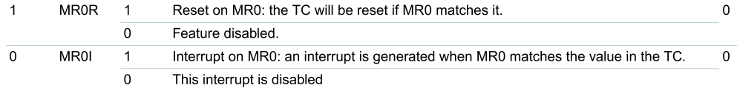
Setup T0MCR interrupt in Init_timer_Eint()
Match reg0 (MR0)
T0MR0 =1382400
Timer
Counter
TC
Interrupt
output
=
T0PR = 0; // set prescaler to 0
T0MR0 =1382400; // set interrupt rate 10Hz, (interval=100mS)
// Pclk/10Hz = (11059200 x 5/4)/ 10
T0MCR = 3; // Interrupt and Reset on MR0
T0TCR = 1; // Timer0 Enable
//Match Control Register (MCR, TIMER0: T0MCR - address 0xE000 4014)
Bit 0,1 of T0MCR (MR0R, MR0I)
PCLK=
13.824MHz
reset

Slide 41
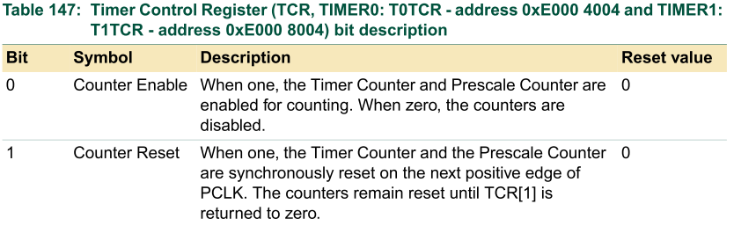
Setup T0TCR Count Control Register in Init_timer_Eint()
T0TCR = 1; // Timer0 Enable
Line 150:
Timer Control Register (TCR, TIMER0: T0TCR - 0xE000 4004)

Slide 42
setup the Vector Control registers in in Init_timer_Eint()
//part4 :Init Timer interrupt////////////////////////////
void Init_timer_Eint (void) {
T0PR = 0; // set prescaler to 0
//T0MR0 =1382400;// T0MR0=Pclk/(desired_freq)=13824000/10=10Hz
// where Pclk= 11059200 x 5/4= 13.824MHz
T0MCR = 3; // Interrupt and Reset on MR0
T0TCR = 1; // Timer0 Enable
VICVectAddr0 = (unsigned long)isr_Timer0; //name of the ISR function
VICVectCntl0 = 0x20 | 4; // use it for Timer 0 Interrupt
VICIntEnable = 0x00000010; // Enable Timer0 Interrupt
// For init. Exint3 ---------------------------
EXTMODE=0x08; // set EINT3 as edge trigger
VICVectAddr1 = (unsigned long)isr_Eint3; // set interrupt vector in 1
VICVectCntl1 = 0x20 | 17; // use it for EINT3 Interrupt
VICIntEnable |= 0x00020000; // Enable EINT3 interrupt
EXTINT = 0x08; // Clear EINT3 flag
}
address of the interrupt service routine isr_Timer0

Slide 43
Setup VICVectCntl0 in Init_Timer_Eint()
VICVectCntl0(bit 0:4)=(0x020 | 4), because
0x20=>bit 5=1 , is the IRQslot_en
‘4’ is the source mask for timer0 (see next slide)
0x020 → bit5=1

Slide 44
Source mask for Timer 0
E.g.
VIC channel mask for timer0 is 4

Slide 45
Setup VICIntEnable in Init_Timer_EINT()
VICIntEnable = 0x00000010; enable timer 0
Bit4 is set

Slide 46
Timer0 hex_mask =4

Slide 47
Appendix 2
The ARM_LPC213x has an PCLK=13.842MHz for peripheral devices
After some internal manipulations:
ARM-LPC213x
F_{OSC}x5=CCLK for MCU
55.296MHz
F_{OSC}
11.0592MHz
CCLK/4=
PCLK =
for peripherals
13.824MHz
The Clock for
timer/counter

Slide 48
Appendix3: How about you need another frequency, say 1KHz interrupt rate?
Example of a 1KHz=freq_out interrupt generator
PCLK /freq_out= PCLK/1K=(11059200 x 5)/(4 )=13.824 MHz/1000=13824
When timer counter (TC)=match reg0 (T0MR0), an interrupt is generated
Match reg0 (MR0)
T0MR0 =13824
Divided by
(pre-scale+1)
Since pre-scale
=T0PR = 0
So divided by 1
Timer
Counter
TC
PCLK
Or
an input pin
CAPx.y
(See pin
assignment
of lpc2131)
=
Freq_out=
=PCLK/T0MR0
Interrupt request
or output pin (MATx.y)
(1KHz, every 1ms)

Slide 49
Examples of other interrupt sources
If you want to use Eint3(source mask=17)
VICVectCntl1 = 0x20 | 17
VicIntEnable=?: Answer: VICIntEnable |= 0x00020000 (why?)
If you want to use Eint0(source mask=14)
VICVectCntl1 = 0x20 | 14
VicIntEnable=? Answer:
If you want to use Uart0(source mask=6)
VICVectCntl1 = 0x20 | 6
VicIntEnable=? Answer:

Slide 50
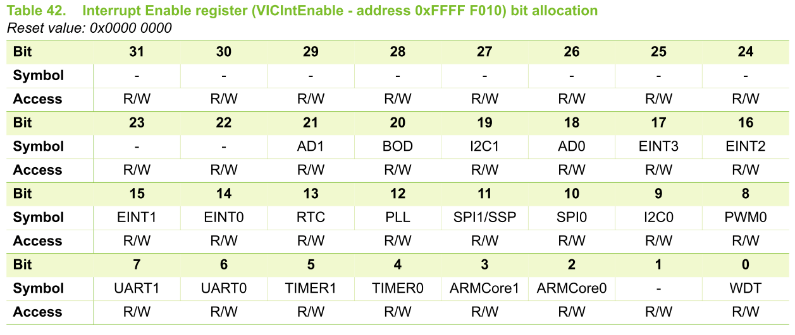
setup external interrupt3 (EINT3) line 158
Bit17 is set
158) VICIntEnable |= 0x00020000; // Enable EINT3 interrupt
159) EXTINT = 0x08; //
Enable external interrupt 3 (EINT3)

Slide 51
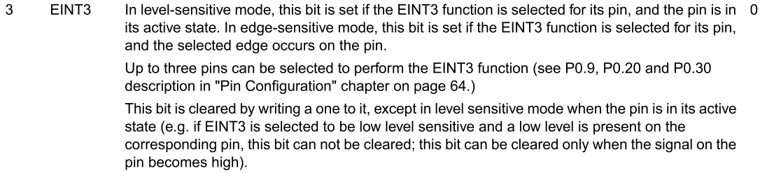
setup external interrupt line 159
155) EXTMODE=0x08; // set EINT3 as edge trigger
156) VICVectAddr1 = (unsigned long)isr_Eint3; // set interrupt vector in 1
157 VICVectCntl1 = 0x20 | 17; // use it for EINT3 Interrupt
158) VICIntEnable |= 0x00020000; // Enable EINT3 interrupt
159) EXTINT = 0x08; //
External Interrupt Flag register (EXTINT - address 0xE01F C140)
bit

Slide 52
Appendix

Slide 53
Interrupt details : chapter5 of [1] from http://www.nxp.com/acrobat_download/usermanuals/UM10120_1.pdf Example UART generates an interrupt request and has the highest priory
0xffff f030 | VICVectAddr reg contans, starting address of ISR_UART()
: | :
0x0000 0018 | LDR pc, [pc,#-0xFF0] Machine code:0xE51F FFF0
Interrupt service routine ISR_UART (software to handle UART) starting address is at VICVectAddr address reg 0xFFFF F030
At 0x18,the instruction is LDR pc, [pc,#-0xFF0] which will redirect Arm to executed ISR_UART() when UART interrupt request is received
VIC places the address there automatically
VIC
IRQ_vector=0x18
ARM7TDMI Processor
Or
function
IRQ
UART
Serial interface
End of transmission
Logic_or
all requests

Slide 54
IRQ execution vector
After initialization, any IRQ on UART0, SPI0, UART1 or I2C will cause jump to IRQ vector (0x18)
  Could put LDR pc, [pc,#-0xFF0] instruction there
  This instruction loads PC with the address that is present in VICVectAddr (0xFFFFF030) register! (meaning goto the address in VICVectAddr=0xFFFF F030)
LDR pc, [addr] → goes to PC+8+addr
  Since -0x0000 0ff0=0xFFFFF00F+1=0xFFFFF010
  PC=0x18+8+-0x0ff0=0x20 +0xFFFFF010= 0xFFFFF030
  so LDR pc, [pc,#-0xFF0] will branch to 0xFFFFF030
This instruction handles all 32 interrupt sources
“-” is 2’s
compliment
0x0000 0018 | LDR pc, [pc,#-0xFF0] Machine code:0xE51F FFF0

Slide 55
Answer for
Examples of other interrupt sources see Interrupt enable register (VICIntEnbale table -- address 0xffff f010
If you want to use Eint3(source mask=17)
VICVectCntl1 = 0x20 | 17
VicIntEnable=?: Answer: VICIntEnable |= 0x00020000 (why?) became bit17 is 1, other bits are 0
If you want to use Eint0(source mask=14)
VICVectCntl1 = 0x20 | 14
VicIntEnable=? Answer:VICIntEnable |= 0x00040000 (why?) because bit14 is 1, other bits are 0
If you want to use Uart0(source mask=6)
VICVectCntl1 = 0x20 | 6
VicIntEnable=? Answer: Answer:VICIntEnable |= 0x40 (why?) because bit6 is 1, other bits are

