Slide 1
Chapter 16
Feedback control of motors, based on
Demo2017.c and
PIDRobotDemo.c
CEG2400 - Microcomputer Systems
Reference : www.tic.ac.uk/micromouse/PRESENTATIONS/Heretic.ppt
http://www.cse.cuhk.edu.hk/khwong/ceg2400/PIDRobotDemo093.c

Slide 2
Objectives
(a)Study DC motors, (b) Servo motors
Study Stepping Motors
Study open-loop and closed-loop control
Control methods
  I) Proportional feedback control
  II) PID (proportional-integral-derivative) control

Slide 3
1a) Direct Current (DC) motors
For robots

Slide 4
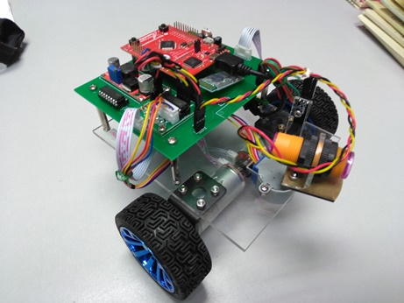
Motors
Our robot
DC motor with speed encoder

Slide 5
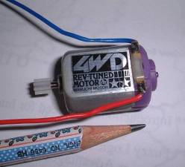
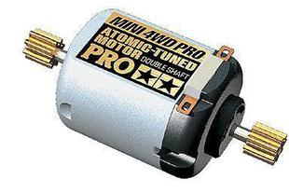
Small Direct Current D.C. motors
Speed (~ 1200-2000 rpm).
Operates on a 3~5Volt, Can use gear box (e.g. ratio 58:1) to increase torque
Use H-bridge circuit to boost up current from the TTL level to motor driving level.
田宫四驱车配件15351 PRO版专用双头马达 ,
picture from http://item.taobao.com/item.htm?id=1606576457&tracelog=newcardfavirate

Slide 6
Motor control chip
L293D: H-bridge circuit, up 2A
LDIR: left motor direction; RDIR: right motor direction
LEN : left motor enable; REN : right motor enable
H-bridge Chips
2 (1A) 1Y(3)
1(EN1/2)
7(2A) (2Y)6
10(3A) (3Y)11
9(EN3/4)
15(4A) (4Y)14
LEN
LDIR
REN
RDIR
Left-motor
Right-motor

Slide 7

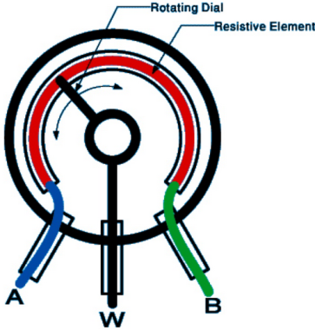

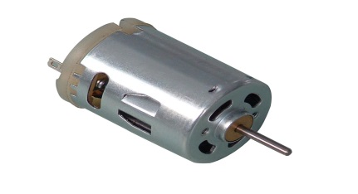
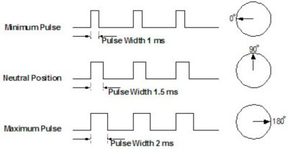
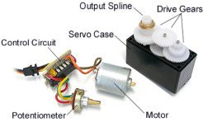
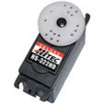
Servo motors (based on DC motor)
Can achieve rotational angle control
Application: robotics, target pointing
The motor shaft is attached to a rotational variable resistor (potentiometer)
When the motor rotation has adjusted the variable resistor to the correct rotational angle, the electronic circuits circuit stops the motor.
https://www.jameco.com/jameco/workshop/howitworks/how-servo-motors-work.html
https://electronicspost.com/describe-the-different-types-of-resistors/
** How do servo motors work: https://www.youtube.com/watch?v=J8atdmEqZsc
https://www.youtube.com/watch?v=hYu9fGE4pCk
Common control method
by adjusting pulse width
1-2ms→ 0-180º

Slide 8
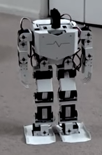
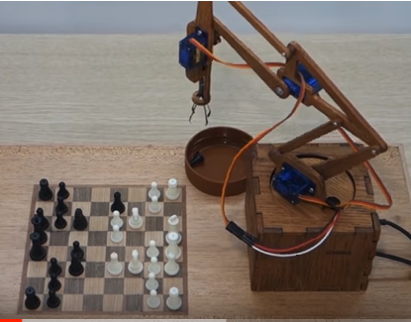
Use of servo motors
Making humanoid robots , or
Robot Arms
https://www.youtube.com/watch?v=n_1aVNnz9rA
https://www.youtube.com/watch?v=NZ6V63u_-D8

Slide 9
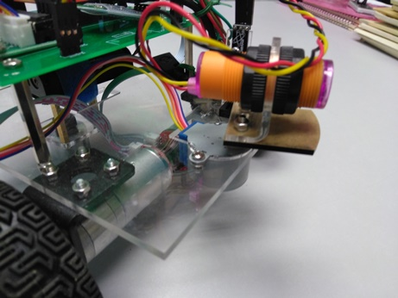
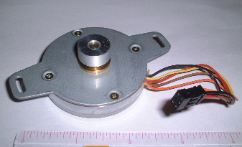
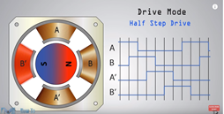

2) Stepping motor (stepper)
Stepping motors are good positional control motors used widely in digital controlled machineries such as digital arm-clocks, printers, disk drives etc.
The stepping motor in our robot
How does a stepping motor work?
https://www.youtube.com/watch?v=TWMai3oirnM
https://www.youtube.com/watch?v=eyqwLiowZiU

Slide 10
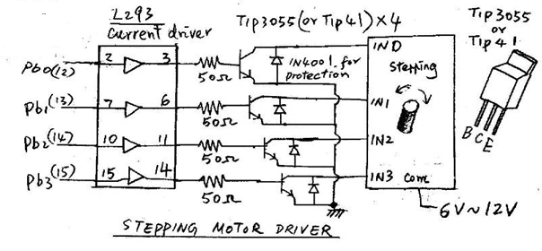
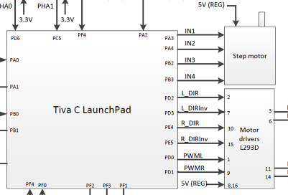
Stepping motor (4-phase) and Circuit
Digital outputs
Large current stepping motors need current drivers
Smaller current Stepping motors can be driven by modern microcontrollers directly by GPIO outputs

Slide 11
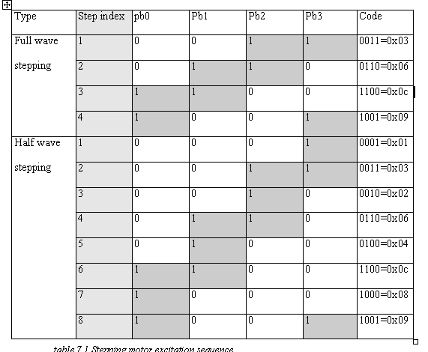
Stepping (stepper)motor control table

Slide 12
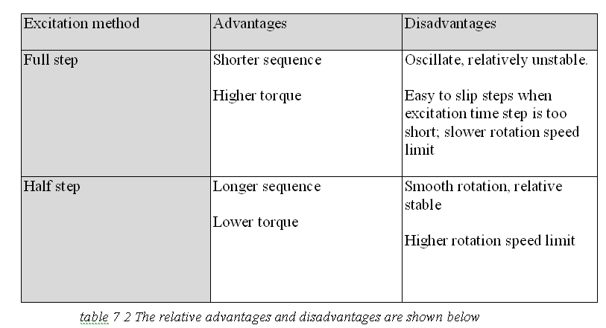
Control method comparisons

Slide 13
Use of stepping motor
Positional control of robot range scanner.
Ultrasonic
Radar system
on a rotational
platform
obstacle
Transmitter
Receiver
IR Distance sensor

Slide 14


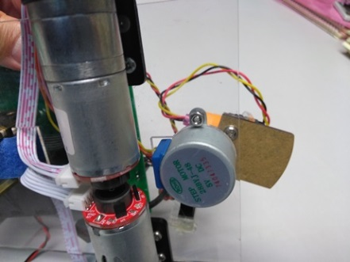
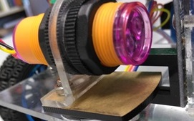
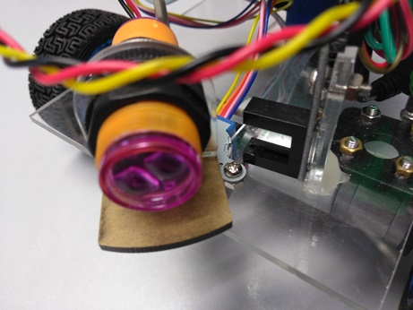
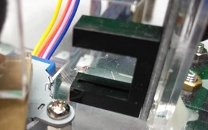
Stepping motor (stepper) in our robot
Infrared (IR) distnace Sensor,
stepper
For setting the angular positioning of an inferred (IR) distance sensor
Operation:
  First, at initialization, the stepper will be adjusted to the reference position (0 degree, the plate is blocking the Photo interrupter gap).
  Then, it can be rotated to θ_{t} degrees (with respect to the reference 0 degree)
stepper
Photo interrupter
LED emitter & sensor
The photo interrupter
θ_{t}

Slide 15
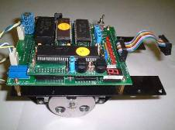
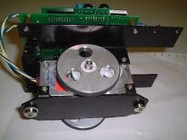
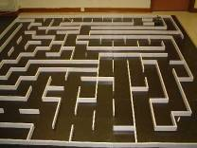
Other usage
Robot building, micro mouse

Slide 16
Stepping motor smooth control method
Control method
Rotating Speed
ω1
Sudden change of speed may result in step-slipping
Time
Rotating speed
ω1
Gradual change of speed will solve the step-slipping problem

Slide 17
3) open-loop and closed-loop control
Feedback control
PID theory and implementation

Slide 18
Open-loop motor control and its problems
Change motor supply power change speed
Problem: How much power is right?
  Ans: don’t know , depends on internal/external frictions of individual motors.
Problem: How to make the robot move straight?
How to control power (Ton) by ISR & an MCU?
  Solution: Use feedback control to read actual wheel:
  Slower, increase power (+ Ton)
  Faster, reduce power (- Ton)

Slide 19
Exercise
When using the open-loop control method with a constant PWM signal for both wheels, explain why the robot would slow down when climbing up hill.
  Ans: When climbing up hill, energy is used to act against gravity, hence the robot is running slower.

Slide 20
Feedback control
The real solution to read the real speed of the wheel and control the speed using feedback control
Require speed encoder to read back the real speed of the wheel at real time.

Slide 21
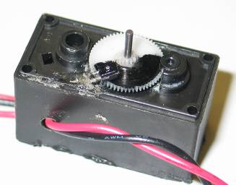
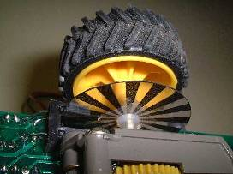
First you need to have speed encoders
Read wheel speed.
Use photo interrupter
Use reflective disk to save space
Based on interrupts

Slide 22
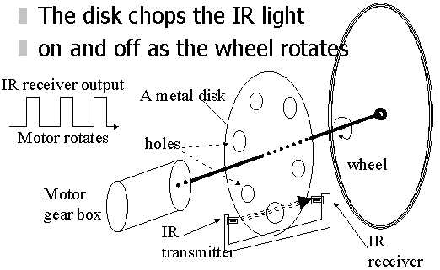
Wheel encoder
Our motor and
speed encoder
Each wheel rotation=
88 on/off changes
IR receiver
Darkened
part
blocks light
IR light source

Slide 23
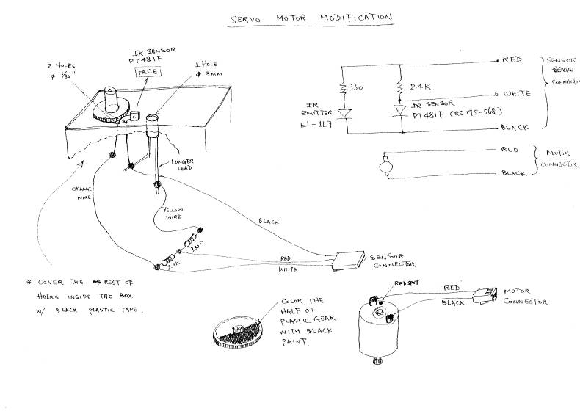

Slide 24
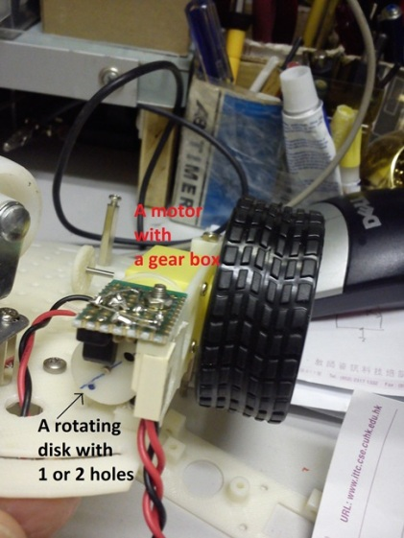
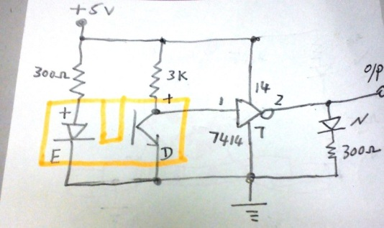
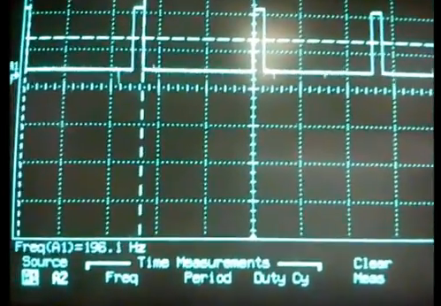
Exercise 1: (Fill in ?__)
Student ID: ___________,Date:_____________
Name: _______________CENG2400 , Ch 16 PID
The Gear ratio =(DC motor speed/wheel speed)=48, and the DC motor speed is 200 Rotations/Second
So the wheel is rotating at 200/48 ≈ 4 rotations/second.
If the disk has 1 hole, the pulse frequency is observed to have _200_?Hz.
Using the same setup , if the disk has 4 holes, the pulse frequency is _800____?Hz.
Wheel radius is r=0.033m, perimeter is 2*pi*0.033 m
The car is moving at 4 rotations per second=?___ 2*3.14*0.033 *4= 0.83 meters per second (at full speed, quite fast)
The speed encoder gives ?_800_Hz pulses.
66mm
This is when the disk has 1 hole.The waveform is 200 Hz
Data comes from
http://item.taobao.com/item.htm?spm=2013.1.0.116.KbMxbr&id=15172908917

Slide 25
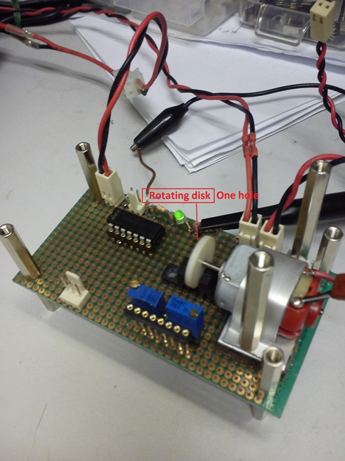
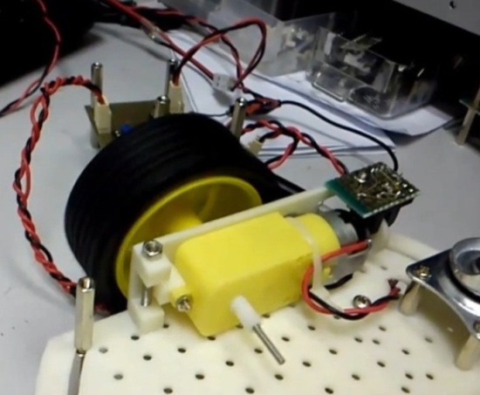


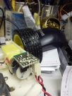

Speed encoder
田宫四驱车配件15351 PRO版专用双头马达 ,
picture from http://item.taobao.com/item.htm?id=1606576457&tracelog=newcardfavirate
Demo
movie

Slide 26
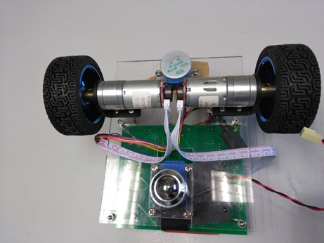
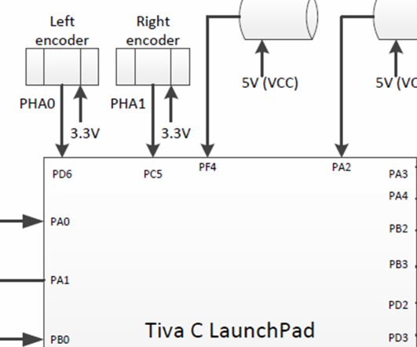
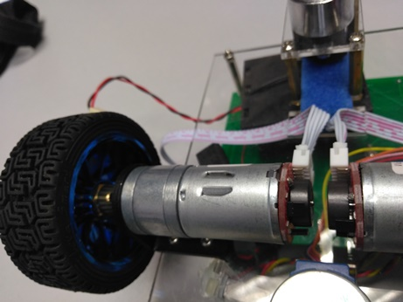
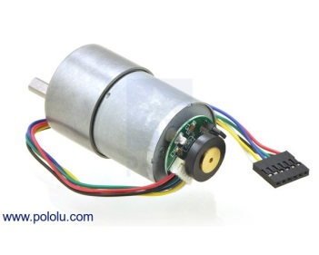
New speed encoder 2017
Only need two GPIO inputs (PD5,PC6)
Software requireddriver.lib http://www.ti.com/tool/SW-TM4C
And the functions are
  QEIPositionSet()
  QEIPositionGet(QEI0_BASE)
I.e.//Set GPIO pins for QEI. PhA1 -> PC5, PhB1 ->PC6.
GPIOPinTypeQEI(GPIO_PORTC_BASE, GPIO_PIN_5 | GPIO_PIN_6);
Speed encoders
Gear box, DC mtoro

Slide 27
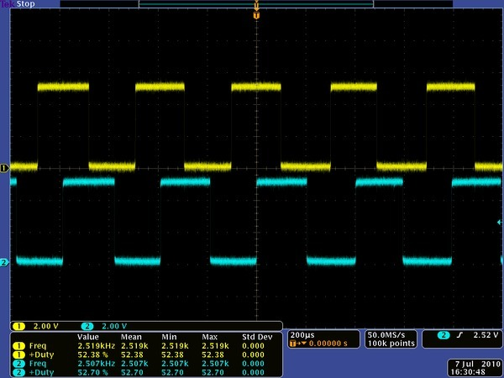
Speed encoder https://www.pololu.com/product/1443
When the encored rotates, pulses will be sent out
Your system program should read and encode the signals
Using the Encoder from https://www.pololu.com/product/1443
“A two-channel Hall effect encoder is used to sense the rotation of a magnetic disk on a rear protrusion of the motor shaft. The quadrature encoder provides a resolution of 64 counts per revolution of the motor shaft when counting both edges of both channels. To compute the counts per revolution of the gearbox output, multiply the gear ratio by 64. ”
For simplicity, our robot only uses one of the two signals

Slide 28
4) Control methods
I) Proportional feedback control
II) PID (proportional-integral-derivative) control

Slide 29
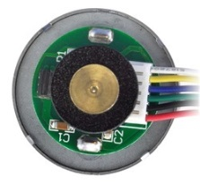
I) Proportional closed-loop feed back control system
Show the left motor control only
if (leftErr >deadband)
leftPWM increase by (Pgain * leftErr)
leftPWM
Required speed
=leftRPMset
leftErr
Motor
Alter PWM for driver L293
+
-
speed encored
leftRPM

Slide 30
II) PID (proportional-integral-derivative) control
A more formal and precise method
Used in most modern machines

Slide 31

control method:
PID (proportional-integral-derivative) control
integral control
Igain* leftErr dt
Motor
&
Required speed=
leftRPMset
wheel
Speed
encoder
leftPWM
Proportional control
Pgain*leftErr
generates PWM
for driver L293
+
-
leftErr
sum
Derivative control
Dgain*[d(leftErr)/dt]
leftPWM
LeftRPM
leftRPM

Slide 32
Introduction
Control for better performance
Use PID, choose whatever response you want
Too much overshoot/undershoot, not stable
Motor speed (w)
Good performance
Criteria depends
on users and
applications
required
Response too slow
time

Slide 33
Exercise 2: Values to evaluate a control system
Describe the terms in the following diagram
Do you want them to be large or small?
Steady
state
error
overshoot
Target
value
Typically
value=10%
Depends
on application
undershoot
0
Settling time
time
Rise time

Slide 34
Use of PID control terms are intertwined http://en.wikipedia.org/wiki/PID_controller
Kp (Pgain): Proportional Gain - Larger Kp typically means faster response since the larger the error, the larger the Proportional term compensation. An excessively large proportional gain will lead to process instability and oscillation.
Ki (Igain): Integral Gain - Larger Ki implies steady state errors are eliminated quicker. The trade-off is larger overshoot: any negative error integrated during transient response must be integrated away by positive error before we reach steady state.
Kd (Dgain): Derivative Gain - Larger Kd decreases overshoot, but slows down transient response and may lead to instability due to signal noise amplification in the differentiation of the error.

Slide 35
Effects of adjusting parameters http://en.wikipedia.org/wiki/PID_controller
Parameter | Rise Time | Overshoot | Settling Time | Steady state error
Kp (Pgain) | Decrease step1 | Increase | Small Change | Decrease
Ki (Igain) | Decrease | Increase | Increase | Eliminate step3
Kd (Dgain) | Small Change | Decrease step2 | Decrease | Small Change

Slide 36
Software
Demo2017.c
(at course webpage)
Old version: http://www.cse.cuhk.edu.hk/~khwong/www2/ceng2400/PIDRobotDemo093.c

Slide 37
PID control algorithm
PID control algorithm using interrupt
The main program and the Interrupt service routine (ISR) __Timer0IntHandler
Main( )
{
Setup( );
:
:
}
_Timer0IntHandler//1000Hz
{
intCnt++;
if intCnt==50;
{//PID core // will be run every 50ms
read wheel speed
PID control to adjust PWM
intCnt=0; //reset counter
}
…..
}

Slide 38
Overview
//////////////main //////////////////////////////////////
Main()
{ setup()
forward (Lstep, Rstep, Lspeed, Rspeed)…..
}
////////////subroutine //////////////////////////////////////////
forward (Lstep, Rstep, Lspeed, Rspeed)
{ lcount=0
if (lcount>=Lstep)
Stop left motor
…same for right motor…
.}
//////////timer triggered , interrupt service routine, 1000Hz///////
_Timer0IntHandler// Interrupt() running at 1000HZ
{ intCnt++;
if intCnt==50;
{//PID core // will be run every 50ms
read wheel speed
PID control to adjust PWM
intCnt=0; //reset counter
}
}
Interrupt
rate 1000Hz
_Timer0IntHandler
see next slide

Slide 39
Speed encoder interfacing
(show left motor only)
Block diagram
ARM7-microcontroller
Motor & speed encoder
1000Hz timer interrupt
/int0
CPU
encoder sensor)
GPIO
Parallel interface

Slide 40
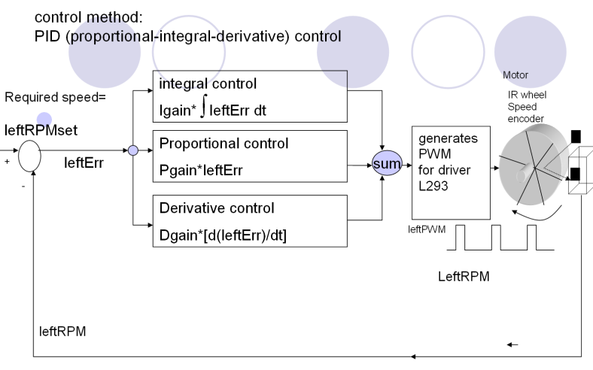
Exercise 3 (refer to Demo2017.c)
_irq interrupt programming method for the main PID loop, using a counter (intcount)
_Timer0IntHandler(void)//timer 1KHz,
{ intCnt++
if(intCnt ==50)
{ //So this PID core is updated at 20Hz (period =50ms)
read wheel speed
Control the PWM using PID (See next slide)
intCnt =0;// reset counter intCnt
}
}
Question: If he line “if(intCnt==50) “ is changed to “if(intCnt==100)”
What will happen to the PID core update period?
Answer: PID core is updated at 10Hz (period =100ms)

Slide 41
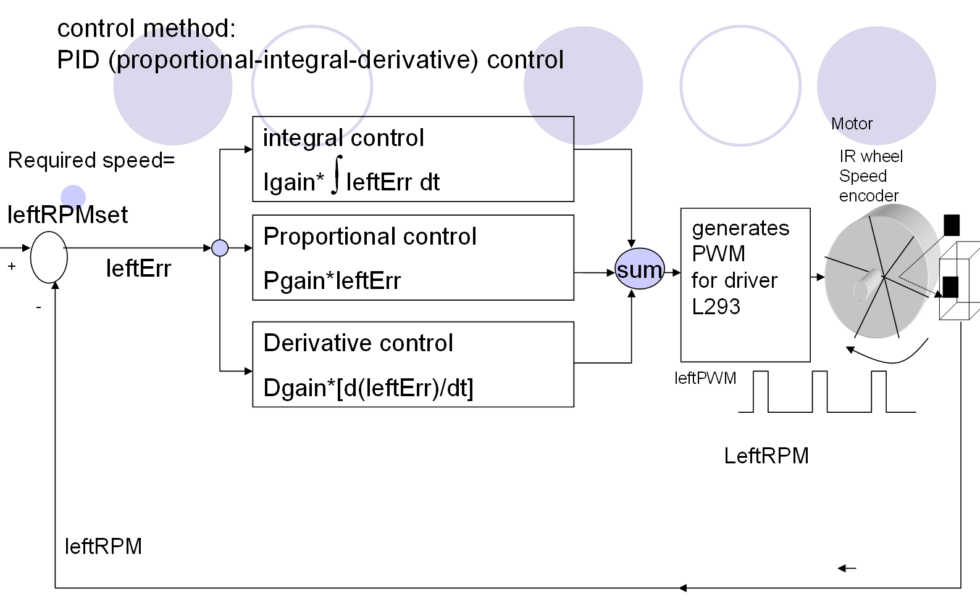
The interrupt service routine enables the loop to run 4 times in a second
Loop once in 50ms

Slide 42
Part 2 :Algorithm for PID core
Set_point
For every 50ms
  Find error=(desired value - measured value)
  {If (error>dead band )
    { find
      Error,
      Accumulated error (add up all previous errors)
      Derivative error (current error – previous error)
      PWM+=Kp* Error+
      Ka*(Accumulated error)+
      Kd* Derivative error ;
    }
    Else
      Error <= dead_band, error too small do nothing

Slide 43
part 2: PID core
PID core
if(intCnt==50) {//for every 20ms
//caculate the speed of left motor in RPM
leftRPM=lefttimeval;
leftErr = leftRPMset - leftRPM; //caculate left error
if((leftErr<DeadBand*(-1))||(leftErr>DeadBand)) //see next slide
{ //if |left error| > deadband
leftP = Pgain * leftErr; //calculate P Proportional term
leftI = Igain * leftaccErr; //calculate I Integral term
leftD = Dgain * (leftErr - leftlastErr); //calculate D Derivative term
leftPWM += (leftP + leftI + leftD);//update left motor PWM using PID
if(leftPWM>PWM_FREQ)
leftPWM=PWM_FREQ;//prevent over range (max.=PWM_FREQ)
if(leftPWM<0) leftPWM = 0; // (min. = 0)
leftaccErr += leftErr; // accumulate error
leftlastErr = leftErr; //update left last error
:
: // handle right motor similarly…….
}
P=Proportional
I Integral
D Derivative

Slide 44
control method:
PID (proportional-integral-derivative) control
integral control
Igain* leftErr dt
Motor
Required speed=
leftRPMset
IR wheel
Speed
encoder
leftPWM
Proportional control
Pgain*leftErr
generates PWM
for driver L293
+
-
leftErr
sum
Derivative control
Dgain*[d(leftErr)/dt]
leftPWM
LeftRPM
leftRPM

Slide 45
Inside the PID core, we will study these lines
5) if((leftErr<DeadBand*(-1))||(leftErr>DeadBand))
:
:
7) leftP = Pgain * leftErr; //calculate P Proportional term
8) leftI = Igain * leftaccErr; //calculate I Integral term
9) leftD = Dgain * (leftErr - leftlastErr);//calculate D Derivative term
10) leftPWM += (leftP + leftI + leftD);//update motorPWM by PID
:
:
14) leftaccErr += leftErr; // accumulate error

Slide 46
Dead band line5) if((leftErr<DeadBand*(-1))||(leftErr>DeadBand))
Dead-band : A Dead-band (sometimes called a neutral zone) is an area of a signal range or band where no action occurs :
only enable motor when leftErr> a small value (deadband, ie =1 in our robot )
Otherwise may oscillate when leftErr is small
leftErr = leftRPM - leftRPMset; //calculate left error
if(leftErr>DeadBand )
{ activate motor}
Dead-band

Slide 47
Exercise 4:
Discuss what will happen if dead-band is changed from 1 to (a) 0.5, or (b) 2.
Example of a dead band ;do nothing “if 10-1<leftPRM <10+1
In our example here
leftPWM=276000 at the beginning and
192800 at steady state
Steady
state
error
Dead band
+/- 1
overshoot
Target speed=
leftRPMset =10
Typically
value=10%
Depends
on application
undershoot
0
Rise time
Settling time
time

Slide 48
Recall:Parameters for evaluating a control system
near steady state
See next slide
Steady
state
error
overshoot
Target
value
undershoot
Typically
value=10%
Depends
on application
0
Settling time
time
Rise time

Slide 49
(line 7) Effects of increasing Kp(P) http://en.wikipedia.org/wiki/PID_controller
Parameter | Rise Time | Overshoot | Settling Time | Steady state error
(1) Kp (Pgain) | Decrease step1 | Increase | Small Change | Decrease
Ki (Igain) | Decrease | Increase | Increase | Eliminate step3
Kd (Dgain) | Small Change | Decrease step2 | Decrease | Small Change

Slide 50
Example: t0→t1, The proportional term when the measurement is below the set point (leftRPMset), proportional P term is +ve
Usage of the P proportional term
For each 50ms, a new
left RPM (speed of wheel) is measured
(leftErr = leftRPMset-leftRPM )
overshoot
Target speed=
leftRPMset =10
8
e.g.
Pgain = 8000;
Igain = 6000;
Dgain = 5000;
6
undershoot
leftErr=
leftRPMset –
leftPRM
=30-28=2
leftErr=
leftRPMset –
leftPRM
=10-6=4
P is
+ve
P is
+ve
In our experiment
leftPWM=276000 at the
beginning and
192800 at steady state
0
t1
t2
t3
t4
time
Rise time
leftP = Pgain * leftErr;
leftP= 8000* (10-6)= 8000*4 is positive
This term pushing up “leftPWM”
(more energy delivered to the wheel).
leftP = Pgain * leftErr;
leftP= 8000* (0-8)= 8000*2 is positive
This term pushing up “leftPWM”
(more energy delivered to the wheel).

Slide 51
Exercise 5: Fill in ?__: t0→t1, The proportional term when the measurement is below the set point (leftRPMset), proportional P term is +ve
Usage of the P proportional term
For each 50ms, a new
left RPM (speed of wheel) is measured
overshoot
Target speed=
leftRPMset =10
8
e.g.
Pgain = 8000;
Igain = 6000;
Dgain = 5000;
6
undershoot
leftErr=
leftRPMset –
leftPRM
=10-8=2
leftErr=
leftRPMset –
leftPRM
=10-6=4
P is
+ve
P is
+ve
In our experiment
leftPWM=276000 at the
beginning and
192800 at steady state
0
t1
t2
t3
t4
time
Rise time
leftP = Pgain * leftErr;
leftP= 8000* (10-6)= 8000*4 is positive
This term pushing up “leftPWM”
(more energy delivered to the wheel).
leftP = Pgain * leftErr;
leftP=?_8000*2____ ,is +ve ?
“leftPWM” is increased or decreased? increase
more/less energy delivered to wheel? more

Slide 52
Example: t1→t3,The proportional term when the measurement is below the set point (leftRPMset), the proportional P term is +ve
P is
-ve
Usage of the P proportional term
For each 50ms, a new
left RPM (speed of wheel) is measured
overshoot
13
Target speed=
leftRPMset =10
leftErr=
leftRPMset –
leftPRM
=10-13= -3
e.g.
Pgain = 8000;
Igain = 6000;
Dgain = 5000;
undershoot
P is
+ve
In our experiment
leftPWM=276000 at the
beginning and
192800 at steady state
0
t1
t2
t3
t4
Rise time
time
leftP = Pgain * leftErr;
leftP= 8000* (10-13)= 8000*(-3) is negative
This term lowering down “leftPWM” (less energy delivered to the wheel).

Slide 53
Understanding PID –a little summary for the P proportional term
When the measurement is below the set point (leftRPMset)
  The motor is currently too slow
  The P term calculated is +ve, need to push the speed higher
When the measurement is above the set point (leftRPMset)
  The motor is running too fast
  The P proportional term is -ve, lowering down the speed.
Increase in Pgain (Kp) will decrease rise time (meaning faster to reach set point) , decrease steady state error (study it later)
  It also increases overshoot

Slide 54
(line 9 ) Effects of increasing Kd (D) http://en.wikipedia.org/wiki/PID_controller
dx/dt
Parameter | Rise Time | Overshoot | Settling Time | Steady state error
Kp (Pgain) Igain | Decrease step1 | Increase | Small Change | Decrease
Ki (Igain) gainI | Decrease | Increase | Increase | Eliminate step3
Kd (Dgain) | Small Change | Decrease step2 | Decrease | Small Change
dx/dt

Slide 55
Derivative term
Derivative control
  Dgain*[d(leftErr)/dt]
d(leftErr)/dt =
  =Derivative term
  =current_Err - last_Err
  =leftErr – leftlastErr ; in our program

Slide 56
Example: time 0→ t1, the Derivative term (=current-previous) When the measurement is rising, the Derivative term is -ve
Target
Value=
leftRPMset
=10
¼ seconds
Usage of the D Derivative term
For each 50 ms, a new
left RPM (speed of wheel) is
measured
overshoot
leftRPMset =10
leftErr=
leftRPMset –
leftPRM
=10-7=3
e.g.
Pgain = 8000;
Igain = 6000;
Dgain = 5000;
7
undershoot
leftlastErr=
leftRPMset –
eftlastPRM
=10-3=7
3
D is
-ve
In our experiment
leftPWM=276000 at the
beginning and
192800 at steady state
0
t1
t2
t3
t4
Rise time
time
leftD = Dgain * (leftErr – leftlastErr);
leftD= 5000* (3-7)= 5000*( -4) is negative
To do:This term lowering down “leftPWM” (less energy delivered to the wheel).

Slide 57
Example: time t1→t2, the Derivative term
When the measurement is rising, the Derivative term is -ve
leftErr=
leftRPMset -leftPRM
=10-15= -5
¼ seconds
Usage of the D Derivative term
For each 50 ms, a new
left RPM (speed of wheel) is
measured
leftPRM
overshoot
15
12
leftRPMset =10
leftlastErr=
leftRPMset -leftlastPRM
=10-12= -2
e.g.
Pgain = 8000;
Igain = 6000;
Dgain = 5000;
undershoot
D is
-ve
D is
-ve
In our experiment
leftPWM=276000 at the
beginning and
192800 at steady state
0
t1
t2
t3
t4
time
Rise time
leftD = Dgain * (leftErr – leftlastErr);
leftD= 5000* (-5- (-2))= 5000*(-3) is negative
This term lowering down
“leftPWM” (less energy delivered to the wheel).

Slide 58
Little Summary: Negative D Derivative term
When the measurement (leftRPM) is rising, the change (change= current-previous) of error (error = setpoint-leftRPM ) is -ve = d(Err/dt)=-ve
D Derivative term= Kd*d(Err/dt) is –VE
Decrease energy to motor → decrease overshoot
overshoot
Setpoint
目標
undershoot
D is
-ve
D is
-ve
0
t1
t2
t3
t4
time
Rise time

Slide 59
Example: time t2→t3, the Derivative term
When the measurement is falling, the Derivative term is +ve
¼ seconds
Usage of the D Derivative term
For each 50ms, a new
left RPM (speed of wheel) is
measured
leftPRM
overshoot
14
11
leftRPMset =10
leftlastErr=
leftRPMset -leftlastPRM
=10-14= -4
undershoot
leftErr=
leftRPMset -leftPRM
=10-11= -1
D is
-ve
D is
+ve
e.g.
Pgain = 8000;
Igain = 6000;
Dgain = 5000;
D is
-ve
0
t1
t2
t3
t4
time
Rise time
In our experiment
leftPWM=276000 at the
beginning and
192800 at steady state
leftD = Dgain * (leftErr – leftlastErr);
leftD= 5000* (-1- (-4))= 5000*3 is positive
This term pushing up
“leftPWM” (more energy delivered to the wheel).

Slide 60
Exercise 6:Fill in ?_ time t2→t3, the Derivative term
When the measurement is falling, the Derivative term is +ve
¼ seconds
Usage of the D Derivative term
For each 50ms, a new
left RPM (speed of wheel) is
measured
leftPRM
overshoot
leftRPMset =10
9
7
undershoot
D is
+ve
leftErr=
leftRPMset -leftPRM
=10-7= 3
leftlastErr=
leftRPMset -leftlastPRM
=10-9= 1
D is
-ve
D is
+ve
D is
-ve
e.g.
Pgain = 8000;
Igain = 6000;
Dgain = 5000;
0
t1
t2
t3
t4
time
Rise time
In our example
leftPWM=276000 at the
beginning and
192800 at steady state
leftD = Dgain * (leftErr – leftlastErr);
leftD= ?5000*(3-1), which is +ve or –ve? +ve
“leftPWM” increased or decreased?_increase_
More/less energy delivered to the wheel?_more__

Slide 61
Little Summary: Positive D Derivative term
When the measurement (leftRPM) is falling, the change (change= current-previous) of error (error = setpoint-leftRPM ) is +ve
D Derivative term= Kd*d(Err/dt) is +VE
Increase energy to motor → decrease undershoot
overshoot
Setpoint
目標
undershoot
D is
+ve
D is
+ve
0
t1
t2
t3
t4
time
Rise time

Slide 62
Understanding PID –a little summary for the D derivative term
When the measurement (leftRPM) is rising,
  The motor is gaining speed
  The D derivative term is –ve, so lowering the motor speed → decrease overshoot
When the measurement (leftRPM) is falling,
  The motor is reducing speed
  The Derivative term is +ve, so pushing the motor speed higher → decrease undershoot
  In conclusion, the gradient of the error (Err) determines the adjustment. Depends on whether d(Err)/dt is +ve or –ve.
Increase in Dgain (Kd) will decrease overshoot/undershoot and settling time (system more stable)

Slide 63
(line 8)Effects of increasing Ki (I) http://en.wikipedia.org/wiki/PID_controller
Parameter | Rise Time | Overshoot | Settling Time | Steady state error
Kp (Pgain) | Decrease step1 | Increase | Small Change | Decrease
Ki (Igain) | Decrease | Increase | Increase | Eliminate step3
Kd (Dgain) | Small Change | Decrease step2 | Decrease | Small Change

Slide 64
control method:
PID (proportional-integral-derivative) control
integral control
Igain* leftErr dt
Motor
Required speed=
leftRPMset
IR wheel
Speed
encoder
leftPWM
Proportional control
Pgain*leftErr
generates PWM
for driver L293
+
-
leftErr
sum
Derivative control
Dgain*[d(leftErr)/dt]
leftPWM
At steady state, leftErr→0, so
So, Pgain*leftErr=0
also Dgain*[d(leftErr)/dt] =0
And if no Integral { Igain* leftErr dt} term, left PWM →0
It is a problem.
LeftRPM
leftRPM

Slide 65
Time → near steady state leftRPMset=leftRPM hence leftErr =0, leftlastErr=0→ leftP=0, leftD=0
In our experiment
leftPWM=276000 at the
beginning and
192800 at steady state
e.g.
Pgain = 8000;
Igain = 6000;
Dgain = 5000;
leftErr = leftRPMset – leftRPM=0
So as leftlastErr = 0
Therefore
Steps
7) leftP = Pgain * leftErr//=0 //calculate P Proportional term
8) leftI = Igain * leftaccErr; //calculate I Integral term
9) leftD = Dgain * (leftErr - leftlastErr)//=0 //calculate D Derivative term
10) leftPWM += (leftP + leftI + leftD);//update left motor PWM using PID
The only valid term is the integral term “leftI”
leftPWM += leftI
The main idea is to create a small term (leftI) to maintain the leftPWM value
near steady state : leftP=0 leftD=0

Slide 66
The integral term is found by adding all previous errors same as leftaccErr=sum{leftErr(t=0)+leftErr(t=1)+.. +leftErr(t=now)}
14) leftaccErr += leftErr;//LeftaccErr is the summation of all previous errors
8) leftI=Igain*leftaccErr// integral term,
:
10) leftPWM += leftI // near steady state, only leftI is valid
:
Don’t worry it will not become infinitive, one measure to safeguard this is:
  11) if(leftPWM>PWM_FREQ);// PWM_FREQ=maximum PWM allowed
  12) leftPWM=PWM_FREQ;//prevent over range
  (max.=PWM_FREQ)
Also, because near steady state , leftaccErr will adjust itself automatically, see next slide
e.g.
Pgain = 8000;
Igain = 6000;
Dgain = 5000;
In our experiment
leftPWM=276000 at the
beginning and
192800 at steady state

Slide 67
How the integral term adjusts itself automatically near steady state
Pgain = 8000;
Igain = 6000;
Dgain = 5000;
Near steady state
  8) leftI=Igain*leftacceErr
  10) leftPWM += leftI
If measured speed (leftRPM) > set point
  leftErr is -ve
  leftaccErr (Acculumation) decreases, hence reducing leftaccErr at a suitable value to maintain leftPWM
If measured speed (leftRPM) < set point
  leftErr is +ve
  leftaccErr (Acculumation) increases, hence increasing leftaccErr at a suitable value to maintain leftPWM
In our experiment
leftPWM=276000 at the
beginning and
192800 at steady state

Slide 68
Understanding PID –a little summary for the I Integral term
When the measurement is below the set point (leftRPMset)
  The motor is slow
  The I Intergral term is +ve, pushing the speed higher
When the measurement is above the set point (leftRPMset)
  The motor is running too fast
  The I intergral term is -ve, lowering down the speed.
Increase in Igain (Ki) will result in
  It is similar to the P term (see above two points)
  So increase overshoot, settling time
  and decrease rise time
  Note: the main function of Integral control is to reduce steady state error

Slide 69
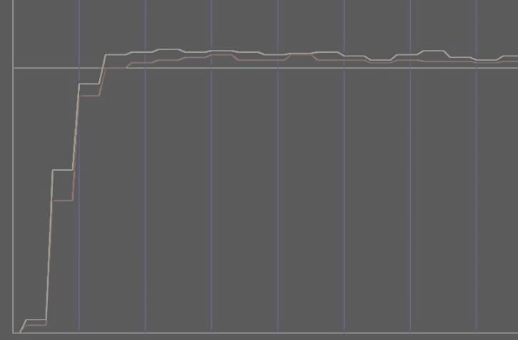
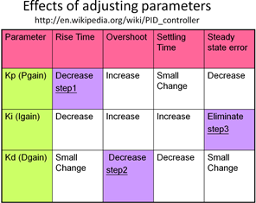
PID Tuning (usually done by trail and error)
Right motor speed
Left motor speed
Desired speed (target)
Tuning PID (adjust manually)
Adjust PID constants:
  Set motor to move from 0 to speed V1 ,
  step1) Pgain proportional_gain (Kp), record 5 seconds of the speed, plot result and evaluate performance
  step2) Dgain derivative_gain (Kd), record 5 seconds of the speed, plot result and evaluate performance
  step3) Igain integral_gain (Ki), record 5 seconds of the speed, plot result and evaluate performance
Repeat steps1,2,3 again until satisfied
Typical good performance we want:
  Short rise time
  Small overshoot/undershoot
  Short settling time
  Small steady state error

Slide 70
Application of
PID

Slide 71
Exercise 16.7: Robot Turning
(for smooth circular turns around 90-degree corners) http://micromouse.cannock.ac.uk/dynamics/smoothcorners.htm
Required speed V (meters per minute) – measure at center of the robot
Turning radius R (meters), from a point C to robot center
Wheel diameter = a (meters)
Use similar triangle
V1/(R+D/2)=V/R
V1=V+(VD)/2R
(a) Write V2 in terms of V,D, and R
(b) If wi=rotations per
minute of wheel I (i=1 or 2),
write w1 and w2 in terms of R,V,D,a
V1 V V2
a
C
D/2 D/2
R
D
C
smooth circular turn

Slide 72
Exercise 16.8 (take home exercise)
Why PID control is good control method?
Describe a PID control system for keeping the water to be at 23 degrees Celsius.
Discus what are the uses of Proportional , Integration, and Derivation in the above application.

Slide 73
Summary
Studies PID control theory and implementation
Learn how to tune PID systems

Slide 74
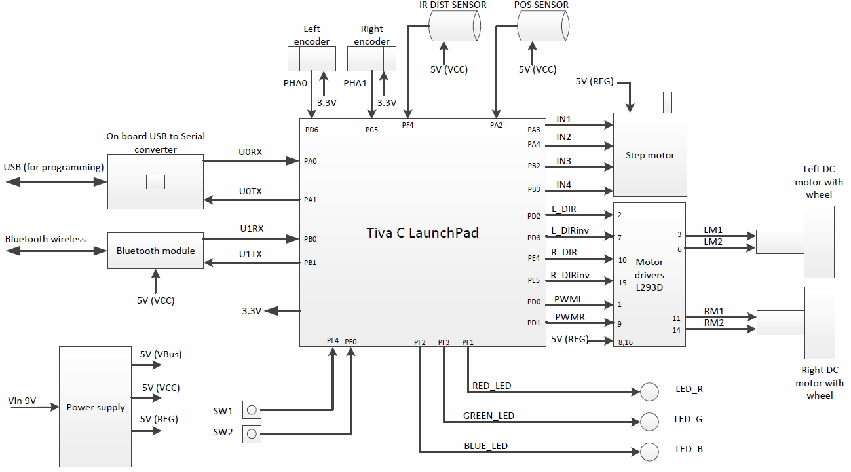
Appendix
Block diagram of our robot control system

Slide 75
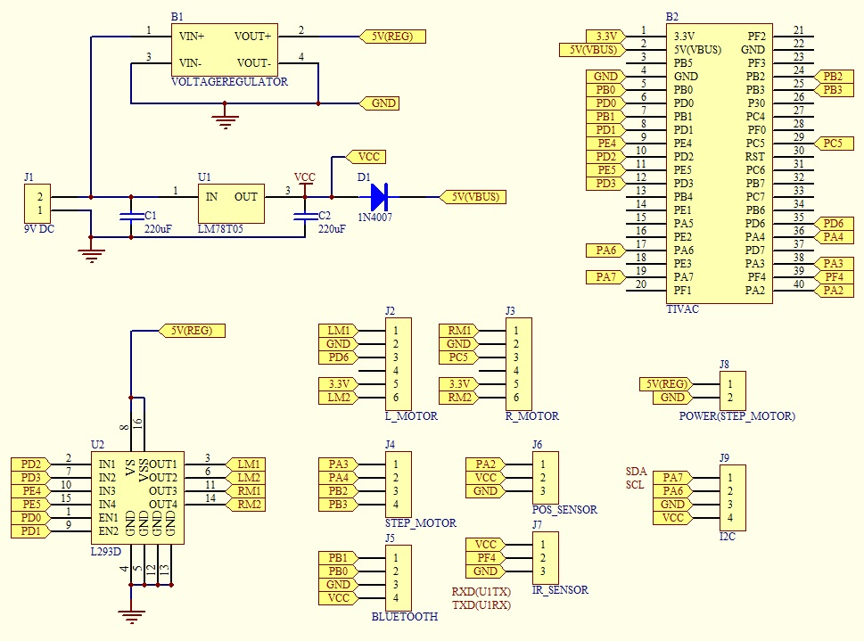
The schematic of the robot control system

