Slide 1
CENG3430 Tutorial 1
Introduction to Vivado

Slide 2
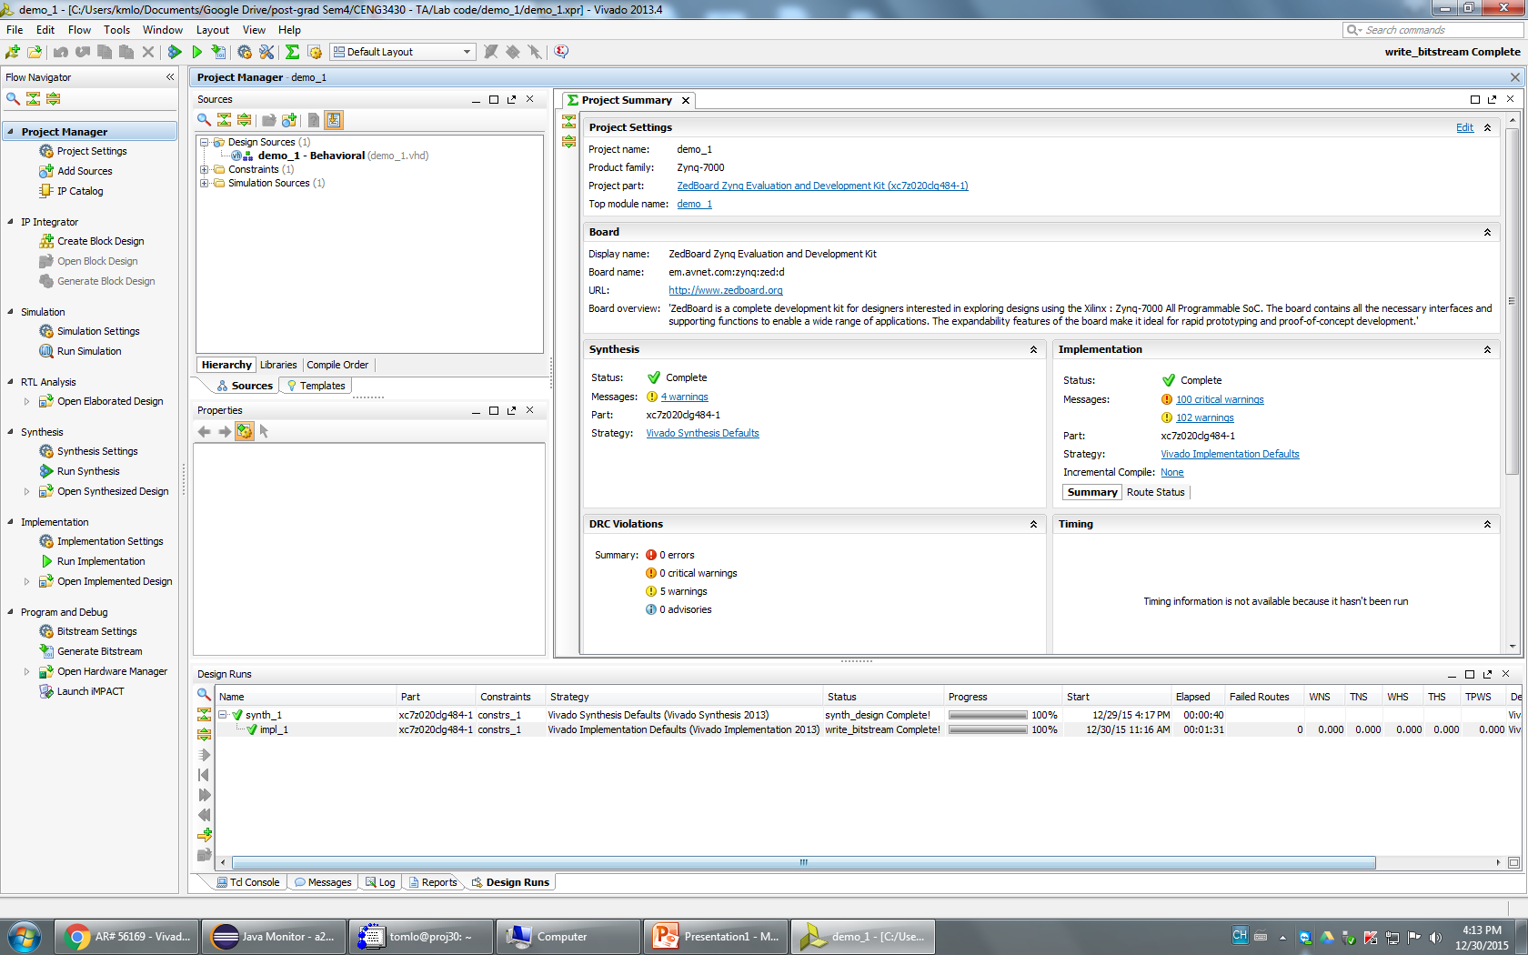
Vivado
Programming using IDE for VHDL / Verilog
Download the compiled code to FPGA board

Slide 3
Step 1: Start the software
Double click the Vivado icon in the desktop
Or start from the Start Menu

Slide 4

Step 2: Create a new project
Or Click File -> New Project…

Slide 5
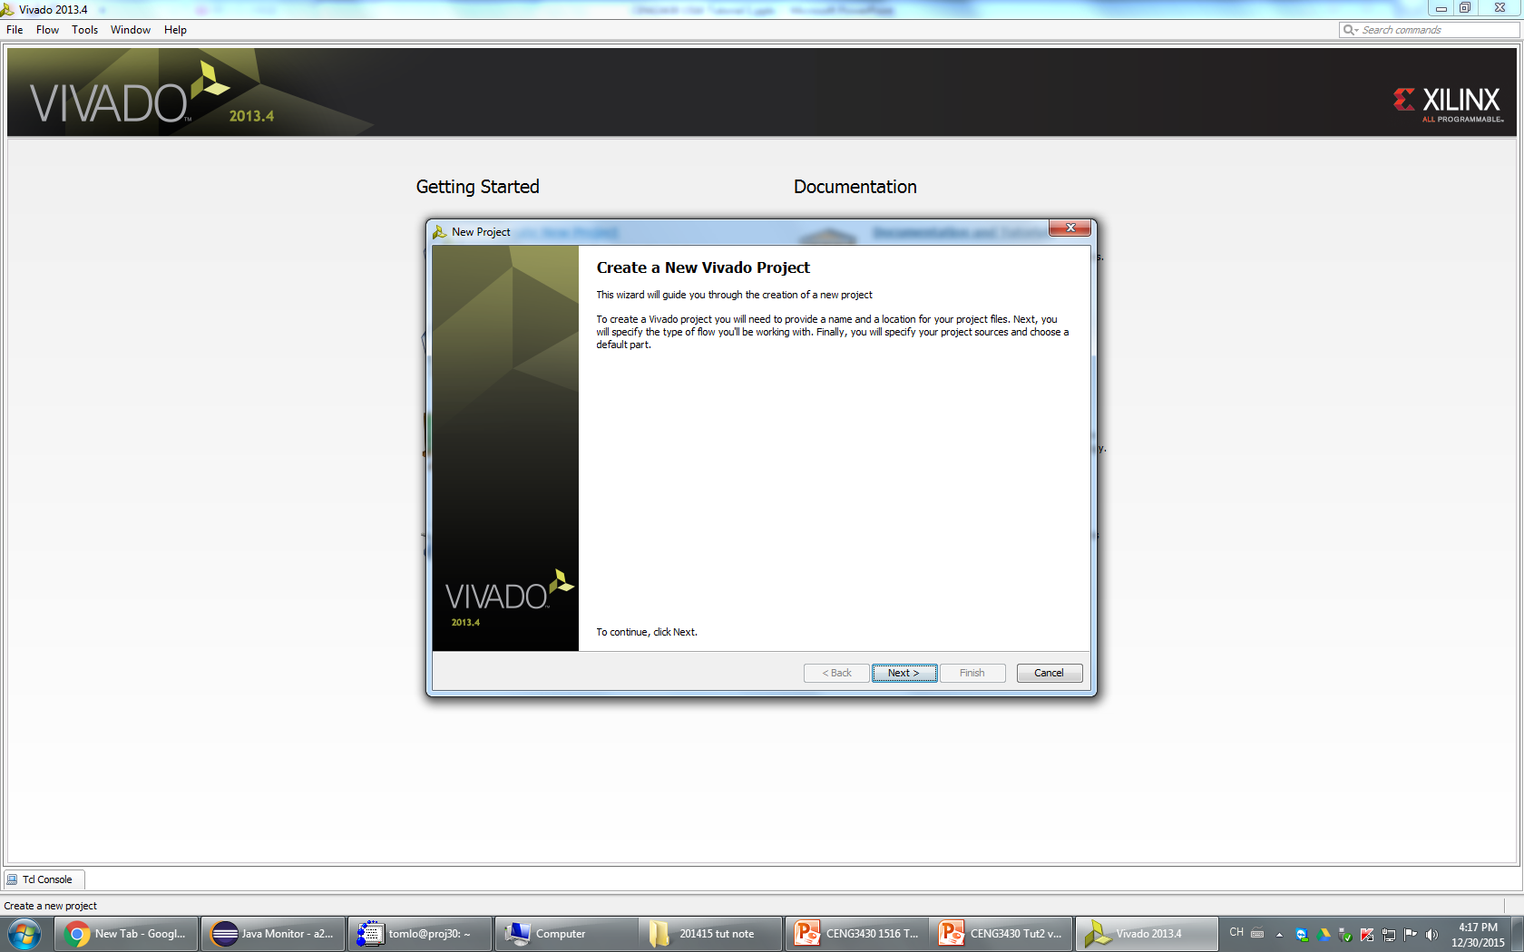
Step 3 : Click Next

Slide 6
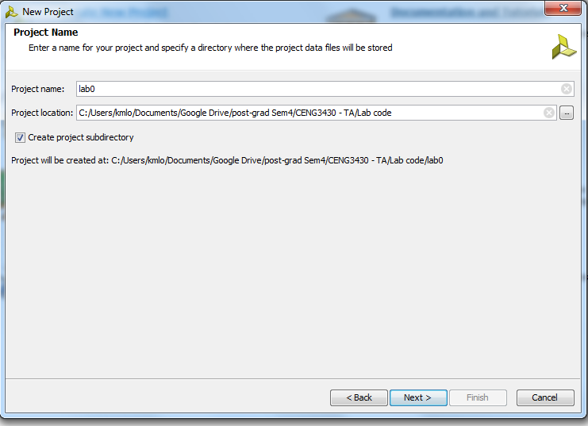
Step 4: Enter the project name
Select the project location for storage

Slide 7
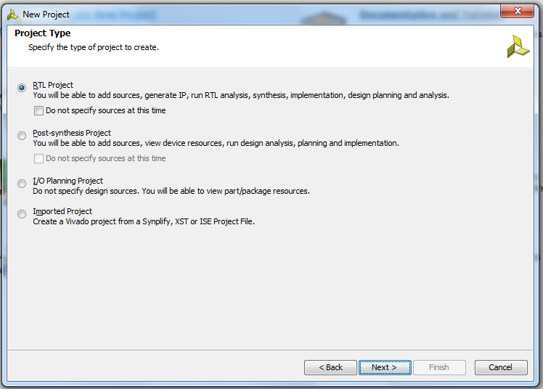
Step 5: Select RTL Project -> Next

Slide 8
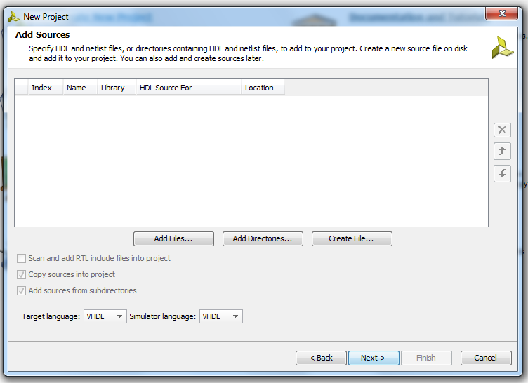
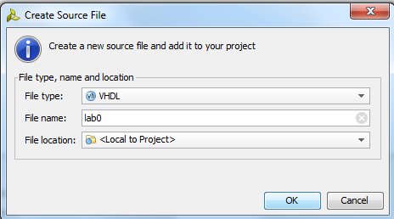
2
1
↑3
Step 6:
1. Select Target language and simulator language as “VHDL”
2. Click “Create File”
Make sure the File type is VHDL
Give name to the source file
Click OK
3. Click Next

Slide 9
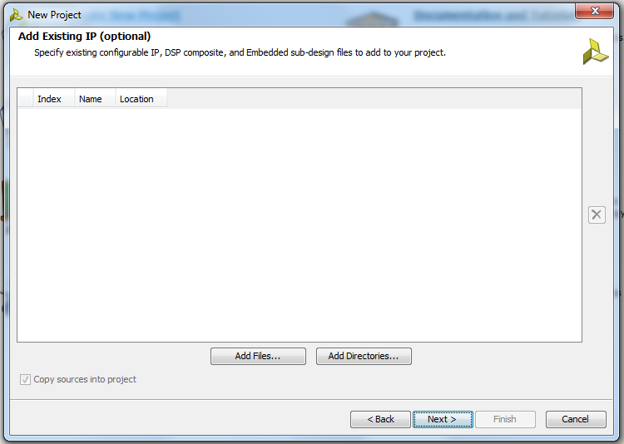
Step 7: Click Next

Slide 10
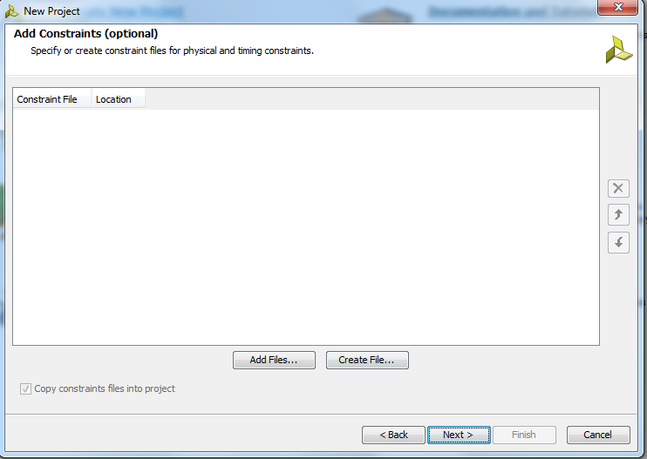
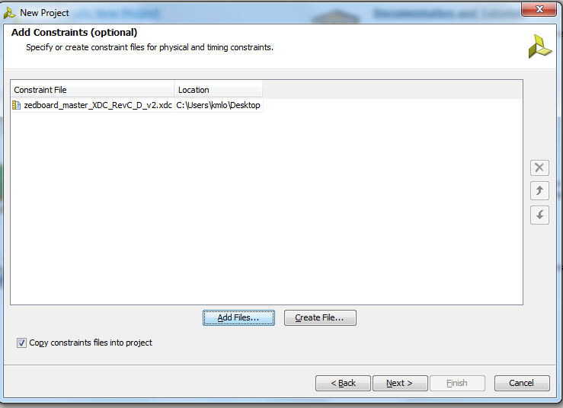
Step 8: Click Add Files, select the downloaded XDC file
Press Next or Press Next if no XDC file

Slide 11
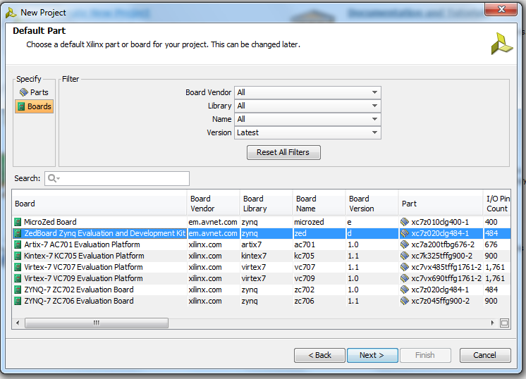
Step 9: Click Boards -> Select Zedboard -> Click Next

Slide 12
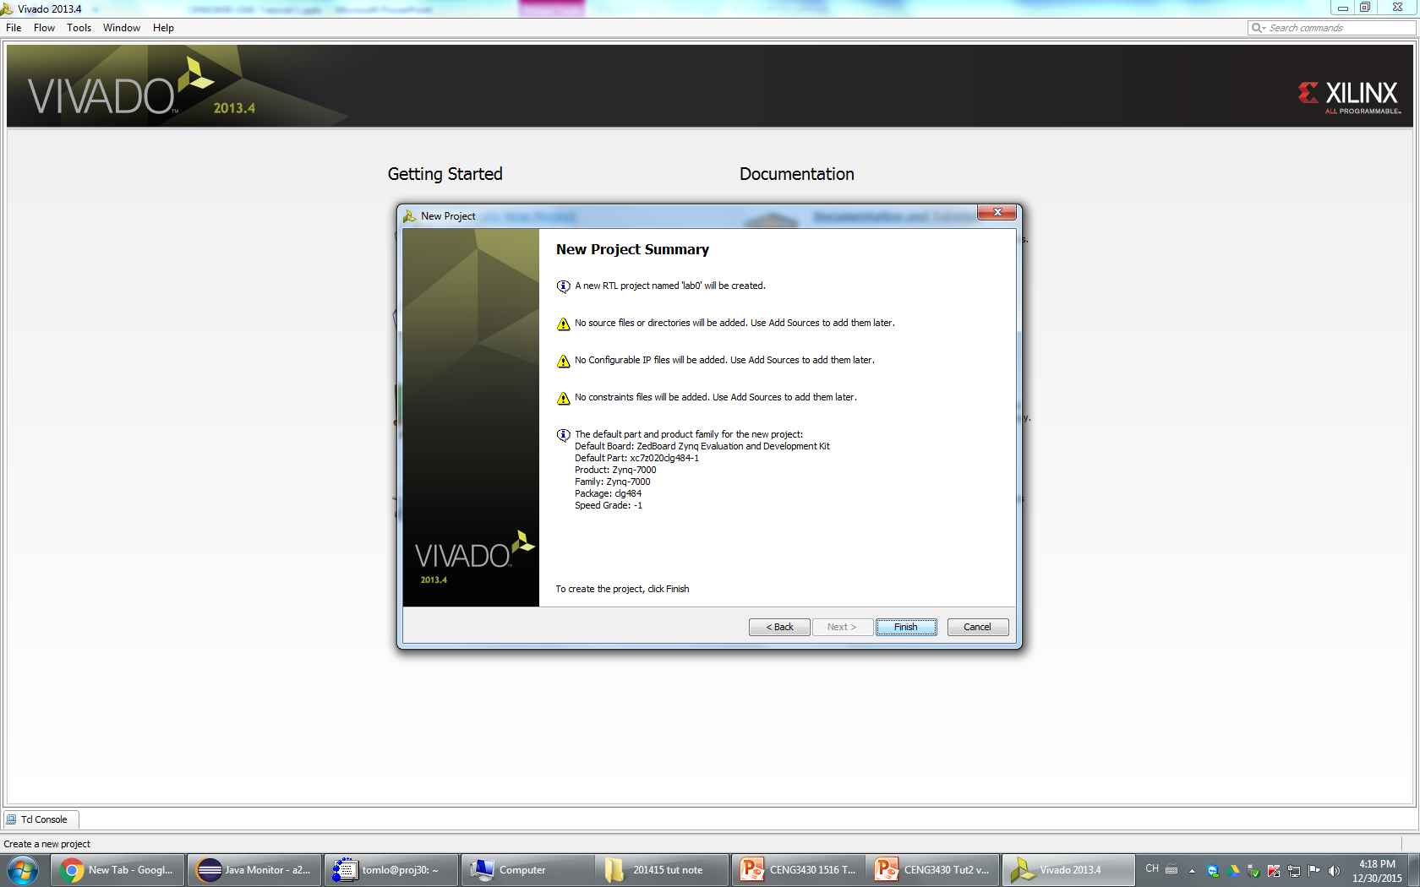
Step 10: Click Finish

Slide 13
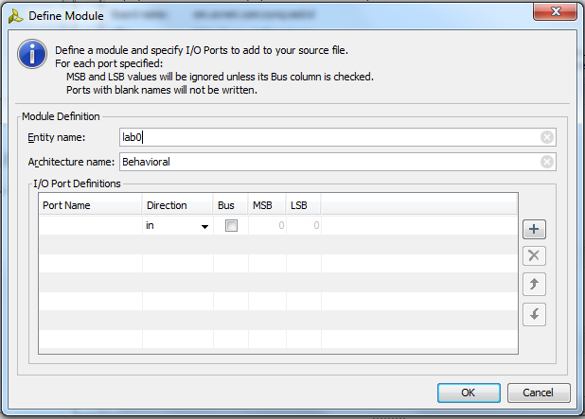
Step 10: If you see this box, just click OK

Slide 14
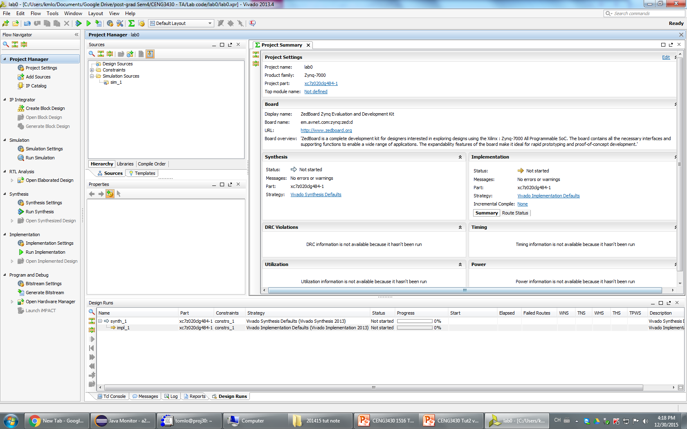
Now we can start writing our code
This is the programming interface :
Code writing area
Source directory
Select different tools
Shows the IDE status / warning / error message

Slide 15
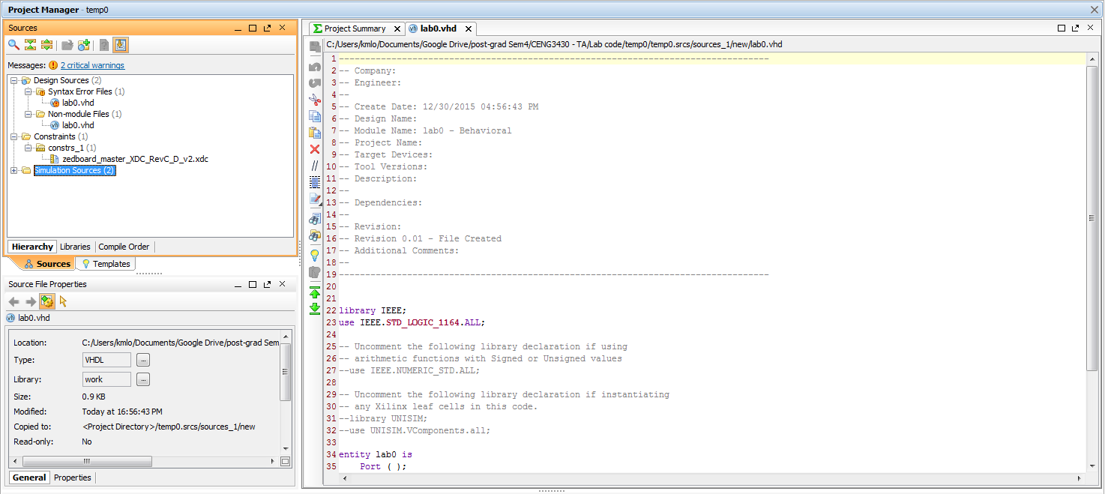
In the source directory, you will see the source file created in Step 6.
Double click to open it.
(It is normal to see the file name appears twice in syntax error files and non-module file if the source code is empty or has syntax error)

Slide 16
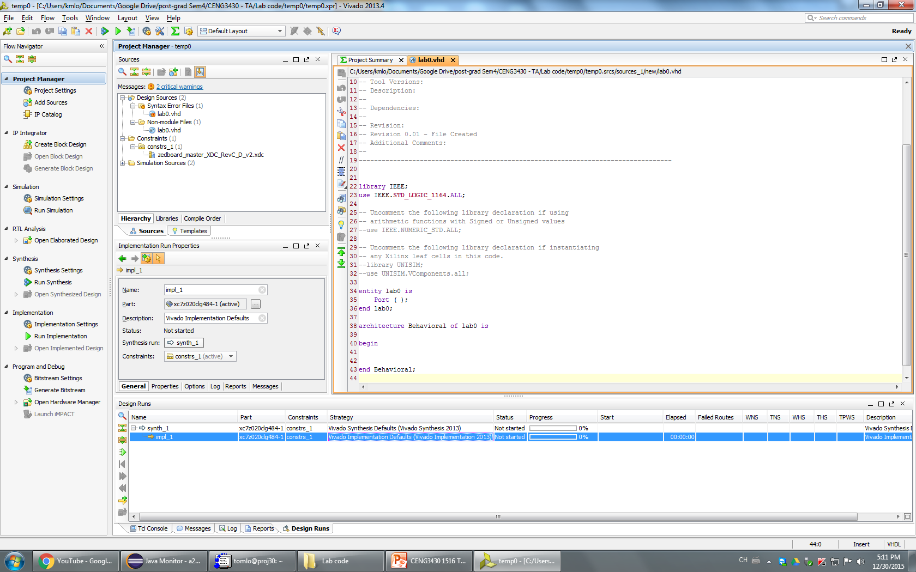
Copy the code downloaded file eLearning

Slide 17
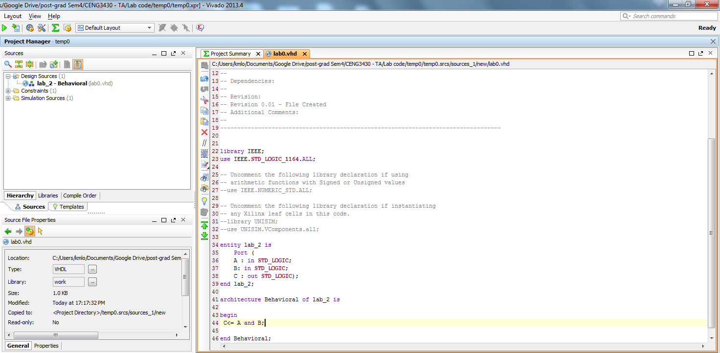
After saving the code, the source directory should look like this

Slide 18
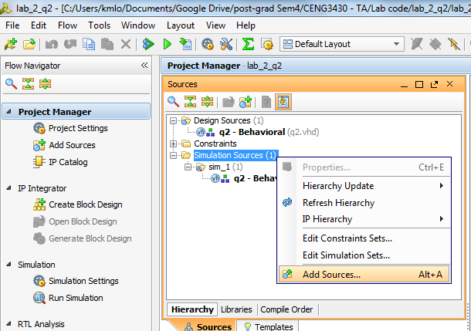
How to write a testbench?
After finishing your source code
Under the source window, right click on the simulation sources
-> Add sources

Slide 19
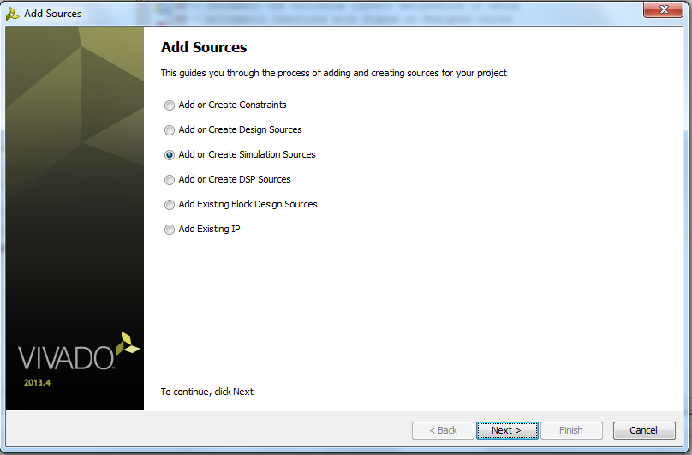
Select “Add or Create Simulation Sources” -> Next

Slide 20
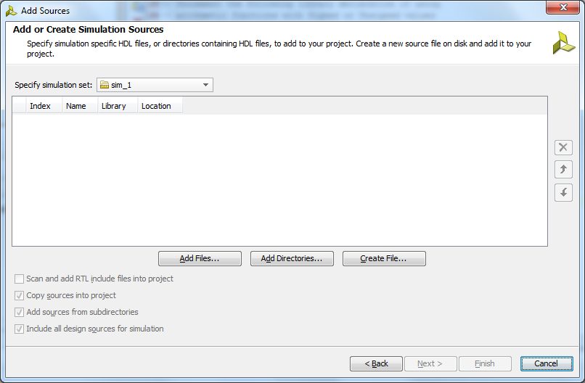
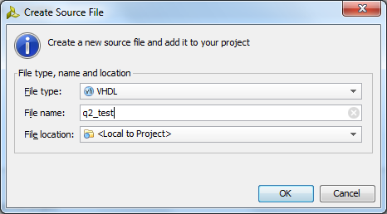
1.
2
4
3
Click “Create File” -> Get the testbench a name
(Usually same name with your source code, adding _test as postfix)
-> “OK”->”Finish”

Slide 21
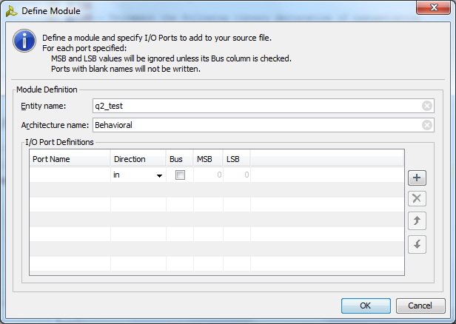
If you see this window, just click OK

Slide 22
Generating testbench file
In Vivado, the testbench file will not generate automatically
(But the older software can do that… )
Go to http://vhdl.lapinoo.net/
Paste your main board source code on it, the website will generate the testbench file for you
Copy the generated content, replace all content in the Vivado testbench file

Slide 23
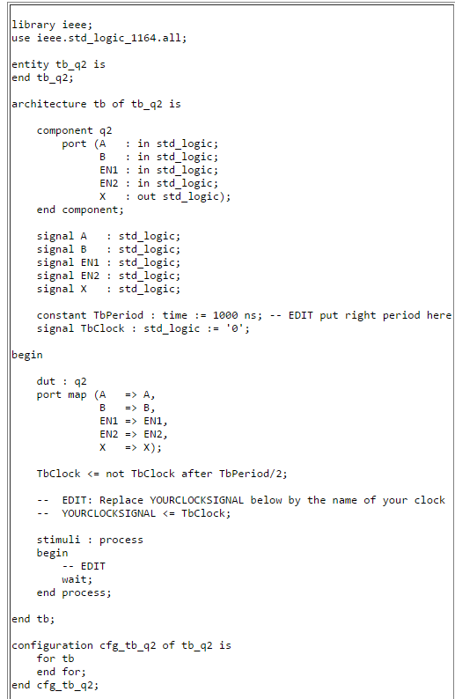
Unfortunately, the generated content have to modify before we execute…
Change the name, to match the name of testbench if you like
This must be the entity name of the design you are trying to test. You first turn it into a component and test it
For example :
A <= '0';
EN0 <= '0';
wait for 100 ns;
A <= '1';
EN1 <= '0';
wait for 100 ns;
Which means you force a constant 0 to A / EN0 for 100ns
After that, you force a constant 1 to A / 0 to EN0 for 100ns
<-Add your test case here
“end tb;” change to “end;”
Remove those line

Slide 24
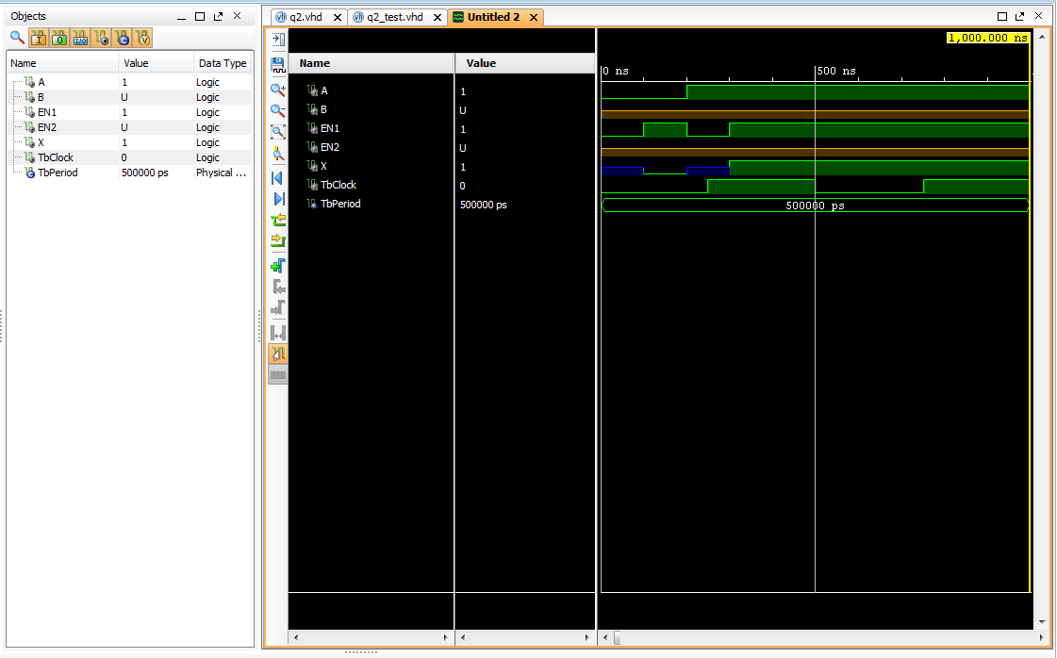

Now you can run simulation
Flow Navigator->Run Simulation->Run Behavioral Simulation
May need to drag the signal (left side under Objects) names to the waveform window
Click this
To zoom in to the appropriate waveform window

Slide 25
Now you can see the result
To adjust the width, modify tbPeriod in the testbench

Slide 26
Exercise
Please follow the instructions to create a VHDL project
Create a new project and a source file
Implement an AND gate using VHDL in source file
Write an test bench file and add to the project
Run the simulation
Demo your simulation result to the tutor

Slide 27
example
Change the name to match the entity name (e.g. test1 here) of the design to be tested.
--Test bench, may be generated by
--http://vhdl.lapinoo.net/testb
library ieee;
use ieee.std_logic_1164.all;
entity tb_test1 is
end tb_test1;
architecture tb of tb_test1 is
component test1
– this component name “test1” must be the same as the entity name I
--in the source you are trying to test
port (A : in std_logic;
B : in std_logic;
C : in std_logic;
F : out std_logic);
end component;
signal A : std_logic;
signal B : std_logic;
signal C : std_logic;
signal F : std_logic;
constant TbPeriod : time := 100 ns; -- EDIT put right period here
signal TbClock : std_logic := '0';
begin
dut : test1
port map (A => A,
B => B,
C => C,
F => F);
TbClock <= not TbClock after TbPeriod/2;
-- EDIT: Replace YOURCLOCKSIGNAL below by the name of your clock
-- YOURCLOCKSIGNAL <= TbClock;
stimuli : process
begin
-- EDIT , give cases for each testing poeriod, can add as many as you like
A <= '0';
B <= '1';
C <= '1';
wait for 100 ns;
A <= '0';
B <= '0';
C <= '1';
wait for 100 ns;
end process;
end tb;
ench/
----------------------testing code ----------------------------------------
-- Company:
-- Engineer:
--
-- Create Date: 01/16/2017 09:15:55 PM
-- Design Name:
-- Module Name: test1 - Behavioral
-- Project Name:
-- Target Devices:
-- Tool Versions:
-- Description:
--
-- Dependencies:
--
-- Revision:
-- Revision 0.01 - File Created
-- Additional Comments:
--
----------------------------------------------------------------------------------
library IEEE;
use IEEE.STD_LOGIC_1164.ALL;
-- Uncomment the following library declaration if using
-- arithmetic functions with Signed or Unsigned values
--use IEEE.NUMERIC_STD.ALL;
-- Uncomment the following library declaration if instantiating
-- any Xilinx leaf cells in this code.
--library UNISIM;
--use UNISIM.VComponents.all;
entity test1 is
Port ( A : in STD_LOGIC;
B : in STD_LOGIC;
C : in STD_LOGIC;
F : out STD_LOGIC);
end test1;
architecture Behavioral of test1 is
begin
F<= (A nor B) and C;
end Behavioral;
Change the Tbperiod time to a suitable range
Add
this
By
you

Slide 28
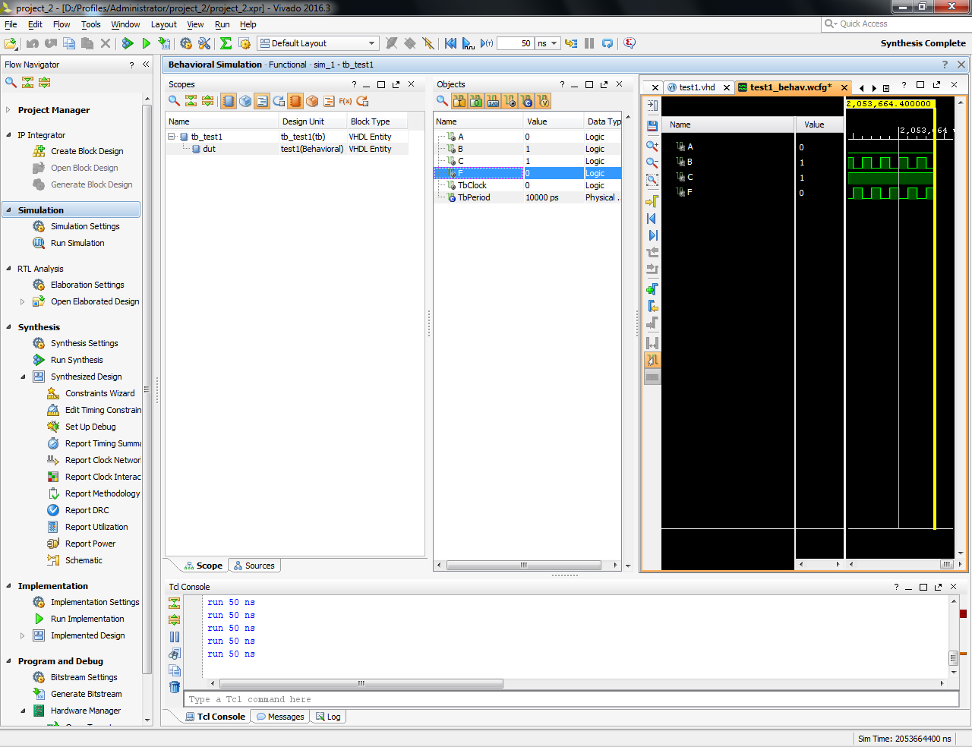
Click the blue-arrow (T) to see the simulation

