Slide 1
CENG3430 Rapid Prototyping of Digital Systems
Free Project specifications

Slide 2
Objective and Requirement
Objective
  To learn and practice how to employ VHDL and FPGA to build useful hardware systems
Requirement
  Design your project based on our Xilinx-Zedboard.
  In your project, the following parts should be included: Input(s), output(s), main core unit, control unit (FSM).
  Two students in one group.

Slide 3
Marking scheme of the course CENG3430
Final examination: 50 %
Course work : 50 %
  Weekly class exercises: 10%
  1 Quiz: 5%
  Weekly Labs: 10%
  Free project: 25%

Slide 4
Marking scheme for the free project (total 100%)
Proposal (1 page) (10%)
Demonstration (50 %)
  Each group will be given 5 minutes to demonstrate your project to us. The project will be evaluated based on:
  The techniques used in the project (10 %)
  Completeness of the project (10 %)
  Creativity of your project (10 %)
  Presentation performance (20 %)
  Note: YouTube links to some previous demo videos can be found at appendix.
Final Report (40 %)

Slide 5
Proposal (1 page) (10%)
Project proposal
  Title
  Group members
  Objectives
  Plan with time schedule
  Additional equipment needed: Each group can buy additional components/equipment (not more than HKD300, keep the receipts, reimburse later though TAs) for the project , e.g. buying “pmod” cards for the zedboard, see

Slide 6
Pmod components available in the lab for your project
    Pplease make request in your proposal, see https://store.digilentinc.com/pmod-modules/ for specifications. You may also request other components not in this list.
Index | Description: Pmod components available | Qty.
1 | Audio Amplifier | 5
2 | Solid State Relay | 5
3 | Temperature Sensor and Thermostat Control | 5
4 | NOR Flash Non Volatile Memory | 5
5 | AD7476A Digital to Analog Converter | 1
6 | Two Axis Joystick | 2
7 | Pmod DA2 Dual 12-bit DAC | 5
8 | Pmod HB5 2A H-bridge Driver + QE F/B | 5

Slide 7
Deadlines
19 March 2018, Monday, 23:59, Proposal (1 page), to be submitted to Blackboard.
20 March 2018, Tuesday, (lab time at SHB102) TA will discuss with your proposal.
27 March 2018, Tuesday, (lab time at SHB102) Students must come to brief us your progress.
10 April 2018, Tuesday, (lab time at SHB102) Students must come to brief us your progress.
17 April 2018, Tuesday, (lab time at SHB102) Final demonstration.
21 April 2018, Saturday 23:59. Final Report to be submitted to Blackboard.

Slide 8
Report
Abstract
Introduction
Theory and design
Implementation and experimental result
Discussions
Conclusion
See the project specification for detail

Slide 9
Proposal (1 page)
Project proposal
  Title
  Group members
  Objectives
  Plan with time schedule
  Additional equipment needed: Each group can buy additional components/equipment (not more than HKD300, keep the receipts, reimburse later though TAs) for the project , e.g. buying “pmod” cards for the zedboard, see
    https://en.wikipedia.org/wiki/Pmod_Interface
    http://store.digilentinc.com/
    http://store.digilentinc.com/pmod-modules/
    Search “pmod“ inside https://world.taobao.com
    Must get permission from the tutor before buying.

Slide 10
Project topic for reference
References
http://hamsterworks.co.nz/mediawiki/index.php/FPGA_Projects

Slide 11
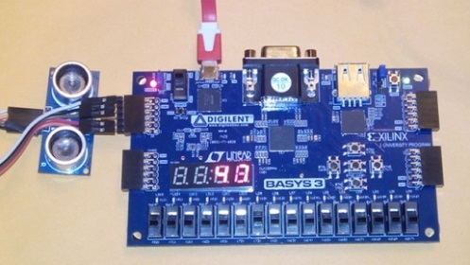
Example1
Ultrasonic radar
You can watch a short video of it at https://www.youtube.com/watch?v=GHbs8RZSRr0
Source
  http://hamsterworks.co.nz/mediawiki/index.php/Sonar
Idea
  count and display the time delay time between sending and receiving the sound package
Improvements: Can add more functions to the radar:
  More user control,
  Longer distance
  Increase accuracy by averaging 10 counts
  Send data to Linux for display

Slide 12
Example2
RS232 interface
Source
  http://hamsterworks.co.nz/mediawiki/index.php/TinyTx
Idea:
  Provided basic features of RS232 interface
Improvements:
  Give more features
  Error check: Parity check
  Variable bitrate etc

Slide 13
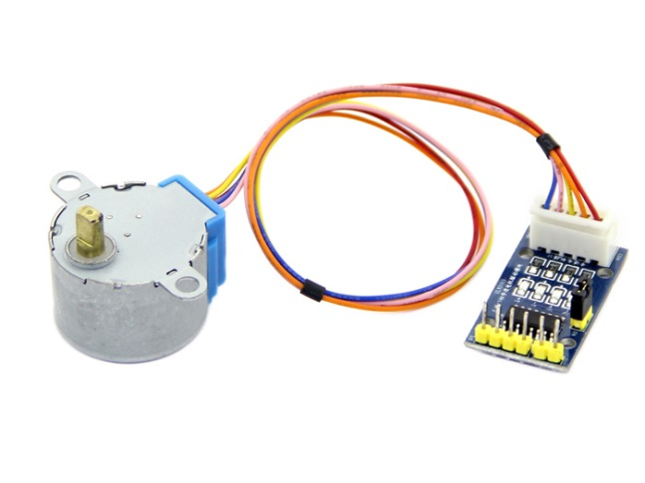
Example3
Stepping motor interface
Source
  http://hamsterworks.co.nz/mediawiki/index.php/Stepper
Idea:
  Control a small steeping motor by providing the clocking pulses
Improvements:
  Build a small robot using it.
  Interface Linux to the motors

Slide 14
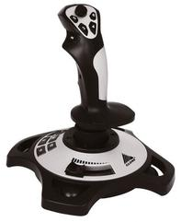
Example 4:
Joystick interface :Analogue input
Source
  http://hamsterworks.co.nz/mediawiki/index.php/Cheap_Analogue_Input
  Be able to read the inputs from a variable resistor
Improvements:
  Multi inputs
  Link to Linux

Slide 15
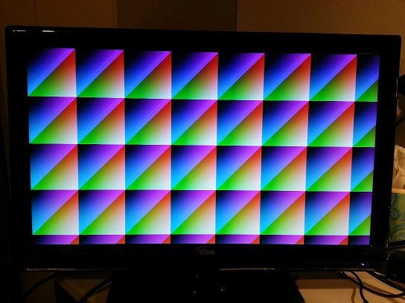
Example 5a:
VGA or HDMI interface
Source
  http://hamsterworks.co.nz/mediawiki/index.php/Zedboard_VGA_HDMI
Idea: generate timing signals for the display
Improvements:
  Create some graphics or animation using this display
  Link to Linux
A demo test has been performed, the file is at
  http://www.cse.cuhk.edu.hk/~khwong/www2/ceng3430/TestVGA.zip

Slide 16
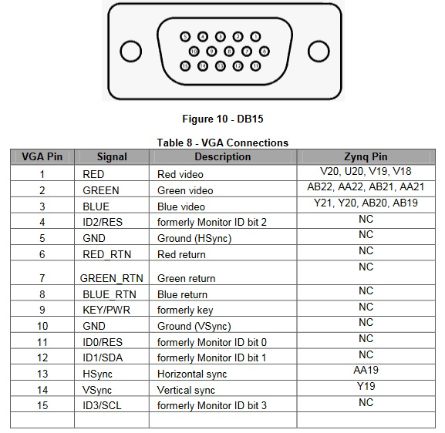
Example 5b : VGA Connector on ZedBoard (By Simon Wong)
The ZedBoard allows 12-bit color video output through a through-hole VGA connector, TE 4-1734682-2. Each color is created from resistor-ladder from four PL pins.

Slide 17
Example 5c: The VGA connections on the ZedBoard are defined in the XDC file as follow:
The VGA connections on the ZedBoard are defined in the XDC file as follow:
# ----------------------------------------------------------------------------
# VGA Output - Bank 33
# ----------------------------------------------------------------------------
set_property PACKAGE_PIN Y21 [get_ports {B1}]; # "VGA-B1"
set_property PACKAGE_PIN Y20 [get_ports {B2}]; # "VGA-B2"
set_property PACKAGE_PIN AB20 [get_ports {B3}]; # "VGA-B3"
set_property PACKAGE_PIN AB19 [get_ports {B4}]; # "VGA-B4"
set_property PACKAGE_PIN AB22 [get_ports {G1}]; # "VGA-G1"
set_property PACKAGE_PIN AA22 [get_ports {G2}]; # "VGA-G2"
set_property PACKAGE_PIN AB21 [get_ports {G3}]; # "VGA-G3"
set_property PACKAGE_PIN AA21 [get_ports {G4}]; # "VGA-G4"
set_property PACKAGE_PIN AA19 [get_ports {HS}]; # "VGA-HS"
set_property PACKAGE_PIN V20 [get_ports {R1}]; # "VGA-R1"
set_property PACKAGE_PIN U20 [get_ports {R2}]; # "VGA-R2"
set_property PACKAGE_PIN V19 [get_ports {R3}]; # "VGA-R3"
set_property PACKAGE_PIN V18 [get_ports {R4}]; # "VGA-R4"
set_property PACKAGE_PIN Y19 [get_ports {VS}]; # "VGA-VS"
set_property IOSTANDARD LVCMOS33 [get_ports -of_objects [get_iobanks 33]];

Slide 18
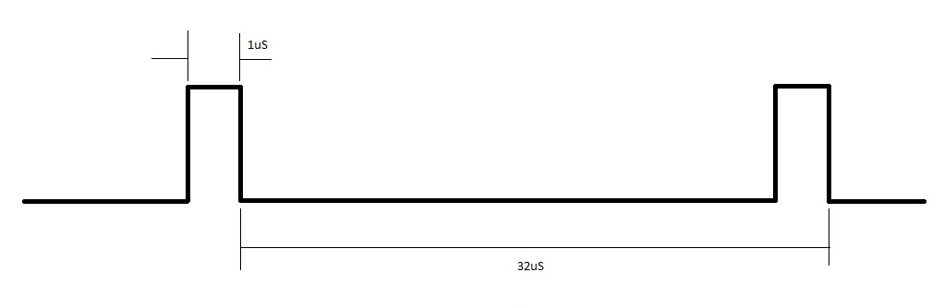
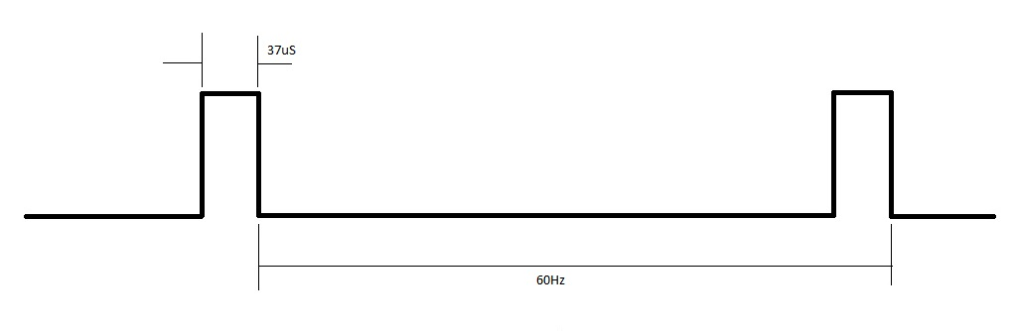
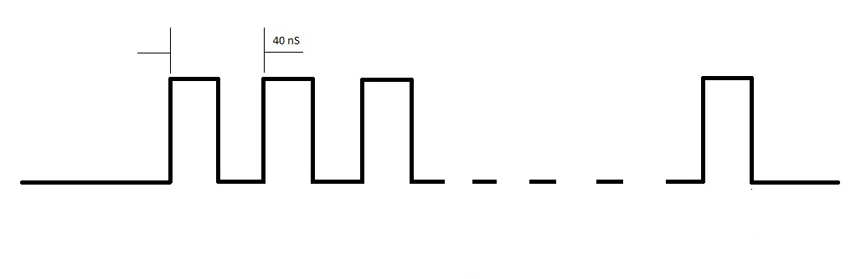
Example 5d : Timing signals
Horizontal Sync HS – we need to generate a horizontal sync pulses to the monitor
Vertical Sync VS – we also need to generate a vertical sync pulses to the monitor
Pixel Clock (pixelclk) – Pixel clock is 25MHz clock derived from 100MHz clock (clk )
1us
37us
40ns

Slide 19
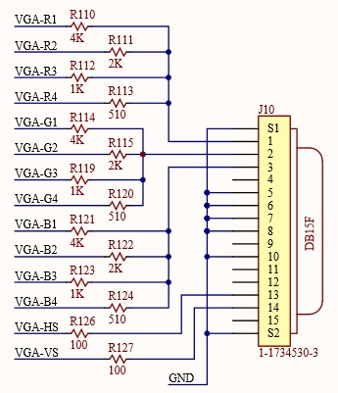
Example 5e : R,G,B data
R,G,B data – R, G and B pixels data are consists of 4 bits per color. The 4 bits RGB color data are converted to analog signal and output to the VGA connector.

Slide 20
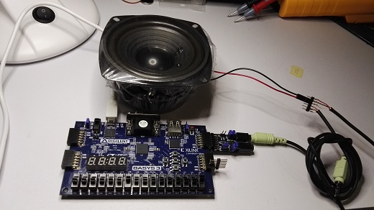
Example 6:
Sound generation
Source
  http://hamsterworks.co.nz/mediawiki/index.php/PMODamp3
  Idea: produce sound from FPGA
Improvements:
  Play music, or generate a song through this interface
  Link to Linux

Slide 21
Example 7:
Play with PMOD modules
Main Source
  http://store.digilentinc.com/pmod-modules/
Small display
  http://store.digilentinc.com/pmod-oledrgb-96-x-64-rgb-oled-display-with-16-bit-color-resolution/
Pmod ACL: 3-axis Accelerometer
  http://store.digilentinc.com/pmod-acl-3-axis-accelerometer/
Microphone
  http://store.digilentinc.com/pmod-mic3-mems-microphone-with-adjustable-gain/
Temperature sensor
  https://blog.digilentinc.com/digilent-pmods-input-pmods-sensors/

Slide 22
References
http://hamsterworks.co.nz/mediawiki/index.php/FPGA_Projects
http://fileadmin.cs.lth.se/cs/Education/EDA385/HT10/student_doc/Piano/report_final.pdf
https://www.beyond-circuits.com/wordpress/tutorial/

Slide 23
Previous demo videos ceng3430 project demos: April, 2017:
0 tetreis V 20170418 173258
https://youtu.be/JyEU1YbYMrc
-------------------------------------
1 Count down Traffic Light System
https://youtu.be/Hksl8gjPFcM
-------------------------------------
2 Space Invader
https://youtu.be/2wEG-U8DNak
-------------------------------------
3 Number Guessing Game
https://youtu.be/iZB-3HZxG5U
-------------------------------------
4 Password Lock
https://youtu.be/IqsHO1Ez7mU
-------------------------------------
5 Piano
https://youtu.be/_VH3fUazEEI
-------------------------------------
6 Tic Tac Toe + Snake + Breakout Clone
https://youtu.be/u6jBlbKlgOA
7 MP3 Player
https://youtu.be/MDIvooGHVvc
-------------------------------------
8 Piano and Music Player
https://youtu.be/dEdnp1Tni9c
-------------------------------------
9 Sonar
https://youtu.be/DiLjDbkbejs
-------------------------------------
10 Washing Machine
https://youtu.be/z7C8dXn9EQ0
-------------------------------------
11 Table Tennis Game
https://www.youtube.com/watch?v=QjVtGCvQZEE
--------------
12 Snake
https://youtu.be/N_8qlq07zNQ
-----------------
13 2 digit Password Lock
https://youtu.be/r6GzCLq5IFc
------------------
14 Ultrasonic range finder
https://youtu.be/OrRvQntMpCQ

