Slide 1
High Speed Logic
Power supply systems

Slide 2
Part 1
High speed circuit

Slide 3
0.1 Frequency / time relation
Basic facts and tools for the analysis of the edge of a clock
  Rise time (T_{r}) = time to rise from 10% to 90% of the signal.
V
90%
10%
t
Tr
A fast falling edge
A slow
rising edge

Slide 4
0.1 Knee frequency calculation
Convert rise-time edge (Tr) and frequency (F_{knee})
F_{knee}=0.5/Tr
e.g. edge=5ns, what is the equivalent frequency.
F_{knee=}=0.5/5ns=100MHz.
Period/2=Tr
Period of the equivalent
signal

Slide 5
Analog / digital signal relation
Can a digital signal pass an analog circuit without distortion?
Use F_{knee} to quickly estimate if the signal can pass the clock edge or not.

Slide 6
Short term (edge) response by F_knee method
Rising or falling edge=
short term behavior
Level 1 or 0 =
long term behavior

Slide 7
Short term (edge) response by F_knee
At high frequency, a wire becomes an inductor. Then a high frequency signal (fast edge) is attenuated (or distorted).
F_knee≈0.5/Tr , where Tr= rise time
I
L
R
A long wire or PCB trace

Slide 8
Frequency response of a low pass trace
Shorter rise time pushes frequency requirement higher. Important results:
  (1) A circuit has flat frequency response up to and including F_knee (≈0.5/Tr) will pass the digital signal with rise edge (Tr).
  (2) The behavior above F_knee of a digital circuit will have little effect on how it processes digital signals.
  (3) Frequency lower than F_knee will affect the long term behavior of the signal.

Slide 9
How to apply the F_knee technique
Find or estimate Tr rise time of your signal.
Find F_knee ≈ 0.5/Tr
Now whether your circuit can pass this signal or not depends on whether the circuit has flat frequency up to F_knee or not.

Slide 10
Example
Since F_knee =0.5/Tr, Tr=0.5/100MHz
Hence Tr should not be shorter than 5ns.
What would happen if Tr is shorter than 5NS (e.g. 3ns) ? Answer: distorted, edge smoothed
This circuit has flat frequency response up to 100MHZ
5ns
5ns
A PCB
TRACE
The output of a 3ns edge
3ns
5ns

Slide 11
F_knee method is only an approximation
F_knee is only defined by the signal rise time and has no relation to other frequency domain parameters. It is easy to use and remember.
An imprecise measure of spectral contents, it cannot make precise prediction of circuit behavior.
Use Fourier transform if an accurate result is required.

Slide 12
Power exercise 1
A circuit can pass signals of 200 MHz without distortion, what is the shortest rising edge that can pass this circuit?

Slide 13
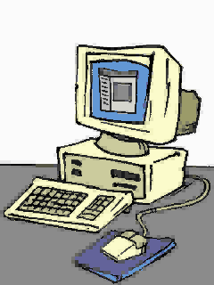
0.2 The horror of large dI/dt
Since ΔV =-L dI/dt , L=inductance.
Since the traces are inductive, Large dI/dt will create huge noise voltage ΔV in the circuit.
dI/dt
ΔV
Large dI/dt creates large voltage ΔV here

Slide 14
Speed dI/dt problem
Logic families having minimum switch times much faster than the propagation delay suffer an unnecessary penalty in system design. Large dI/dt creates problems.
Given two families with identical propagation delay statistics, the family with the slowest output switching time will be cheaper and easier to run.

Slide 15
Speed dV/dt problems
Circuit response lower than F_{knee} may distort signal, circuit response higher than F_{knee} is not important in our design.
Shorter T_{r} (switch time) results in higher F_{knee}. So unnecessary short T_{r} is a problem.
So shorter Tr will not work in poorly designed circuits.
Shorter Tr will give larger dI/dt, which will cause ground bounce. (will be discussed later)

Slide 16
How to find dI/dt from dV/dt
dI/dt creates problems.
Since dV/dt is easier to measure, so we try to find dI/dt from ΔV (output voltage change),Tr(rise time) and C(load capacitance).
We will show that
max(dI/dt) =1.52 ΔV C/(Tr)²

Slide 17
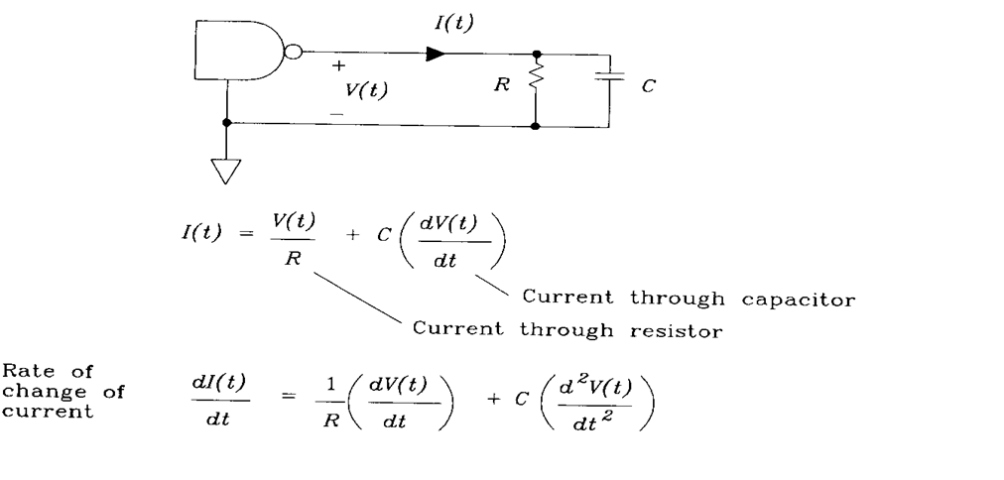
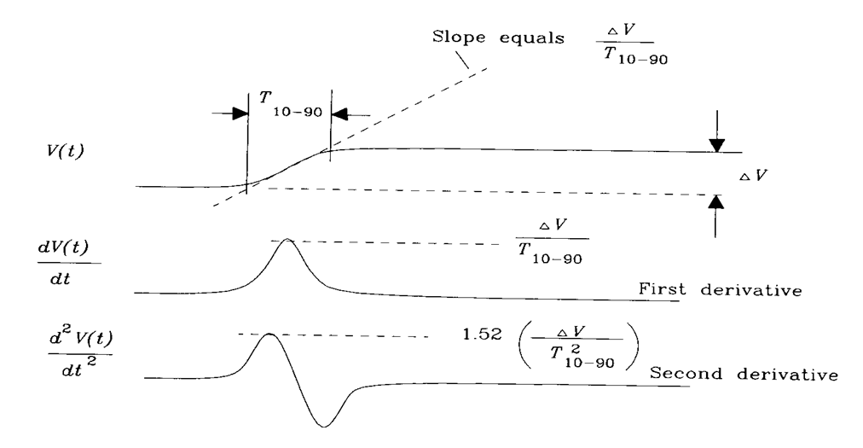
T₁₀₋₉₀≈Tr
=rise time
from 10 to 86 %
_{Fig.2.14}
_{of [1]}
Max slope is (ΔV/2)/(T_{r}/2)
= ΔV/T_{r}
T₁₀₋₉₀≈Tr
Max slope is
(ΔV/T_{r})/ (T_{r}/2)]
=2 ΔV/(T²_{r} )---(i)
-------------------------
More precisely:
consider voltage difference ≈ 0.76*ΔV (from 10 % to 86%) in equ. (i).
Max slope is =0.75*{2 ΔV/(T_{r}²)}
≈ 1.52 ΔV/(T²_{r} )
T_{r}/2

Slide 18
Showed two important relations
(1/R)max(dV/dt)= (1/R)ΔV/Tr
C*max(d²V/dt²)=C*1.52*ΔV/(Tr)²

Slide 19
Effect of dI/dt at output and at power supply is similar dI/dt is difficult to measure, so use dV/dt easier estimate, it is easier
ΔV_{L}
Power supply V
L
to 1/T²_{r}, big,
more significant
R
C
Tr
∝ 1/T_{r}, smaller so ignored

Slide 20
Max(dI_{capacitor}/dt) ∝ 1/T₁₀₋₉₀²
Shorter Tr will give larger dI/dt, which will cause ground bounce.
ΔV_{L}
Power supply
Same dI/dt
L
dI/dt
R
C
Tr

Slide 21
Exercise 2
ΔV_{L}
Power supply V
L
R
C
5V step
Tr
1ns

Slide 22
Part 2
Power systems

Slide 23
Power system
Fixed and variable power supply
  use 78xx chip
  Use power transistor 3055
Use of opto-coupler
Use capacitors to stabilize power

Slide 24
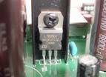
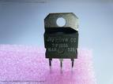
Fixed and variable Power supply
http://eddie.dyec.com.tw/diy-demo/audio-diy/cd_dvd_modify/cd-100_2/cd100_2image/7805.jpg
Use power supply chips 78xx
  E.g. 7805 for supper isolation to reduce interference
E.g. Variable power supply design and usage, e.g. step down 5V --> 3V.
1
3
Fixed at 5V,
current limit 500mA
7805
7V or above
200uF
2
TIP3055
Input power
V1(5V)
R1
Output=V1[R2/(R1+R2)]
(0-5V)
R2
100uF

Slide 25
Power exercise 3
If I have a power source 9 V and want to produce a power supply of 5V, R1=10K.
Suggest two methods to achieve this.
Answer:
TIP3055
Input power
V1
R1
Output=V1[R2/(R1+R2)]
R2

Slide 26

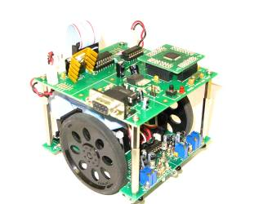
Example: Use of 7805 power stabilizer and opto isolator
8031
7.2V or above
Power supply
7805
7805
Xilinx
Optical
Isolators
4N35
2 systems has no
electrical linkage
Electrically Isolated
light
Low power
High power
3 Volts battery
Current driver
circuit
Left/Right motors

Slide 27
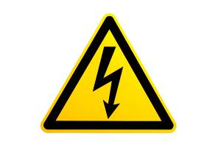


Board level Power supply sys.
Power systems
  provide stable voltage references
  distribute power to all devices
We will learn about how to find
  board level bypass capacitors
  capacitor array
Examples and pictures are from Reference :High speed digital design by HW Johnson and Graham, Prentice Hall

Slide 28
Method (in single ended signaling) to reduce ground noise (low cost) for normal gates : return current is the same as the ground
Use better power distribution method:
  Rule 1: Low impedance ground
  Rule 2: Low impedance power (5V) lines
  Rule 3:Low impedance between power (5V) and ground (0V) -- use of bypass capacitors.

Slide 29
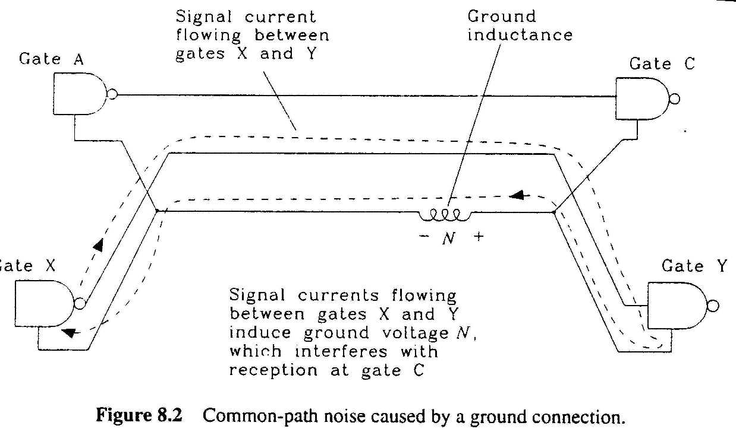
Power Rule 1: Use low-impedance ground connections between gates -- use ground planes, power rails.
Reasons:
  Fig. 8.2 shows the hypothetical noise “N” in the ground loop, which is caused by the return current flowing through the ground inductance

Slide 30
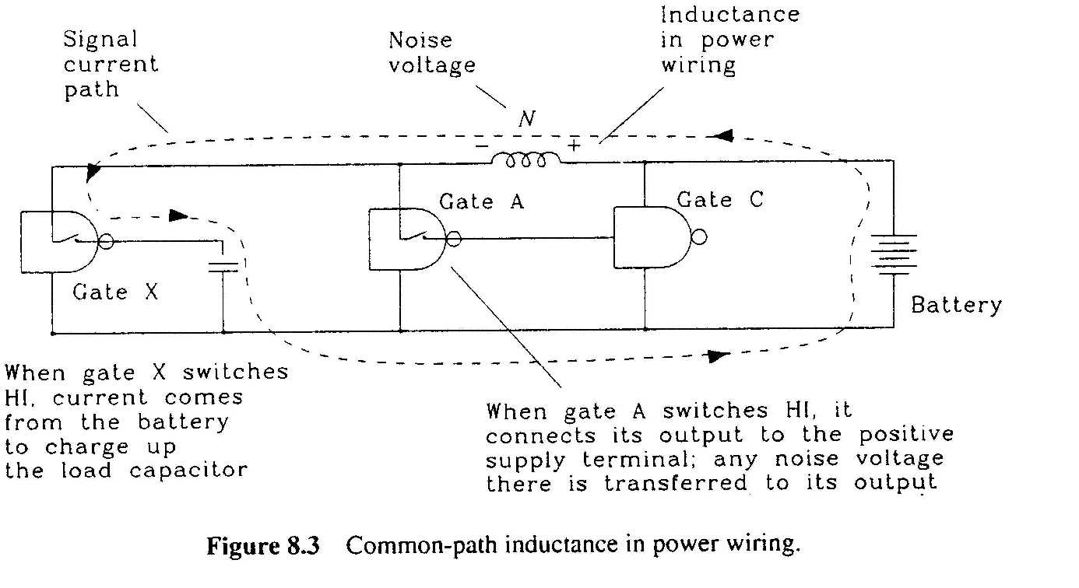
Power Rule 2: The impedance between power pins on the two gates should be as low as possible (fig. 8.3) --use power planes,etc. Reasons:
  common path inductance between power pins on any other gates is a problem even the ground is perfect.
  If N is large, gate A may receive a lower power supply or reference voltage.

Slide 31
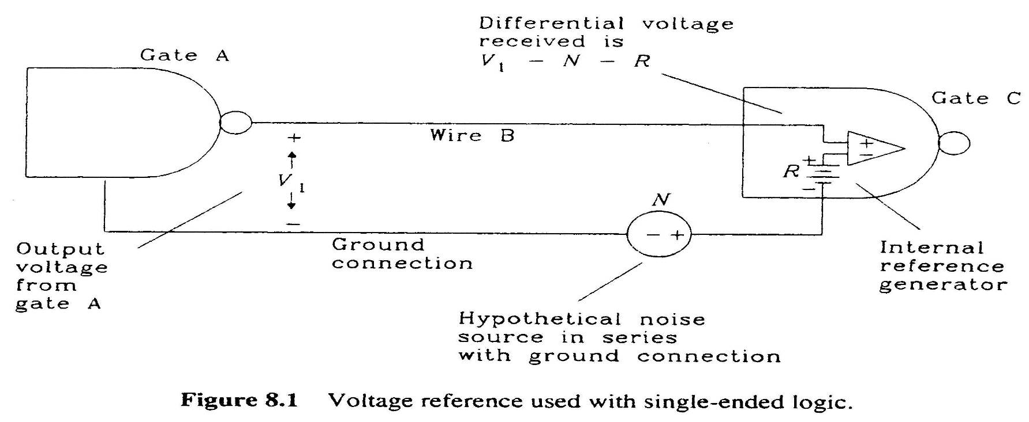
Voltage reference problems
Differential input= V₁-N-R,
The ground wire has inductance and creates noise voltage N which should be as low as possible.
(2.5V)

Slide 32
Power
Exercise
4
(2.5V)
R (internal reference voltage is 2.5V) i.e.
  gate_C_out =1(high) when the input of the gate C amplifier is positive
  Else gate_C_out=0 (low)
Now V1=2.8V, R (internal reference voltage is 2.5V,
What is Gate_C_out when
(i) noise N=0?
(ii) noise N=0.5?
(iii) Why there is noise N?

Slide 33
Power Rule 3: There must be a low-impedance path between power and ground (fig. 8.4)-- use by- pass-capacitors.
Reasons (Fig 8.3):
  The return current flows thru. the battery should create a voltage drop as low as possible to maintain a good reference. The impedance of the battery must be low.
  By pass capacitors provide such low impedance paths.
L_{pcable}=100nH
L_{tot}=N number of L_{C3} in parallel
C₃
Perfect
Power
supply
C₃
Cap.
array
L_{C2}
Board bypass
capacitor C₂
C₃

Slide 34
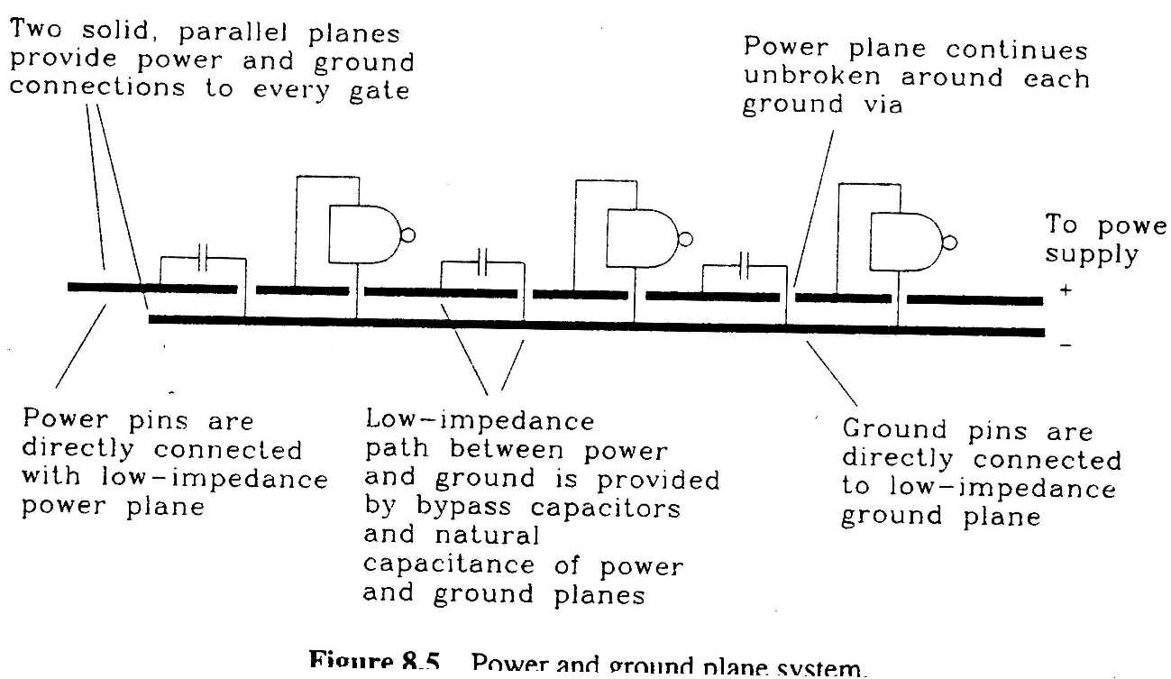

Use of power, ground planes and capacitor array
Rule3
Rule 2
Rule1

Slide 35
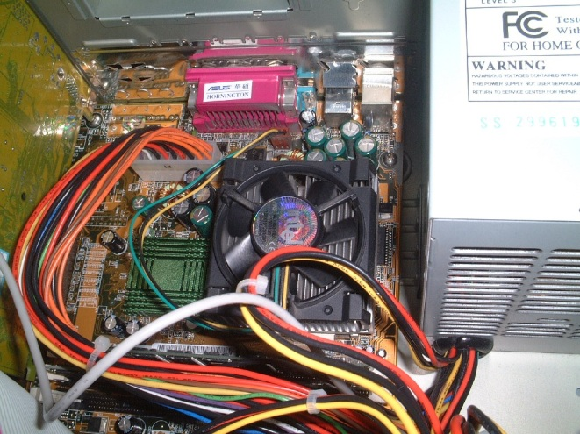
Power system design techniques:
Multi-layer Power distribution
Power supplies designed and sold usually have very low output impedance.
But the wiring to the board and devices may contain inductance.
To maintain a stable power to the circuits we have to solve it in 3 different levels:
  Power distribution wiring
  Board level filtering
  Local filtering at individual integrated circuits

Slide 36
Level 1: Power distribution wiring
Resistance of power distribution wiring.
  Resistance proportional to inverse diameter wire, 40% increase of wire diameter reduces resistance by 1/2.
  Sense wire in new power supply designs corrects for resistance in power distribution wiring ( http://reprap.org/bin/view/Main/PCPowerSupply)
Inductance, a more difficult issue. (Section 8.2.1)
  Use low-inductance wiring -- wide-flat wires.
  Use differential logic Fig. 8.6 (not economical)
  Reduce power supply current change can minimize the effect of inductance -- using by pass capacitors.

Slide 37


Level 2 :Board level filtering
Fig. 8.7, switching at output of gate A can create a large current change through the power supply.
For a 1ns edge (at high frequency) , the inductance blocks the current from the power supply to gate A.
Add C₂ (board level by pass capacitor) in fig. 8.8 to reduce the current passing through the inductance.
Example 8.1 shows how to calculate the value of the board level by pass capacitor. This capacitor C_{board_bypass} provides low impedance up to a Power-System-Wiring frequency F_{PSW.}
Water
tanks
In
Germany
Mannheim

Slide 38
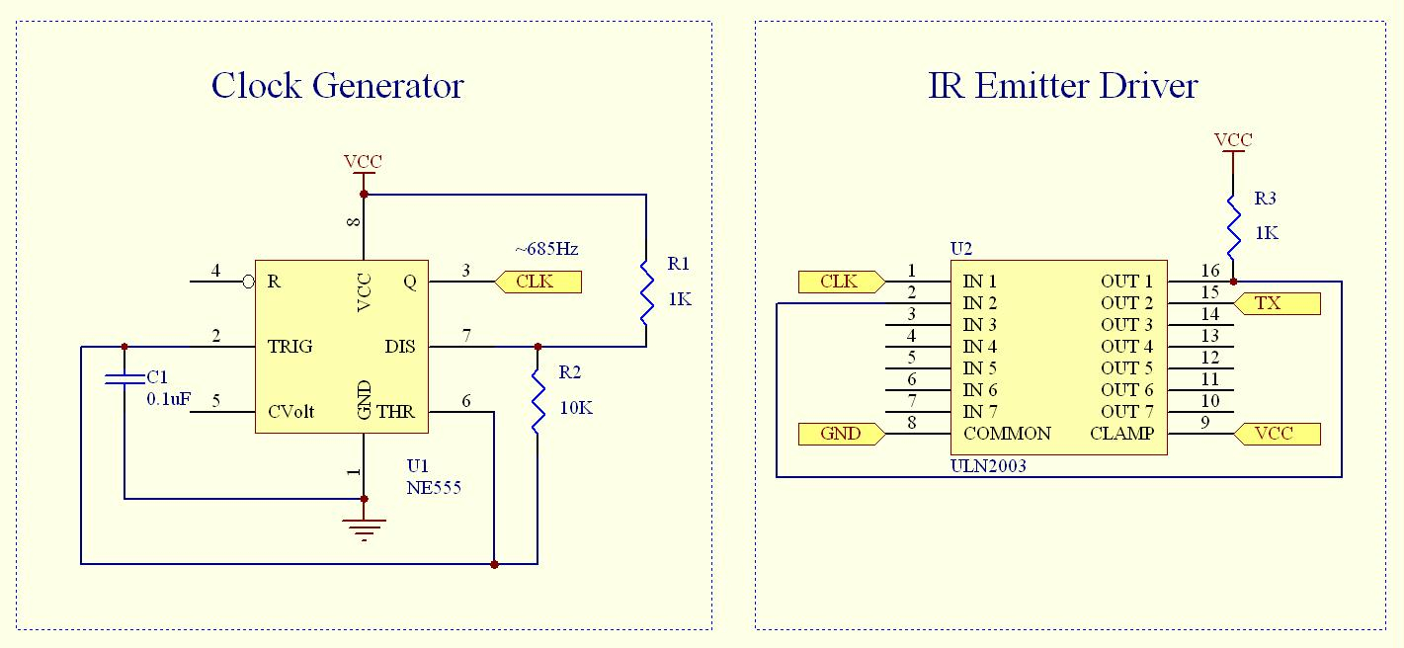
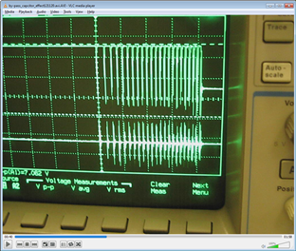
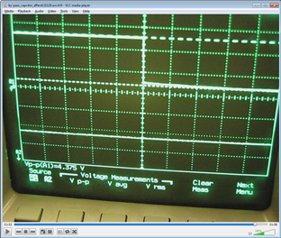
Demo
By-pass capacitor
10uF
+
Youtube
TX
(Noisy)
Vcc
(Noisy)
TX
(Clean)
Vcc
(Clean)
No by-pass capacitor
using by-pass capacitor

Slide 39
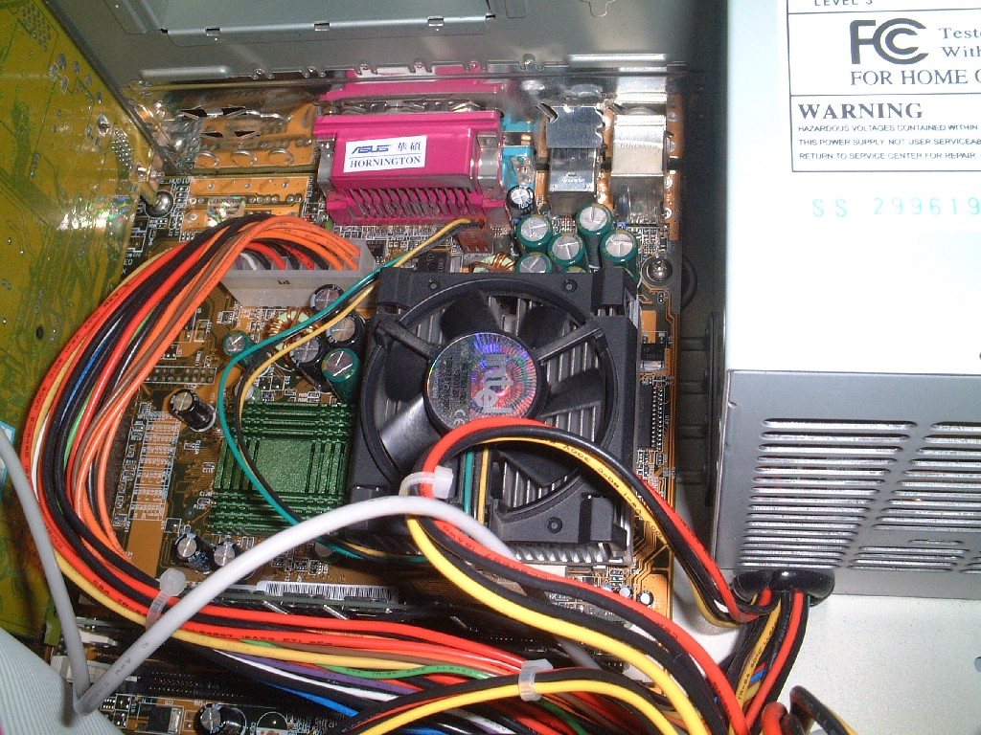
A PC mother board with board level by-pass filter (use parallel capacitors to make a big one: reduce leg inductance; save size and cost)
Board level by-pass capacitors(C2)
Power supply
and cable

Slide 40
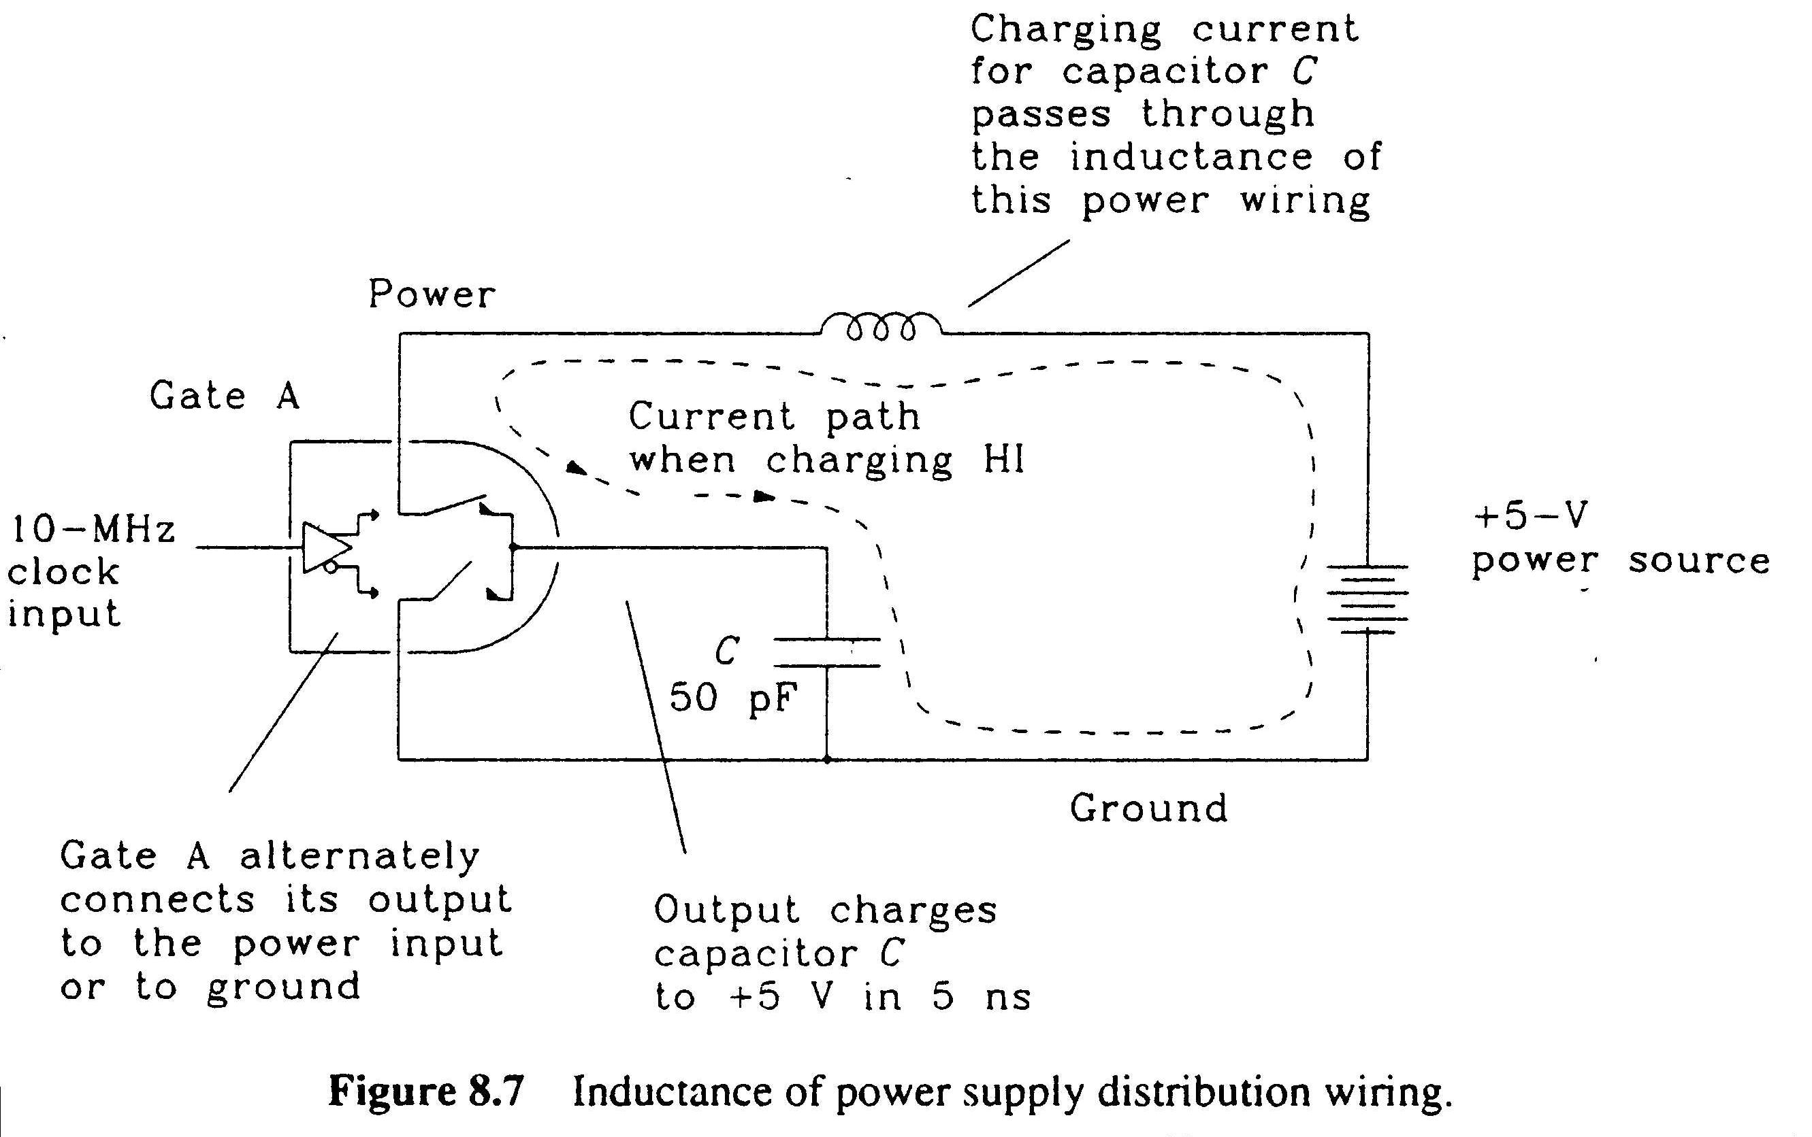

C₂
to be
added

Slide 41
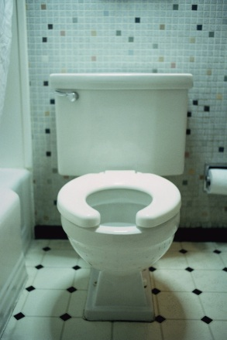
Level 3: Local filtering at individual integrated circuits
However no capacitor is perfect, L_{C2} (at the legs of by pass capacitor C₂) may cause its impedance to rise at high frequency.
The best way to get very low inductance is to use a lot of parallel small capacitors.
Use capacitor array to reduce the the problem of L_{C2} at high frequency.
See Example 8.2

Slide 42
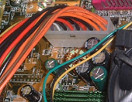
Analogous to the water delivery system
Power supply
Board level
By Capacitor
e.g. 10uF-200uF
or
e.g. 10uF-200uF
Capacitor
Array e.g. 0.01uF

Slide 43

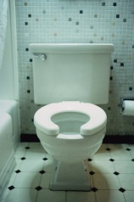
Multi-level by pass capacitors design
Power supply -> board --> individual Ics
Example:F_{psw} F_{board} F_{c_array}
below159KHz 159K->3.18M 3.18M->F_{knee}
10u-1000uF 32x0.016uF
A power supply provides low impedance at low frequency.
Board level by pass capacitors provide low impedance at higher frequency
Parallel a lot of small capacitors provide very low impedance up to a very high frequency F_{knee}(e.g. edge=5ns, F_{knee}=0.5/Tr=0.5/5ns=100MHz).

Slide 44
Power supply bypass capacitor design
Design calculations, find

Slide 45
Revision of important formulas
(Remember them!!!!)
Impedance of C at freq.
Impedance of L at freq.
  current passing thru. a capacitor with changing voltage
  voltage across an inductor with changing current
Also when impedance is in terms of F_{knee}:

Slide 46
Level 1 - Power distribution lines
Board level by pass capacitor(C2) design
Cap array(C3)
≈0.1 ~ 1uF
Vcc
Power
supply
Ground
Board level
electrolytic
bypass capacitor
≈ 10~500uF
Digital circuit board

Slide 47
Level 2 - bypass capacitor design
Board level by pass capacitor (C2) design
Vcc
Cap array (c3)
≈0.1 ~ 1uF
Power
supply
Ground
Board level
electrolytic
bypass capacitor
≈ 10~500uF
Digital circuit board

Slide 48
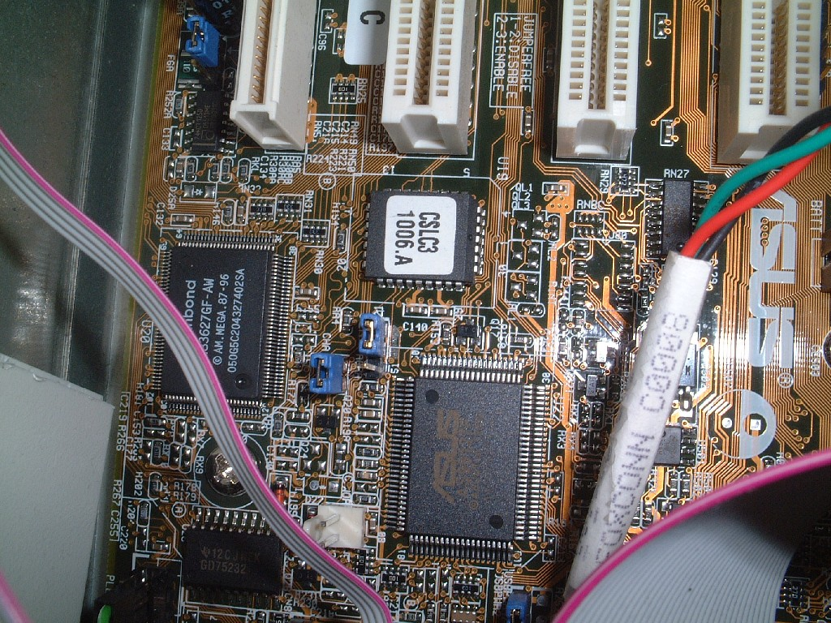
Capacitor array C3 (a number of surface mounted capacitors)
Old type

Slide 49
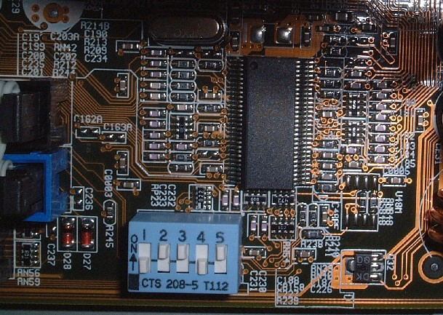
Capacitor array C3 (a number of new type surface mounted capacitors)
Old type

Slide 50
Board level filtering calculations
Why board level by-pass cap. C2 is needed?

Slide 51
Procedure for level 2 (board level) calculation
2-1. First find out the maximum change of current the circuit demands.
2-2. Then find the maximum tolerated impedance of the inductor
2-3. Find at what signal frequency (or edge using Tr=0.5/Fknee) this inductor has too much impedance
2-4. Find the value of the required bypass cap. C2

Slide 52
Given:N=100 gates, C=10pF load in Δ t =5ns, supply voltage= E,inductance L_{pcable}= 100nH
Step2-1: find max. change of current the circuit demands
Assume max. tolerable noise Δ E_{N}=0.1Volts
Maximum noise allowed=0.1V
Perfect 5V
power supply
Digital circuit,
when 100 gates are
switching draws 1A
L_{pcable}=100nH
impedance <0.1 Ω
Ground

Slide 53
Additional Explanation
Dear professor,
In the previous slide, we computer the maximum current change is 1A, then we use ohm’s law to calculate the impedance. But I am confuse that if we use the max current change to calculate, the result should be minimum impedance since the noise En is fix. So impedance should larger than 0.1 ohm.
Answer: Thanks for your question and I think it is a very good question on this topic. For your query, I think it is a naming problem; the explanation of calling it Xmax is as follows:
  We set the noise allowed (by noise margin) to be En=0.1 Volts. If the total required current is 1A
  The max impedance is Xmax=En/1A=0.1 Ohms. You are right to say that if the required current is less, say 0.9 A, Xmax will be 0.1/0.9=1.111 Ohms, it is higher than 0.1 Ohms. Then how can I say this is called Xmax. The reason is we call it Xmax because it is the X allowed for that situation, and you cannot allow a higher impedance X in the circuit, that means when I=0.9A, your Xmax is 0.11 Ohms.
  Or in my original slide , when I=1A, Xmax is 0.1 Ohms.
  Using another example, if the current is I= 1.1A (higher than 1A), En=0.1 is not changed because it is coming from the noise margin (you don’t want noise to be higher than that in your circuit) , Xmax=En/I=0.1/1.1=0.09 Ohms, so in this case Xmax is 0.09 Ohms. That means when you design a circuit, you cannot allow impedance inside the circuit higher than 0.09 Ohms.

Slide 54
Step2-2:
Assume max. current change=1A, so ΔI= from 0A to 1A is 1A
Impedance X_{L}of power cable L_{pcable}
=Δ E_{N} / Δ I = 0.1Ω
Maximum noise allowed=0.1V
Perfect 5V
power supply
Digital circuit,
when 100 gates are
switching draws 1A
L_{pcable}=100nH
impedance <0.1 Ω
Ground

Slide 55
Step2-3: Find at what signal frequency the inductor has too much impedance
(At a very slow edge, the power source is blocked by the inductor, let alone T_{r}=5ns that the circuit demands)
Maximum noise allowed=0.1V
Perfect 5V
power supply
Digital circuit,
when 100 gates are
switching draws 1A
L_{pcable}=100nH
impedance <0.1 Ω
Ground

Slide 56
Photos of the board and caps(board C2 and Cap array C3).
Local filtering
Cap array C3
≈0.1 ~ 1uF
Vcc
Power
supply
Ground
Board level
Electrolytic C3
bypass capacitor
≈ 10~500uF
Digital circuit board

Slide 57
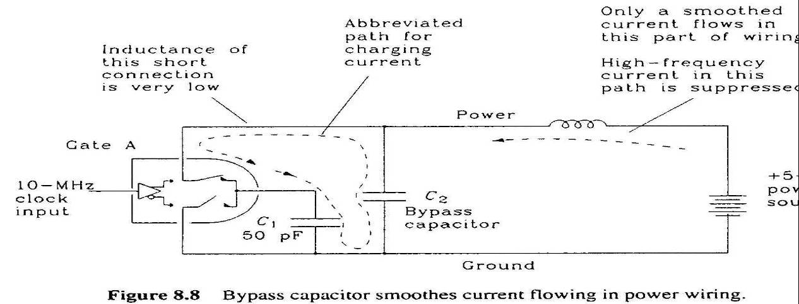
Step2-4: Find board level by-pass cap. to give an alternative power path at high freq.
At what freq. L_{pcable} is too large(>0.1 Ω)?
Below this F_{pcable} frequency, the power supply unit can supply current; above this the bypass C₂ can supply current.
X_{L}=2π FL

Slide 58
Level 3 Local filtering
It is needed because of the inductance at the legs of the board level bypass capacitor
Local filtering using capacitor array

Slide 59
Level 3 - Local filtering
Board level by-pass capacitor C2 design
Local filtering
C3
Vcc
Power
supply
Ground
Board level
electrolytic
bypass capacitor
≈ 10~500uF
Digital circuit board

Slide 60
When Freq. >159KHz, the power supply cannot supply current
But when freq. is too high, the inductance at bypass cap C₂ may have problems.See next
When freq. >159KHz, the paths
are cut off by the large impedance
L_{pcable}=100nH
Digital circuit
Perfect
Power
supply
Board bypass
capacitor C₂
=10uF
L_{C2}=5nH

Slide 61
But the board level by-pass cap has inductance 5nH at its legs
The maximum impedance at legs is 0.1 Ω, so that noise is controlled under 0.1V.
So when freq. is higher than 3.18MHz, the legs of the by-pass capacitor will block current flow, so use an array of small capacitors to supply current.
Low freq, get power
from power supply
Mid. freq. Get power
from board level cap.
High freq.Get power
from cap. array
F₁ =159KHz
F₂=3.18MHz

Slide 62
When Freq. F₂ >3.18Mhz, the board bypass cap. cannot supply current
Freq.
When freq.F₂ >3.18MHz, these paths
are cut off by the large impedance
L_{pcable}=100nH
Perfect
Power
supply
L_{C2}=5nH
Board bypass
capacitor C₂
Digital circuit

Slide 63
Level 3 Design procedures
Step 3-1: Find the highest (F₃ ) frequency of the system based on T_{r3} (e.g. 5ns) .
Step 3-2: Find (L_{tot3}) total inductance tolerated.
Step3-3: Find (N) total number of cap used for the cap. array for the given serial inductance of each capacitor element. (e.g. 5ns).
Step 3-4 : Find (C₃) the minimum value of each Cap. array element.

Slide 64
Capacitor array number N calculations
L_{tot3}=Max. tolerable induct. for all array capacitors
X_{max}= Max. tolerable impedance for all array capacitors
Step 3-1: Find highest F₃ frequency: comes from clock edge 5ns , therefore
L_{pcable}=100nH
L_{tot3}=L_{C3}/32 (in parallel)
C₃
Perfect
Power
supply
C₃
L_{C2}=5nH
Cap.
array
C_{tot3}
Board bypass
capacitor C₂
C₃

Slide 65
Capacitor array number N calculations
L_{tot3}=Max. tolerable induct. for all array capacitors
X_{max}= Max. tolerable impedance for all array capacitors
Step 3-3: Find N
We will use an array of capacitors to provide alternative power source at high freq.
Given L_{C3}=5nH (legs of each small caps. C₃).
L_{pcable}=100nH
L_{tot3}=L_{C3}/32 (in parallel)
C₃
Perfect
Power
supply
C₃
L_{C2}=5nH
Cap.
array
C_{tot3}
Board bypass
capacitor C₂
C₃

Slide 66
Step 3-4
Find (C₃):the minimum value of each Cap. array element
Again X_{max}=0.1Ω to provide current to gates,
Find minimum C₃ value to do the job so use F₂=3.18MHz (lower side)
C₃
C₃
Cap.
array
C_{tot3}
C_{tot3}=32 C₃ in parallel
C₃

Slide 67
Note: Verify that when F₂=3.18MHz or T₂₌157ns,
T₂₌157ns is the clock edge limit when L_{C2} blocks the current.
(L_{C2} pathway)
Or
(C_{tot3} pathway)
XC3_array
X_{LC2}
X
0.1 Ω
F_{2s}=3.18MHz

Slide 68
Overall impedance X and Freq. plot
Current from
power supply
Current from
Cap. Array C3
No current
demand here
Current from C2
X_{C2}
X_{C3_array}
X_{pcable}
X_{Ltot3}
X_{LC2}
X
0.1 Ω
See
next
slide
F1=159KHz
3.18MHz
100MHz

Slide 69
A summary of the steps :
Based on power line inductance, find max impedance Xmax
Based on Xmax, find the lowest effective freq.(F1) of the board-level bypass cap (C_bypass)
Based on F1, find C_bypass value.
To solve the problem caused by legs of C_bypass using capacitor array (C3_array).
  Find the minimum number (N) of array elements needed based on the inductance of the legs of elements in C3_array, and the maximum required frequency inside the board.
  From N find the value of individual element of C3_array (C3)
  Plot the frequency response curves of the whole span of frequencies.

Slide 70
Power exercise 5
A hardware system has 500 digital outputs, each output is switching a 10-pF load at 5ns.
The power comes from a perfect voltage source of 5V via a power cable of inductance 200nH.
The maximum allowable supply voltage drop within the system is 0.1V.
The series inductance of each capacitor (for all types) is 5nH. Ignore the inductance of the traces in the system board. State any assumptions you used in the calculations.
Find board level bypass capacitor C2
Find the number N of elements in the capacitor array and its individual value C3.

Slide 71
Power Exercise 6
A large PCB board contains two circuit areas groups, A and B. The overall power comes from a perfect voltage source of 5Volts. The maximum allowable supply voltage drop anywhere in the board is 0.1Volts.
Given that dI = |C (dV/dt)|, for dI is the change in current, C is the capacitance of the capacitor and dV/dt is the rate of change of the voltage. The board level bypass capacitors for serving both group A and B have a very small series inductance. State any assumptions you used in the calculations.
  Three large board level by-pass capacitors are provided, how do you place them? Copy the following diagram to your answer book and insert the bypass capacitors in your diagram.
Calculate the values required? Show your calculation
Power cable with inductance =150nH
A large PCB
Circuit trace with inductance=35nH
Power supply +
Ground
Circuit group A:
  100 outputs
each output has a capacitive load of 10pF.
switching time is 10ns
Circuit trace with inductance=60nH
Circuit group B
  120 outputs
each output has a capacitive load of 5pF.
switching time is 15ns

Slide 72
Appendix
Answers to exercises

Slide 73
Q&A on capacitor array
C₃
C₃
Cap.
array
C_{tot3}
C₃
Should the impedance of inductance X_{Ltot3} and capacitance X_{Ctot3} (both are 0.1 Ω) be added together since they are in series? (The total equivalent C_{tot3}=0.5uF, L_{Ctot3}=5nH/32)
Ans: Yes they should be added together. But at 3.18MHz, X_{Ltot3(3.18MHz)} =2 π 3.18M (5nH/32) ≈ 3x10⁻³ Ω (very low), while X_{Ctot3(3.18MHz)} = 1/[2 π 3.18M (0.5uF)] ≈ 0.1 Ω .
On the other hand at 100MHz, X_{Ltot3(100MHz)} = 2 π 100M (5nH/32) ≈0.1 Ω while X _{Ctot3(100MHz)} =1/[2 π 100M (0.5uF)]≈ 3x10⁻³ Ω is low.
So between 3.18MHz and 100MHz, when X_{C} and X_{L} are added they will not be too much larger than 0.1 Ω.

Slide 74
Answers:
Answer1:
  Tr=2.5ns.
Answer2:
  (i) noise N=0? Ans: 2.8-0-2.5=0.3 positive, gateC out 1
  (ii) noise N=0.5? Ans:2.8-0.5-2.5=-0.2V neg. so gateC out is 0 (ii) Why there is noise N? ans: ground loop, long wire
Answer3:
  Exercise: When gate A is on , N=0.5V , what is Vdiff? ANS: V0=2.5(FIXED),V1=2.5: v0+v1-(V0-v1)=2.5+2.5-(2.5-2.5)=5V, N has no effect
  Exercise: When gate A is off , N=0.5V, what is Vdiff? ANS: V0=2.5(FIXED), V1=0: v0+v1-(V0-v1)=2.5+0-(2.5-0)= 0V, N has no effect
Answer4 : (verified on 29 March 2016)
  Board level bypass capciator(C2)=500uF
  Capacitor array totoal=C_total_array=12.5uF
  Number o capacyor in the cap. Array(N)=157
  Each element of the cap. array isC3 = 0.079uF.
Answer5 :
  C1=7.3uF
  C2=0.875uF
  C3=0.24uF

Slide 75
Appendix

Slide 76
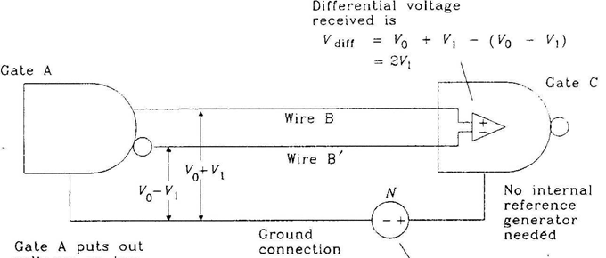
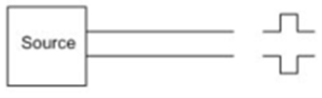
Alternative method (differential signaling) to reduce ground noise (expensive) by using differential logic gates and transmission lines
Gate C sees V_diff
V0=2.5 (fixed),
When a gate is on, V1 =2.5 else V1=0
A method to remove ground connection noise
Differential signaling logic uses 3 wires (2 signals plus ground) to connect a stage to the next, while the usual non-differential signaling logic uses 2 wires (signal + ground) only.
V1
V0
=2.5+V₁
=2.5-V₁

Slide 77
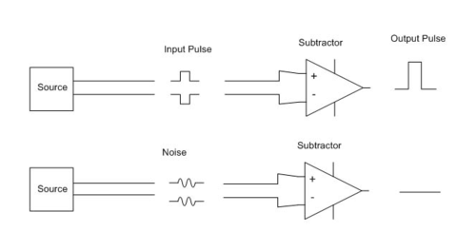
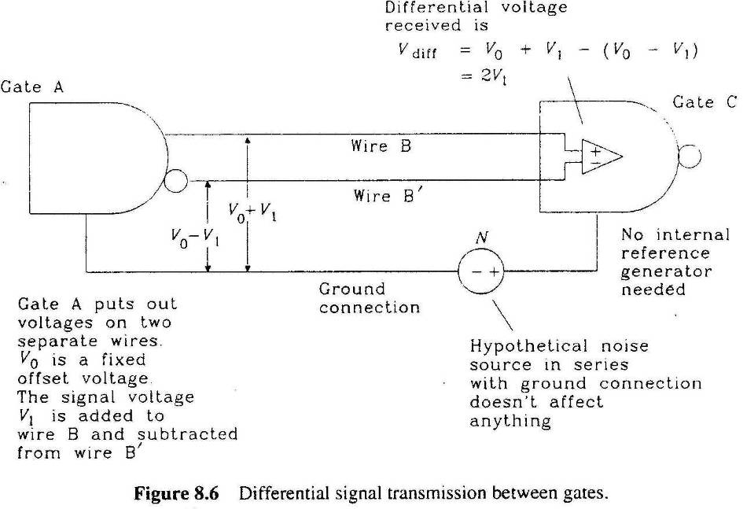
Signal propagation
http://en.wikipedia.org/wiki/Differential_signaling

